Slide 1
UNIT IV DATAPATH SUBSYSTEMS
Topics
Sub system design,
Shifters,
Adders,
ALUs,
Multipliers,
Parity generators,
Comparators,
Zero/One detectors,
Counters.

Slide 2
1’s & 0’s Detectors
1’s detector: N-input AND gate
0’s detector: NOTs + 1’s detector (N-input NOR)
A₇ A₆
A₃ A₂
A
A
allzeros
5
A
1
A
4
A₃ A₂
A₁ A₀
allones
0
A₇ A₆
A₅ A₄
A₃ A₂
allones
6/3/2015
A
299
1
A₀

Slide 3
Comparators
0’s detector:
1’s detector:
A = 00…000 A = 11…111
Equality comparator: A = B
Magnitude comparator: A < B
300

Slide 4




Equality Comparator
Check if each bit is equal (XNOR, aka equality gate)
1’s detect on bitwise equality
B[3]
A[3]
B[2]
A[2]
B[1]
A[1]
B[0]
A[0]
A = B
301

Slide 5




Magnitude Comparator
Compute B – A and look at sign
B – A = B + ~A + 1
For unsigned numbers, carry out is sign bit
A ≤ B
C
N
B₃
A₃ B₂
A₂ B₁
A₁ B₀
A₀
A ≥ B
Z
A = B
302

Slide 6
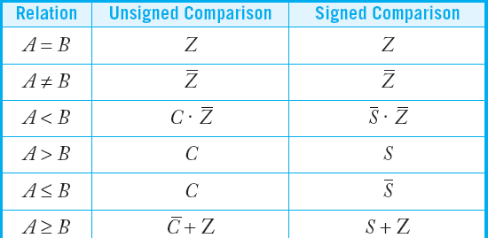
Signed vs. Unsigned
For signed numbers, comparison is harder
C: carry out
Z: zero (all bits of B – A are 0)
N: negative (MSB of result)
V: overflow (inputs had different signs, output sign
≠ B)
S: N xor V (sign of result)
–
303

Slide 7
Shifters
Logical Shift:
– “hifts number left or right and fills with 0’s
1011 LSR 1 = 010
Arithmetic Shift:
– Shifts number left
1 1011 L
SL1 = 0110
or right
. Rt shift sign
extends
1011 ASR1 = 1101
Rotate:
1011 ASL1 = 0110
– Shifts number left
or righ
t and fills with lo
st bits
1011 ROR1 = 1101
1011 ROL1 = 0111
304

Slide 8
Adders
Single-bit Addition
Carry-Ripple Adder
Carry-Skip Adder
Carry-Look ahead Adder
Carry-Select Adder
Carry-Increment Adder
Tree Adder
305

Slide 9
Barrel Shifter
Barrel shifters perform right rotations using wrap-around wires.
Left rotations are right rotations by N – k = k + 1 bits.
Shifts are rotations with the end bits masked off.
306

Slide 10

Single-Bit Addition
A B
A B
Half Adder
Full Adder
S = A ⊕ B
C
S = A ⊕ B ⊕ C
^{C}out
C
out
C_{out} = MAJ ( A, B,C)
C = A B
S
S
out
A | B | ^{C}out | S
0 | 0
0 | 1
1 | 0
1 | 1
A | B | C | ^{C}out | S
0 | 0 | 0
0 | 0 | 1
0 | 1 | 0
0 | 1 | 1
1 | 0 | 0
1 | 0 | 1
1 | 1 | 0
1 | 1 | 1
0
0
0
0
0
1
0
1
0
1
0
1
1
0
1
0
0
1
1
0
1
0
1
1
307

Slide 11
PGK
For a full adder, define what happens to carries
(in ter A and B)
Generate: Cout = 1 independent of C
G = A •
Propagate: Cout = C
P = A
Kill: Cout = 0 independent of C
• K = ~A • ~B
ms of
B
⊕ B
308

Slide 12

Full Adder Design I
Brute force implementation from eqns
S = A ⊕ B ⊕ C
^{C}out
= MAJ ( A, B,C)
A
A
B
B
C
C
A
A
A B C
B
B
B
S
C
C
C
A
B
B A
A B C
S
MAJ
C
out
C
C
C
B
B
B
A
C
A
out
A
B
B
A
309

Slide 13
Full Adder Design II
Factor S in terms of Cout
S = ABC + (A + B + C)(~Cout)
Critical path^{MIN}i^{O}s^{RIT}u^{Y} sually C to Cout in ripple
A
addeB r
•
C
^{C}out
S
S
^{C}out
310

Slide 14
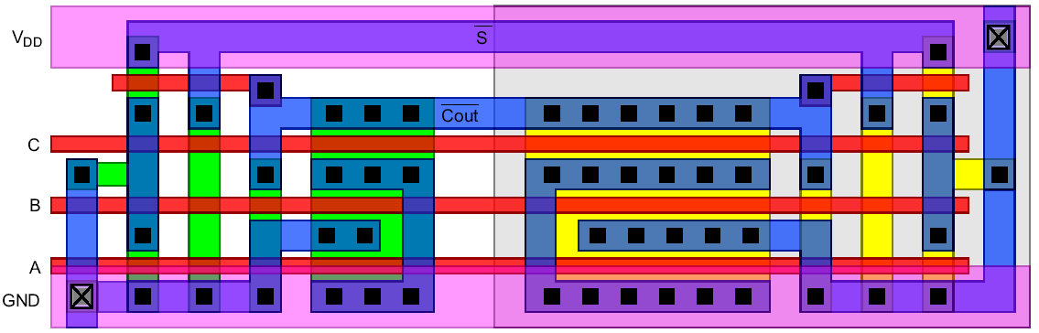
Layout
Clever layout circumvents usual line of diffusion
Use wide transistors on critical path
Eliminate output inverters
311

Slide 15
Full Adder Design III
Complementary Pass Transistor Logic (CPL)
– Slightly faster, but more areBa
B
B
C
A
B
C
B
C
S
B
C
^{C}out
A
B
C
B
C
A
B
C
S
B
C
^{C}out
A
B
B
312

Slide 16
Full Adder Design IV
Dual-rail domino
Very fast, but large and power hungry
Used iφn very fast multipli_{φ}ers
C_h A_h A_h B_h B_h
C_{out} _h
C _l
C_l A_l
B_l B_l
out
A_l
S_l
φ
C_l
S_h
C_h
C_h
B_h
B_l
B_h
A_h
A_l
313

Slide 17




Carry Propagate Adders
N-bit adder called CPA
Each sum bit depends on all previous carries
How do we compute all these carries quickly?
^{A}N...1
^{B}N...1
^{C}out
^{C}in
^{C}out C_{in}
11111 carries
^{1111 A}4...1
+0000 B_{4...1}
^{0000 S}4...1
00000
1111
+0000
1111
C
+
C
out
in
S
N...1
314

Slide 18
Carry-Ripple Adder
Simplest design: cascade full adders
Critical path goes from Cin to Cout
Design full adder to have fast carry delay
A₄ B₄ A₃ B₃ A₂ B₂ A₁ B₁
^{C}out
C
C
C
^{C}in
3
2
1
S₄
S₃
S₂
S₁
315

Slide 19
Inversions
Critical path passes through majority gate
Built from minority + inverter
Eliminate inverter and use inverting full adder
A₄ B₄ A₃ B₃ A₂ B₂ A₁ B₁
^{C}out
^{C}in
C₃
C₂
C₁
S₄
S₃
S₂
S₁
316

Slide 20



Generate / Propagate
Equations often factored into G and P
Generate and propagate for groups spanning i:j
^{G}i: j ^{= G}i:k ^{P}i: j ^{= P}i:k
^{P}i:k ^{G}k −1: j
^{P}k −1: j
Base case
^{G}0:0 ^{P}0:0
≡
≡
G₀ = C_{in}
G ≡
G_{i} = A_{i} B_{i}
i:i
P ≡
P_{i} = A_{i} ⊕ B_{i}
P₀ = 0
i:i
Sum:
S_{i} =
^{P}i ^{⊕ G}i−1:0
317

Slide 21

PG Logic
A₄
B₄ A₃
B₃ A₂
B₂ A₁
B₁
^{C}in
1: Bitwise PG logic
G₄ P₄
G₃ P₃
G₂ P₂
G₁ P₁
G₀ P₀
2: Group PG logic
^{G}3:0
^{G}2:0
^{G}1:0
^{G}0:0
C₃
C₂
C₁
C₀
3: Sum logic
C₄
^{C}out
S₄
S₃
S₂
S₁

Slide 22









Carry-Ripple Revisited
P_{i}
^{G}i:0 ^{= G}i ^{G}i−1:0
A₄ B₄ A₃
B₃ A₂
B₂ A₁
B₁
^{C}in
G₄ P₄
G₃ P₃
G₂ P₂
G₁ P₁
G₀ P₀
^{G}3:0
^{G}2:0
^{G}1:0
^{G}0:0
C₃
C₂
C₁
C₀
C₄
^{C}out
S₄
S₃
S₂
S₁

Slide 23
Carry-Skip Adder
Carry-ripple is slow through all N stages
Carry-skip allows carry to skip over groups of n bits
– Deci^{A}s¹⁶i^{:13}o^{B}n^{16:13}based o^{A}n^{12:9}n^{B1}-^{2:9}bit propa^{A8}g^{:5} a^{B8}t^{:5} e signal ^{A4:1 P}16:13 ^{P}12:9 ^{P}8:5 ^{P}4:1
^{B}4:1
1 1
_{C8} 1 _{C4} 1
0 + 0
^{S}8:5
C
^{C}12
^{C}in
out
0 + 0
^{S}16:13
+
+
^{S}12:9
^{S}4:1
320

Slide 24
Carry-Lookahead Adder
Carry-lookahead adder computes Gi:0 for many bits in parallel.
Uses higher-valency cells with more than two inputs.
^{A}16:13 ^{B}16:13
^{A}12:9 ^{B}12:9
^{A}8:5 ^{B}8:5
^{A}4:1
^{B}4:1
^{C}out
^{G}16:13 ^{P}16:13
^{C}12
^{G}12:9 ^{P}12:9
C₈
^{G}8:5 ^{P}8:5
C₄
^{G}4:1 ^{P}4:1
+
+
+
+
^{C}in
^{S}16:13
^{S}12:9
^{S}8:5
^{S}4:1
321

Slide 25
Carry-Select Adder
Trick for critical paths dependent on late input X
Precompute two possible outputs for X = 0, 1
Select proper output when X arrives
Carry-seAl₁e_{6:13} cB₁t_{6:13} adder pA_{12:}r₉ eB₁₂c_{:9} omputAe_{8:5} sB₈n_{:5} -bAi₄t_{:1} ms
s^{B}4:u1
– For both⁺ po⁰ ssible car⁺rie⁰s into n-b⁺it g⁰roup
^{C}out
C₈
^{C}12 C
1 1 1
4
_{C}
+ + + +
in
1
0
1
0
1
0
^{S}16:13
^{S}12:9
^{S}8:5
^{S}4:1
322

Slide 26
Carry Save Addition
A full adder sums 3 inputs and produces 2 outputs
– Carry output has twice weight of sum output
N full adders in parallel are called carry save adder
– Produce N sums and N carry outs
X₄ Y₄ Z₄ X₃ Y₃ Z₃ X₂ Y₂ Z₂ X₁ Y₁ Z₁
C₄ S₄
C₃ S₃ C₂ S₂
^{X}N...1 ^{Y}N...1 ^{Z}N...1
C₁ S₁
n-bit CSA
6/3/2015
327
^{C}N...1
^{S}N...1

Slide 27
CSA Application
Use k-2 stages of CSAs
– Keep result in carry-save redundant form
Final CPA computes actu₀a₀₀l₁ r_{X}esult
0001 0111 1101 0010
0111 Y
+1101 Z
1011 S
0101_ C
0101_ X
1011 Y
+0010 Z S C
4-bit CSA
0101_
1011
5-bit CSA
01010_
00011
00011
01010_
01010_
00011
+
A
+ B S
10111
10111
328

Slide 28
Multiplication
Example:
1100 : 12₁₀
0101 : 5₁₀
multiplicand multiplier
1100
partial products
product
M x N-bit multiplication
Produce N M-bit partial products
Sum these to produce M+N-bit product
0000
1100
0000
00111100 : 60₁₀
329

Slide 29
General Form
Multiplicand: Y = (yM-1, yM-2, …, y1, y0)
Multiplier: X = (xN-1, xN-2, …, x1, x0)
⎞ ⎛ N −1
⎛
⎜ ∑ ⎟ ∑
⎝ j=0 ⎠ ⎝ i=0
⎞
M −1
N −1 M −1
P =
y 2
j
x 2
i
=
∑ ∑
x_{i} y _{j} 2
i+ j
j
⎜
i
⎟
⎠ i=0 j=0
y
Product:
y
y
y
y
y
multiplicand
5
4
3
2
1
0
 |  | x₅ | x₄ | x₃ | x₂ | x₁ | x₀ | multiplier
 |  | x₀y₅ | x₀y₄ | x₀y₃ | x₀y₂ | x₀y₁ | x₀y₀
 |  | x₁y₅ x₁y₄ | x₁y₃ | x₁y₂ | x₁y₁ | x₁y₀
 | x₂y₅ | x₂y₄ x₂y₃ | x₂y₂ | x₂y₁ | x₂y₀ |  |  | partial
 | x y x y | x y x y | x y | x y |  |  |  | products
x₄y₅ | x₄y₄ x₄y₃ | x₄y₂ x₄y₁ | x₄y₀
x₅y₅ x₅y₄ | x₅y₃ x₅y₂ | x₅y₁ x₅y₀
^{p}11 ^{p}10 ^{p}9 | p₈ p₇ | p₆ p₅ | p₄ | p₃ | p₂ | p₁ | p₀ | product
3 5
3 4
3 3
3 2
3 1
3 0
330

Slide 30
Dot Diagram
Each dot represents a bit
x₀
partial products
multiplier x
^{x}15
331

Slide 31

Array Multiplier
y₃
y₂
y₁
y₀
x₀
x₁
CSA
Array
x₂
x₃
CPA
p₇
p₆
p₅
A B
p₄
p₃
p₂
p₁
p₀
Sin A Cin
critical path
A
B
A
B
B
=
Sin
Cout
Cin =
Cout
Cin
Cout
Cin
Sout
Cout Sout
Sout
Sout
6/3/2015
332

Slide 32



Rectangular Array
Squash array to fit rectangular floorplan
y₃ y₂ y₁ y₀
x₀
x
p₀
1
x
p₁
2
x
p₂
3
p₃
p₇
p₆
p₅
p₄
333

Slide 33
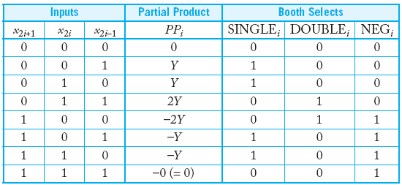
Booth Encoding
Instead of 3Y, try –Y, then increment next partial product to add 4Y
Sim pro
ilarly, for 2Y, try –2Y + 4Y in next partial
duct
335

Slide 34
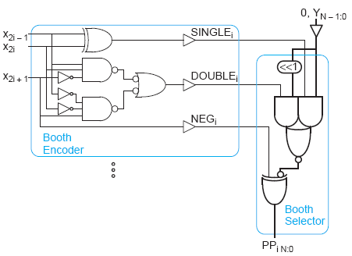
Booth Hardware
Booth encoder generates control lines for each P
– Bo
P
oth selectors choose PP bits
336

Slide 35
Advanced Multiplication
Signed vs. unsigned inputs
Higher radix Booth encoding
Array vs. tree CSA networks
337

Slide 36
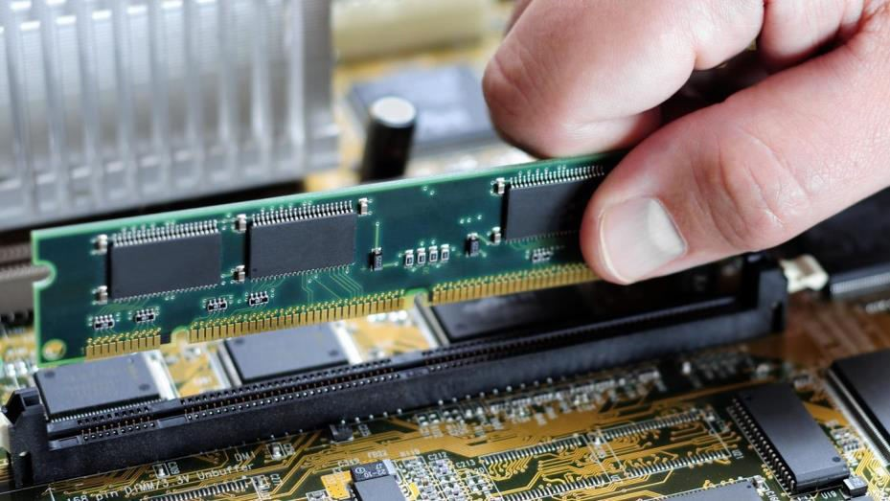
Array Sub Systems
Topics:
SRAM DRAM ROM
Serial Access Memories
Content Addressable Memory
338

Slide 37
Semiconductor Memory Types
Semiconductor Memories
Read/Write (R/W) Memory
or Random Access Memory (RAM)
Read-Only Memory (ROM)
Mask (Fuse) ROM
Programmable ROM (PROM) Erasable PROM (EPROM)
Electrically Erasable PROM (EEPROM)
Flash Memory
Ferroelectric RAM (FRAM)
Dynamic RAM (DRAM)
Static RAM (SRAM)
339

Slide 38
Semiconductor Memory Types (Cont.)
Design Issues
» Area Efficiency of Memory Array: # of stored data bits per
unit area
» Memory Access Time: the time required to store and/or retrieve a particular data bit.
» Static and Dynamic Power Consumption
Requirements
» Easy reading
» Easy Writing
» High density
» Speed, more speed and still more speed
349

Slide 39
Memory Architecture
Stores large number of bits
m × n memory
m x n: m words of n bits each
k = Log2(m) address input signals
or m = 2k words
e.g., 4,096 x 8 memory:
» 32,768 bits
» 12 address input signals
» 8 input/output data signals
 |  |  |  | …
…
m words
n bits per word
memory external view
r/w
2^{k} × n read and write memory
enabl
e_{A}
0
^{A}k-1
Memory access
…
r/w: selects read or write
enable: read or write only when asserted
multiport: multiple accesses to different locations simultan^{Q}ne-1ously^{Q}0
…
341

Slide 40
Semiconductor Memory Types (Cont.)
RAM: the stored data is volatile
DRAM
» A capacitor to store data, and a transistor to access the capacitor
» Need refresh operation
» Low cost, and high density ⇒ it is used for main memory
SRAM
» Consists of a latch
» Don’t need the refresh operation
» High speed and low power consumption ⇒it is mainly used for cache memory and memory in hand-held devices
342

Slide 41
RAM: “Random-access” memory
External view
Typically volatile memory
r/w
enable
2^{k} × n read and write memory
bits are not held without power supply
A₀
Read and written to easily by micropro…ce
ssor
during execution
^{A}k-1
…
Internal structure more complex than ROM^{Qn-1}
Q₀
a word consists of several memory cells, each storing 1 _{I}b_{n}i_{t}t_{ernal view}
each input and output data line connects to each cell in its column
rd/wr connected to every cell
when row is enabled by decoder, each cell has log
I₃ I₂ I₁ I₀
4×4 RAM
i decoder
enable
2×4
t stores
ed bit when
c tha
s stor
input data bit when rd/wr indicates write or ou^{A}t⁰ put
rd/wr indicates read
A₁
Memory
cell
rd/wr
To every cell
Q₃ Q₂ Q₁ Q₀
343

Slide 42

Memory Chip Configuration
Row Address N bits
M
2 Cells
Memory Cell Array
Complete Address N+M Bits
Row Dec
WL
Cell
N
2 Cells
I/O Interface
DL
^{D}in
^{d}in
I/O Control
^{D}out
^{d}out
Column Dec.
Control Signals
s
Column Addres M Bits
344

Slide 43




Static Random Access Memory (SRAM)
SRAM: ThebitsltionereCd data can be retained inbditelifnienCitely, without any need for a periodic refresh operation.
1-bit SRAM cell
VDD
bit line C
bit line C
load
load
word line word line
Complementary Column arrangement is to achieve a more
reliable SRAM operation
345

Slide 44


4T-SRAM(Resistive-Load SRAM Cell )
undoped polysilicon resistor
VDD
bit line C
bit line C
R
R
SRAM cell is accessed via two bit (column) lines C and its complement for reliable operation
word line
word line
pass transistors to activated by a row select (RS) signal to enable read/write operators
Basic cross-coupled 2-inverter latch with 2 stable op points for storing one-bit
346

Slide 45
6T-SRAM
VDD
bit line C
bit line C
Full CMOS SRAM
Cell
word line
word line
VDD
bit line C
bit line C
Depletion-Load
SRAM Cell
word line
word line
347

Slide 46




SRAM Operation Principles
RS=0: The word line is not selected. M3 and M4 are OFF
One data-bit is held: The latch preserves one of its two stable states.
If RS=0 for all rows: CC and CC are charged up to near VDD by pulling up of MP1 and MP2 (both in saturation)
Pull-up transistor (one per column)
VDD
VDD
VDD
MP1
MP2
bit line C
R
R
bit line C
VC
M3
V1
V2
M4
VC
CC
M1
M2
CC
RS
word line
348

Slide 47


SRAM Operation Principles (Cont.)
Pull-up transistor (one per column)
VDD
VDD
VDD
MP1
MP2
bit line C
R
R
bit line C
VC
M3
V1
V2
M4
VC
CC
M1
M2
CC
RS
word line
RS=1: The word line is now selected. M3 and M4 are ON
Four Operations
Write “1” Operation (V1=VOL, V2=VOH at t=0-):
VC ⇒ VOL by the data-write circuitry. Therefore, V2 ⇒ VOL, then M1 tur
off V1⇒VOH and M2 turns on pulling down V2 ⇒ VOL.
349

Slide 48
SRAM Operation Principles (Cont.)
Pull-up transistor (one per column)
VDD
VDD
VDD
MP1
MP2
bit line C
R
R
bit line C
VC
M3
V1
V2
M4
VC
CC
M1
M2
CC
RS
word line
Read “1” Operation (V1=VOH, V2=VOL at t=0-):
VC retains pre-charge level, while VC ⇒ VOL by M2 ON. Data-read circuitry detects small voltage difference VC – VC > 0, and amplifies it as a “1” data output.
350

Slide 49

SRAM Operation Principles (Cont.)
Pull-up transistor (one per column)
VDD
VDD
VDD
MP1
MP2
bit line C
R
R
bit line C
VC
M3
V1
V2
M4
VC
CC
M1
M2
CC
RS
word line
Write “0” Operation (V1=VOH, V2=VOL at t=0-):
VC ⇒ VOL by the data-write circuitry.
Since V1 ⇒ VOL, M2 turns off, therefore V2 ⇒ VOH.
351

Slide 50
SRAM Operation Principles (Cont.)
Pull-up transistor (one per column)
VDD
VDD
VDD
MP1
MP2
bit line C
R
R
bit line C
VC
M3
V1
V2
M4
VC
CC
M1
M2
CC
RS
word line
Read “0” Operation (V1=VOL, V2=VOH at t=0-):
VC retains pre-charge level, while VC ⇒ VOL by M1 ON.
Data-read circuitry detects small voltage difference VC – VC < 0, and
amplifies it as a “0” data output.
352

Slide 51
SRAM Operation Principles (Cont.)
Pull-up transistor (one per column)
VDD
VDD
VDD
MP1
MP2
bit line C
R
R
bit line C
VC
M3
V1
V2
M4
VC
CC
M1
M2
CC
RS
word line
3. Write “0” Operation (V1=VOH, V2=VOL at t=0⁻):
VC ⇒ VOL by the data-write circuitry.
Since V1 ⇒ VOL, M2 turns off, therefore V2 ⇒ VOH.
353

Slide 52
SRAM Operation Principles (Cont.)
Pull-up transistor (one per column)
VDD
VDD
VDD
MP1
MP2
bit line C
R
R
bit line C
VC
M3
V1
V2
M4
VC
CC
M1
M2
CC
RS
word line
4. Read “0” Operation (V1=VOL, V2=VOH at t=0⁻):
VC retains pre-charge level, while VC ⇒ VOL by M1 ON.
Data-read circuitry detects small voltage difference VC – VC < 0,
and amplifies it as a “0” data output.
354

Slide 53


Circuit of CMOS SRAM Cell
Pull-up transistor (one per column)
(Column voltages can reach to full VDD)
VDD
VDD
VDD
MP1
MP2
bit line C
M5
M6
bit line C
VC
M3
V1
V2
M4
VC
CC
M1
M2
CC
RS
word line
Advantages
Very low standby power consumption
Large noise margins than R-load SRAMS
Operate at lower supply voltages than R-load SRAMS
Disadvantages
Larger die area: To accommodate the n-well for pMOS transistors and polysilicon contacts. The area has been reduced by using multi- layer polysilicon and multi-layer metal processes
CMOS more complex process
355

Slide 54


Dynamic Read-Write Memory (DRAM) Circuits
SRAM: 4~6 transistors per bit
4~5 lines connecting as charge on capacitor
DRAM: Data bit is stored as charge on capacitor Reduced die area
Require periodic refresh
WL
M1
M2
M3
M4
parasitic storage
capacitances
BL
BL
Four-Transistor DRAM Cell
356

Slide 55
DRAM Circuits (Cont.)
WL(read)
X
M2
M1
M3
parasitic storage
capacitances
WL(write)
BL(write)
BL(read)
Three-Transistor DRAM Cell
No constraints on device ratios Reads are non-destructive
Value stored at node X when writing a “1” = V_{WWL}-V_{Tn}
357

Slide 56

3T-DRAM — Layout
BLR
BLW
GND
RWL
M3
M2
WWL
M1
Source: Digital Integrated Circuits 2nd
358

Slide 57

One-Transistor DRAM Cell
WL
M1
explicit storage
capacitances
BL
One-Transistor DRAM Cell
Industry standard for high density dram arrays
Smallest component count and silicon area per bit
Separate or “explicit” capacitor (dual poly) per cell
359

Slide 58

Operation of Three-Transistor DRAM Cell
VDD
Precharge devices
MP1 MP2
PC
RS
M3
M1
M2
C2
C3
C1
WS
Data_in Data_out
DATA
C2, C3 >> C1(>10C1)
The binary information is stored as the charge in C1
Storage transistor M2 is on or off depending on the charge in C1
Pass transistors M1 and M3: access switches
Two separate bit lines for “data read” and “data write”
360

Slide 59



Operation of Three-Transistor DRAM Cell (Cont.)
VDD
PC write 1 PC
① 2 ③
read 1 PC write 0 PC read 0
4 ⑤ 6 ⑦ 8
MP1
Precharge devices
MP2
PC
PC
WS
RS
M1
M3
DATA
C2
M2
C3
C1
Din
WS
Stored data
Data_in
Data_out
RS
DATA
Dout
The operation is based on a two-phase non-overlapping clock scheme
» The precharge events are driven by φ1, and the “read” and “write”
operations are driven by φ2.
» Every “read” and “write” operation is preceded by a precharge
cycle, which is initiated with PC going high.
361

Slide 60


Operation of Three-Transistor DRAM Cell (Cont.)
VDD
Precharge devices
MP1 MP2
Pre-charge Cycle
C3
PC
C2
RS
M3
M1
M2
C2
C3
C1
WS
Data_in
Data_out
DATA
Write “1” OP: DATA = 0, WS = 1; RS = 0
» C2, C1 Share charge due to M1 ON
» Since C2 >> C1, the storage node C1 attains approximately the same logic level.
362

Slide 61

Operation of Three-Transistor DRAM Cell (Cont.)
RS
M3
M1
M2
C2
C3
C1
WS
Data_in
Data_out
DATA
Read “1” OP: DATA = 0, WS = 0; RS = 1
» M2, M3 ON ⇒ C3, C1 discharges through M2 and M3, and the falling column voltage is interpreted bt the “data read” circuitry as a stored logic “1”.
363

Slide 62
Operation of Three-Transistor DRAM Cell (Cont.)
RS
M3
M
1
M2
C
2
C
3
C1
WS
Data_out
Data_in
DATA
Write “0” OP: DATA = 1, WS = 1; RS = 0
» M2, M3 ON ⇒ C2 and C1 discharge to 0 through M1 and data_in nMOS.
364

Slide 63
Operation of Three-Transistor DRAM Cell (Cont.)
RS
M3
M1
M2
C2
C3
C1
WS
Data_in
Data_out
DATA
Read “0” OP: DATA = 1, WS = 0; RS = 1
» C3 does not discharge due to M2 OFF, and the logic-high level on the Data_out column is interpreted by the data read circuitry as a stored “0” bit.
365

Slide 64
Operation of One-Transistor DRAM Cell
WL
Column
M1
C
2
C
1
capacitance
BL
1-bit DRAM Cell
C2>>C1
Write “1” OP: BL = 1, WL = 1 (M1 ON)⇒C1 charges to “1”
Write “0” OP: BL = 0, WL = 1 (M1 ON)⇒C1 discharges to “0”
Read OP: destroys stored charge on C1 ⇒ destructive refresh is
needed after every data read operation
366

Slide 65
SRAM
RAM
DRAM
^{V}DD
WL
WL
WL
DL
DL
DL
367

Slide 66
Semiconductor Memory Types (Cont.)
ROM: 1, nonvolatile memories
2, only can access data, cannot to modify data
3, lower cost: used for permanent memory in printers, fax, and game machines, and ID cards
Mask ROM: data are written during chip fabrication by a photo mask
PROM: data are written electrically after the chip is fabricated.
» Fuse ROM: data cannot be erased and modified.
» EPROM and EEPROM: data can be rewritten, but the number of subsequent re-write operations is limited to 10⁴-10⁵.
EPROM uses ultraviolet rays which can penetrate through the crystal glass on package to erase whole data simultaneously.
EEPROM uses high electrical voltage to erase data in 8 bit units.
Flash Memory: similar to EEPROM
368

Slide 67
ROM: “Read-Only” Memory
Nonvolatile
Can be read from but not written to, by a
processor in an microcomputer system
External view
Traditionally written to, “programmed”,
before inserting to microcomputer system
Uses
enable
2^{k} × n ROM
A₀
…
^{A}k-1
Store software program for general-purpose processor
Store constant data (parameters) needed by system
Implement combinational circuits (e.g., decoders)
…
^{Q}n-1
Q₀
369

Slide 68
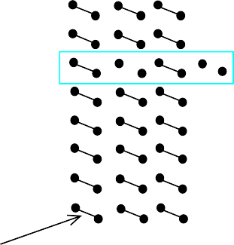
Example: 8 x 4 ROM
Horizontal lines = words
Vertical lines = data
Lines connected only at circles
Decoder sets word 2’s line to 1 if
address input is 010
Data lines Q3 and Q1 are set to 1 because there is a “programmed” connection with word 2’s line
Word 2 is not connected with data
lines Q2 and Q0
Output is 1010
Internal view
8 × 4 ROM
3×8
decoder
word 0
word 1
word 2
word
line
enabl
_{A}e
0
A₁
A₂
data line
programm
able
connection
Q₃ Q₂ Q₁ Q₀
370

Slide 69
Memory – ROM
Nonvolatile Memory
SRAM and DRAM and attractive due to their speed
however, they are volatile which means when the power is removed, the data is lost
for a microcomputer, we need a nonvolatile storage device so that upon power-up, the computer knows what to do.
currently, the most popular semiconductor ROM is Flash (or EEprom)
before looking at the details of a Flash transistor, let’s first look at the
different types of ROM arrays and addressing modes
371

Slide 70
Memory – ROM
ROM Arrays
There are two basic types of ROM arrays
NOR-based ROM
NAND-based ROM
NOR-based ROM
All Column Lines are pulled-up using a PMOS transistor (or resistor)
The Row Lines are connected to the gates of NMOS transistors at the intersection of Row and Column Lines
The presence or absence of the NMOS transistors dictates whether a 1 or a 0 is stored
If the NMOS transistor is present, it will pull down the Column Line when its gate is driven high by the Row Line
If the NMOS transistor is absent, the Column Line will not be pulled down, so it will
37r2emain pulled up by the PMOS’s

Slide 71
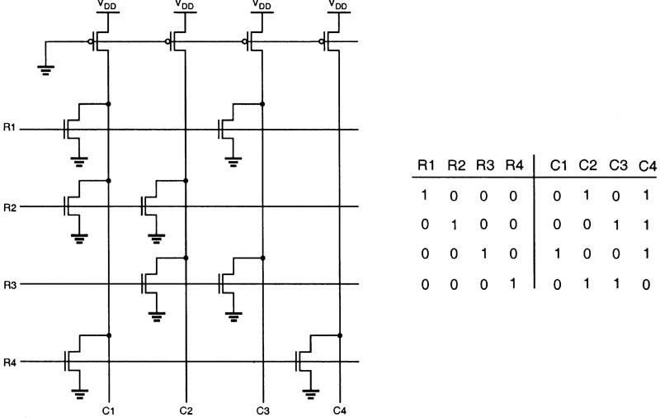
Memory – ROM
NOR-based ROM
In order to Read from the array, the Row line is asserted and the desired Column line is observed
a NOR-based ROM is similar to a Hex Keypad
373

Slide 72
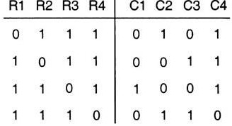
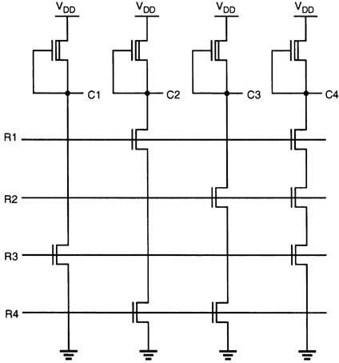
Memory – ROM
NAND-based ROM
NAND-based ROM is a different array architecture
it uses a depletion-load NMOS as the pull-up transistor
the Column NMOS’s are connected in series with the
column lines (i.e. a NAND configuration)
If an NMOS exists in the Column line and the Row line is asserted, the NMOS will pull the Column Line down and represent a stored ’0’
If an NMOS is absent on the Column line and the Row line is asserted, the Column Line will remain pulled high by the depletion NMOS and represent a stored ‘1’
since all of the NMOS’s are in series, in order to Read
from a Row, all other Rows much be turned ON
this means in order to distinguish the Row we are asserting,
we write a ‘0’ to it
374

Slide 73
Memory – ROM
NAND-based ROM
In this configuration, if an NMOS is present, it will represent a “stored 1” since in order to address its location, the Row line is driven to a ‘0’ and the NMOS not turned on. This leaves the Column line pulled HIGH
if an NMOS is absent, it will represent a “stored 0” since all of the other Row NMOS’s are turned on and will pull the Column Line LOW
this gives the opposite behavior as in a NOR-based ROM
 | NOR | NAND
NMOS present | 0 | 1
NMOS absent | 1 | 0
- it also gives a complementary addressing scheme
 | NOR | NAND
Address Row Line by driving: | 1 | 0
All other Row Lines driven to: | 0 | 1
375

Slide 74
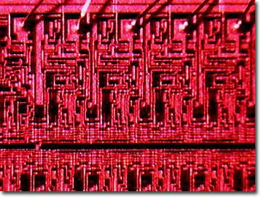
Mask-programmed ROM
Connections “programmed” at fabrication
set of masks
Lowest write ability
only once
Highest storage permanence
bits never change unless damaged
Typically used for final design of high-volume systems
spread out NRE (non-recurrent engineering) cost for a low unit cost
376

Slide 75
OTP ROM: One-time programmable ROM
Connections “programmed” after manufacture by user
user provides file of desired contents of ROM
file input to machine called ROM programmer
each programmable connection is a fuse
ROM programmer blows fuses where connections should not exist
Very low write ability
typically written only once and requires ROM programmer device
Very high storage permanence
bits don’t change unless reconnected to programmer and more fuses
blown
Commonly used in final products
cheaper, harder to inadvertently modify
377

Slide 76



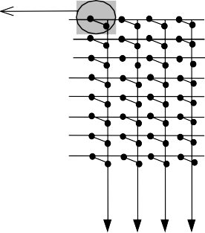







EPROM: Erasable programmable ROM
Programmable component is a MOS transistor
Transistor has “floating” gate surrounded by an insulator
(a) Negative charges form a channel between source and drain storing a logic 1
(b) Large positive voltage at gate causes negative charges to move out of channel and get trapped in floating gate storing a logic 0
(c) (Erase) Shining UV rays on surface of floating-gate causes negative charges to return to channel from floating gate restoring the logic 1
(d) An EPROM package showing quartz window through which UV light can pass
floating gate
0V
source
drain
(a)
+15V
(b)
source
drain
Better write ability
can be erased and reprogrammed thousands of times
5-30 min
Reduced storage permanence
program lasts about 10 years but is susceptible to radiation and electric noise
(c)
source
drain
Typically used during design development
(d)
378
.

Slide 77
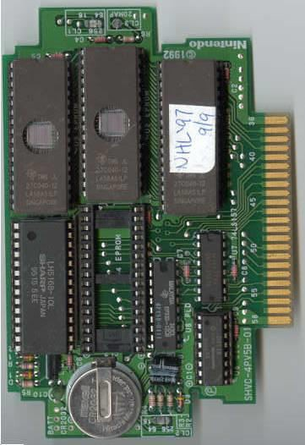
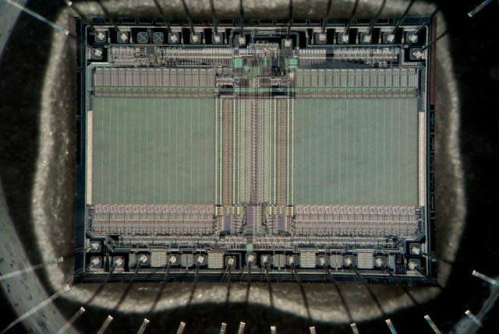
Sample EPROM components
379

Slide 78
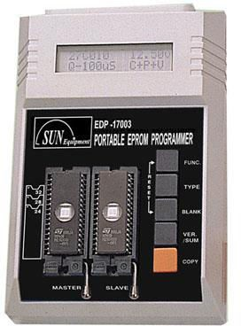
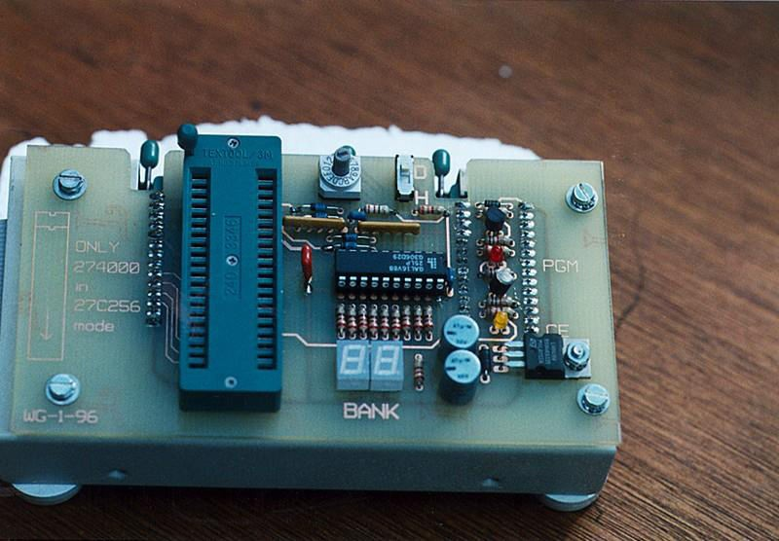
Sample EPROM programmers
380

Slide 79
EEPROM: Electrically erasable programmable ROM
Programmed and erased electronically
typically by using higher than normal voltage
can program and erase individual words
Better write ability
can be in-system programmable with built-in circuit to provide higher
than normal voltage
» built-in memory controller commonly used to hide details from memory user
writes very slow due to erasing and programming
» “busy” pin indicates to processor EEPROM still writing
can be erased and programmed tens of thousands of times
Similar storage permanence to EPROM (about 10 years)
Far more convenient than EPROMs, but more expensive
381

Slide 80
FLASH
Extension of EEPROM
Same floating gate principle
Same write ability and storage permanence
Fast erase
Large blocks of memory erased at once, rather than one word at a time
Blocks typically several thousand bytes large
Writes to single words may be slower
Entire block must be read, word updated, then entire block written back
Used with embedded microcomputer systems storing large data
items in nonvolatile memory
e.g., digital cameras, MP3, cell phones
382

Slide 81
Serial Access Memories
Serial access memories do not use an address
– Shift Registers
– Serial In Parallel Out (SIPO)
– Parallel In Serial Out (PISO)
– Queues (FIFO, LIFO)
383

Slide 82
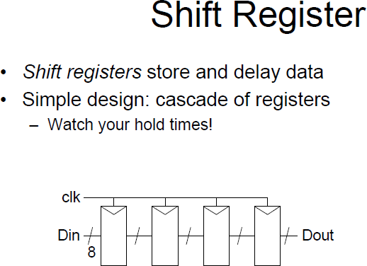
384

Slide 83
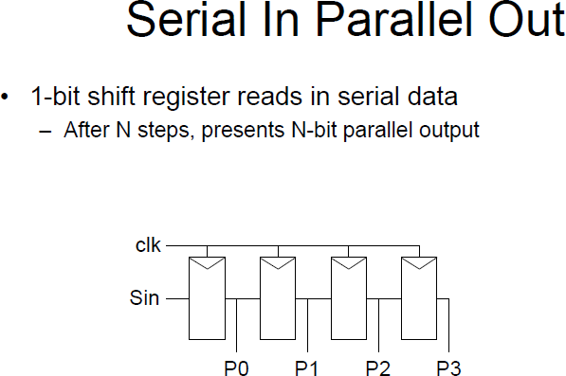
385

Slide 84
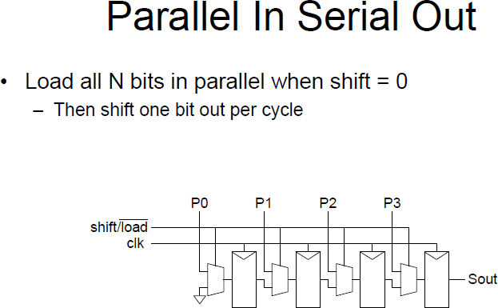
386

Slide 85
SEMICONDUCTOR INTEGRATED CIRCUIT
DESIGN
Programmable Logic Array (PLA)
Programmable
Array Logic(PAL)
FPGAs
CPLDs
Standard cells
Design Approach
Programmable logic devices (PLD)
Parameters influencing low power design
400

Slide 86
Programmable logic is defined as a device with configurable
PLD
logic and flip-flops linked together interconnect.
Why we are going for PLDs
Problems by Using Basic Gates
Many components on PCB:
with programmable
As no. of components rise, nodes interconnection complexity grow exponentially
Growth in interconnection will cause increase in interference, PCB size, PCB
design cost, and manufacturing time
402

Slide 87
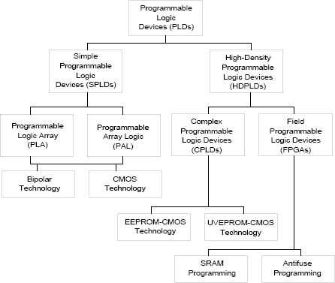
PROGRAMMABLE LOGIC DEVICES (PLD)
405
PLD Hierarchical Architecture

Slide 88
PLD
The purpose of a PLD device is to permit elaborate digital logic designs to be implemented by the user in a single device.
Can be erased electrically and reprogrammed with a new design, making them very well suited for academic and prototyping
Types of Programmable Logic Devices
SPLDs (Simple Programmable Logic Devices)
ROM (Read-Only Memory)
PLA (Programmable Logic Array)
PAL (Programmable Array Logic)
GAL (Generic Array Logic)
CPLD (Complex Programmable Logic Device)
FPGA (Field-Programmable Gate Array)
406

Slide 89
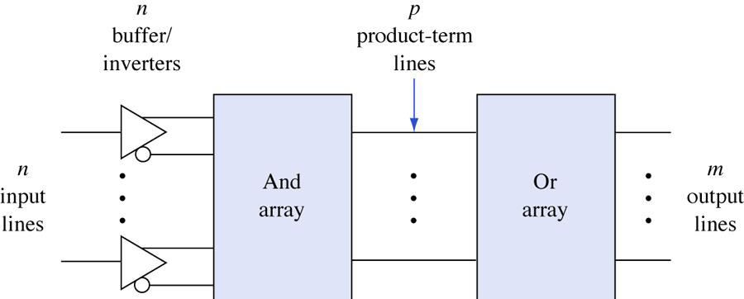
General structure of PLDs.
407

Slide 90
PLD
The first three varieties(ROM, PLA, PAL) are quite similar to each other:
They all have an input connection matrix, which connects the inputs of the device to an array of AND- gates.
They all have an output connection matrix, which connect the outputs of the AND-gates to the inputs of OR-gates which drive the outputs of the device.
The gate array is significantly different and will be described later.
408

Slide 91
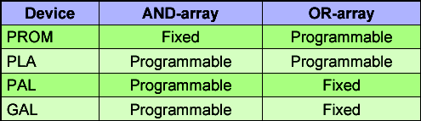
PLD
The differences between the first three categories are these:
1. In a ROM, the input connection matrix is hardwired.
The user can modify the output connection matrix.
In a PAL/GAL the output connection matrix is hardwired. The user can modify the input connection matrix.
In a PLA the user can modify both the input connection matrix and the output connection matrix.
409

Slide 92
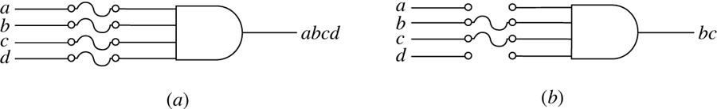
Programming by blowing fuses.
(a) Before programming.
(b) After programming.
410

Slide 93
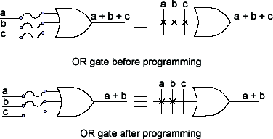
OR - PLD Notation
411

Slide 94
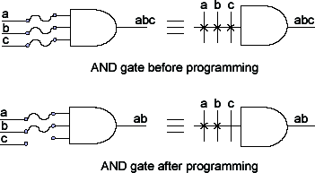
AND - PLD Notation
412

Slide 95
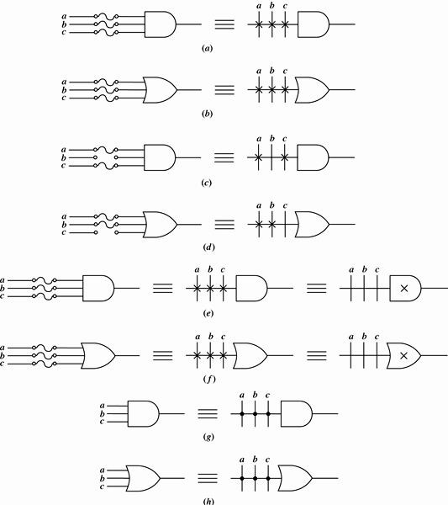
413

Slide 96
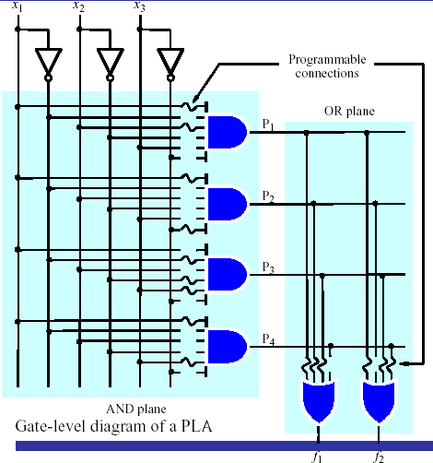
PLA
414

Slide 97
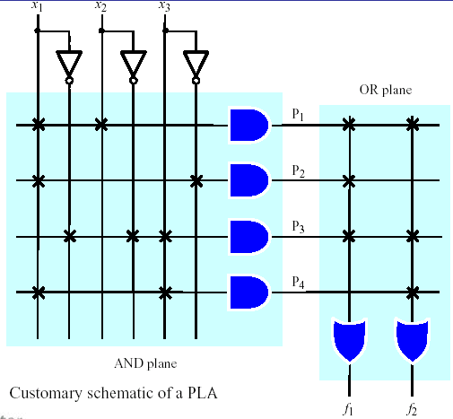
PLA
A 3×2 PLA with 4 product terms.
415

Slide 98
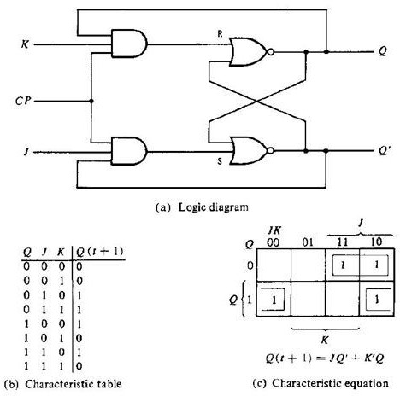
JK FF implementation using PLA
416

Slide 99
PALs
Programmable Array Logic
a fixed OR array.
 | Inputs Dense array of AND gates |  | Product terms | Dense array of OR gates
 |  |  |  |  | Outputs
42
5

Slide 100
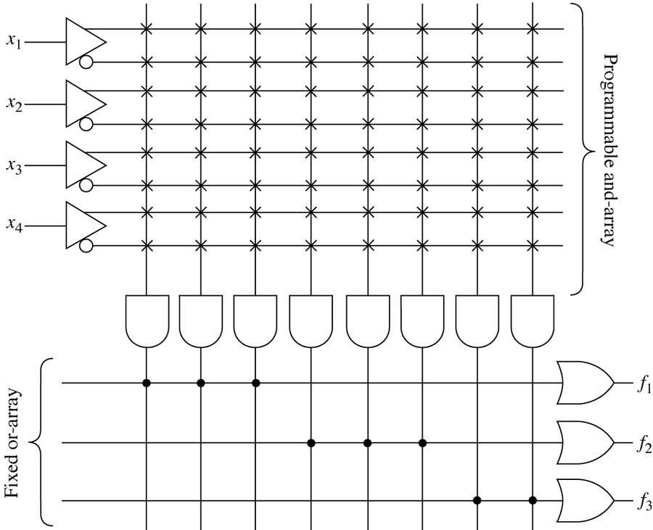
A simple four-input, three-output PAL device.
426

Slide 101
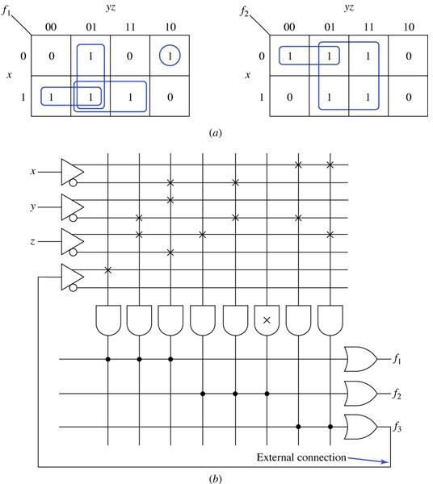
An example of using a PAL device to realize two Boolean functions. (a) Karnaugh maps. (b) Realization.
427

Slide 102
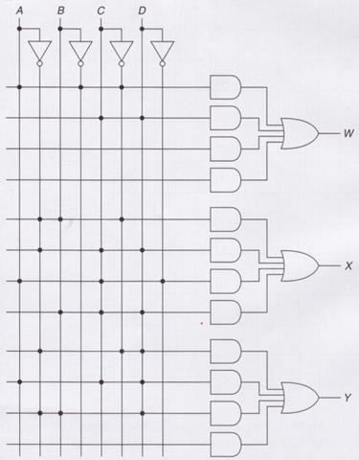
PAL
x x
x
W = AB′C′ + CD
X = A′BC′ + A′CD + ACD′ + BCD
Y = A′C′D + ACD + A′BD
428

Slide 103
FPGA AND CPLD
FPGA - Field-Programmable Gate Array.
CPLD - Complex Programmable Logic Device
FPGA and CPLD is an advance PLD.
Support thousands of gate where as PLD only support hundreds of gates.
429

Slide 104
What is an FPGA?
Before the advent of programmable logic, custom logic circuits were built at the board level using standard components, or at the gate level in expensive application-specific (custom) integrated circuits.
FPGA is an integrated circuit that contains many (64 to over 10,000) identical logic cells that can be viewed as standard components. Each logic cell can independently take on any one of a limited set of personalities.
Individual cells are interconnected by a matrix of wires and programmable switches. A user's design is implemented by specifying the simple logic function for each cell and selectively closing the switches in the interconnect matrix.
Array of logic cells and interconnect form a fabric of basic building blocks for logic circuits. Complex designs are created by combining these basic blocks to create the desired circuit
430

Slide 105
What does a logic cell do?
The logic cell architecture varies between different device families.
Each logic cell combines a few binary inputs (typically between 3 and
10) to one or two outputs according to a Boolean logic function
specified in the user program .
In most families, the user also has the option of registering the combinatorial output of the cell, so that clocked logic can be easily implemented.
Cell's combinatorial logic may be physically implemented as a small look-up table memory (LUT) or as a set of multiplexers and gates.
LUT devices tend to be a bit more flexible and provide more inputs
per cell than multiplexer cells at the expense of propagation delay.
431

Slide 106
What does 'Field Programmable' mean?
Field Programmable means that the FPGA's function is defined by a user's program rather than by the manufacturer of the device.
A typical integrated circuit performs a particular function defined at the time of manufacture. In contrast, the FPGA's function is defined by a program written by someone other than the device manufacturer.
Depending on the particular device, the program is either 'burned' in permanently or semi-permanently as part of a board assembly process, or is loaded from an external memory each time the device is powered up.
This user programmability gives the user access to complex integrated designs without the high engineering costs associated with application specific integrated circuits.
432

Slide 107
How are FPGA programs created?
Individually defining the many switch connections and cell logic functions would be a daunting task.
This task is handled by special software. The software translates a user's schematic diagrams or textual hardware description language code then places and routes the translated design.
Most of the software packages have hooks to allow the user to influence implementation, placement and routing to obtain better performance and utilization of the device.
Libraries of more complex function macros (eg. adders) further simplify the design process by providing common circuits that are already optimized for speed or area.
433

Slide 108
FPGA
FPGA applications:-
DSP
Software-defined radio
Aerospace
Defense system
ASIC Prototyping
Medical Imaging
Computer vision
Speech Recognition
Cryptography
Bioinformatic
And others.
434

Slide 109
FPGA Principles
A Field-Programmable Gate Array (FPGA) is an integrated circuit that can be configured by the user to emulate any digital circuit as long as there are enough resources
An FPGA can be seen as an array of Configurable Logic Blocks (CLBs) connected through programmable interconnect (Switch Boxes)
436

Slide 110
FPGA structure
CLB
SB
CLB
SB
SB
SB
CLB
SB
CLB
Configurable Logic Blocks
Interconnection Network
I/O Signals (Pins)
437

Slide 111

Simplified CLB Structure
Look-Up Table (LUT)
MUX
D
SET
Q
CLB
SB
CLB
CLR Q
SB
SB
SB
CLB
SB
CLB
Configurable Logic Blocks
Interconnection Network
I/O Signals (Pins)

Slide 112
Example: 4-input AND gate
A B
C D
O
A | B | C | D | O
0 | 0 | 0 | 0 | 0
0 | 0 | 0 | 1 | 0
0 | 0 | 1 | 0 | 0
0 | 0 | 1 | 1 | 0
0 | 1 | 0 | 0 | 0
0 | 1 | 0 | 1 | 0
0 | 1 | 1 | 0 | 0
0 | 1 | 1 | 1 | 0
1 | 0 | 0 | 0 | 0
1 | 0 | 0 | 1 | 0
1 | 0 | 1 | 0 | 0
1 | 0 | 1 | 1 | 0
1 | 1 | 0 | 0 | 0
1 | 1 | 0 | 1 | 0
1 | 1 | 1 | 0 | 0
1 | 1 | 1 | 1 | 1
0
A B
0
0
O
0
MUX
0
SET
0
D
Q
0
C D
0
0
0
0
CLR Q
0
0
0
0
0
1
Configuration bits
6/3/2015

Slide 113
Example 2: Find the configuration bits for the following circuit
A0
2-to-1
D
SET
Q
MUX
A1
CLR Q
A0 A1
S
MUX
Clock
SET
D Q
A0 | A1 | S
0 | 0 | 0
0 | 0 | 1
0 | 1 | 0
0 | 1 | 1
1 | 0 | 0
1 | 0 | 1
1 | 1 | 0
/3/ 1 | 1 | 1
S
CLR Q
Configuration bits
6

Slide 114
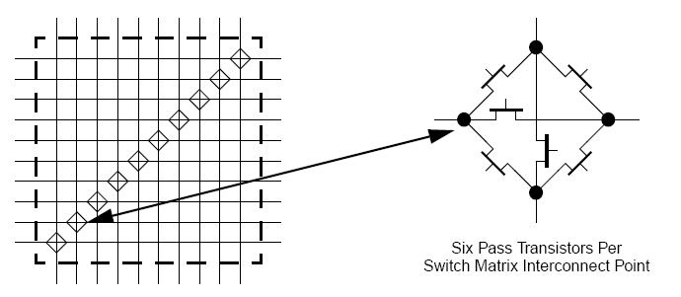
Interconnection Network
Configuration
bits
0
1
0
CLB
SB
CLB
0
0
0
SB
SB
SB
CLB
SB
CLB
Configurable Logic Blocks
Interconnection Network
I/O Signals (Pins)

Slide 115
Example 3
Determine the configuration bits for the following circuit implementation in a 2x2 FPGA, with I/O constraints as shown in the following figure. Assume 2-input LUTs in each CLB.
Input1
Input2
CLB0
SB0
CLB1
Input1 Input2
SET
D Q
Output
SB1
SB2
SB3
Input3
CLR Q
CLB2
Input3
SB4
CLB3
Output

Slide 116
CLBs required
CLB 1
CLB 2
Input1 Input2
SET
D Q
Output
CLR Q
Input3
0
0
MUX
O
MUX
Output
Input1 Input2
0
SET
D Q
O
Input3
SET
1
D Q
0
1
CLR Q
1
CLR Q
1
0
0
Configuration bits
Configuration bits

Slide 117
Placement: Select CLBs
Input1
Input2
CLB0
SB0
CLB1
SB1
SB2
SB3
CLB2
Input3
SB4
CLB3
Output
444

Slide 118

Routing: Select path
Input1
SB1
Configuration bits
Input2
CLB0 |  |  |  | SB0 |  |  |  |  | CLB1
SB1 |  |  |  | SB2 |  |  |  |  | SB3
CLB2 |  |  |  | SB4 |  |  |  |  | CLB3
0
0
0
1
0
0
SB4
Input3
Configuration bits
Output
0
0
1
0
445

Slide 119
Configuration Bitstream
The configuration bitstream must include ALL CLBs and SBs, even unused ones
CLB0: 00011
CLB1: 01100
CLB2: XXXXX
CLB3: ?????
SB0: 000000
SB1: 000010
SB2: 000000
SB3: 000000
SB4: 000001
446

Slide 120
FPGA Advantages
Long time availability
Can be updated and upgraded at your customer's site
Extremely short time to market
Fast and efficient systems
Performance gain for software applications
Real time applications
Massively parallel data processing
447

Slide 121
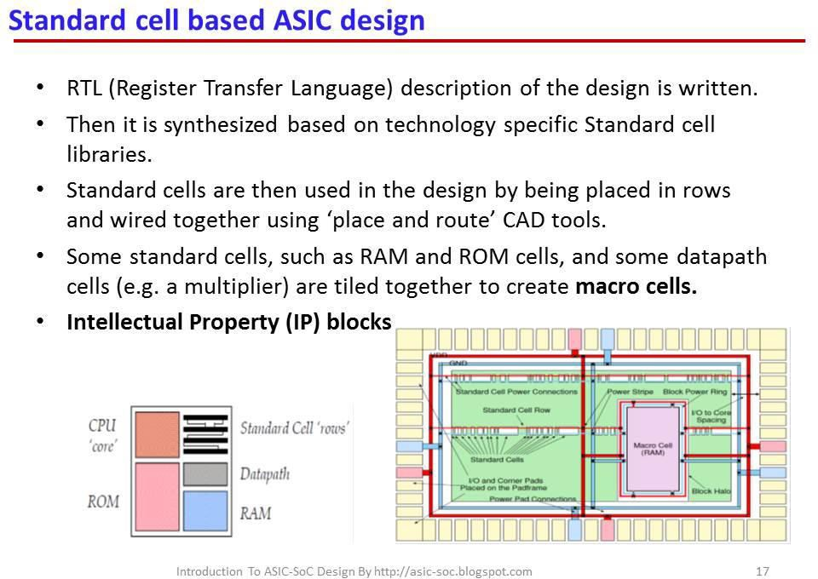
FPGA EDA Tools
■ Must provide a design environment based on digital design concepts and components (gates, flip-flops, MUXs, etc.)
■ Must hide the complexities of placement, routing and bitstream generation from the user. Manual placement, routing and bitstream generation is infeasible for practical FPGA array sizes and circuit complexities.
448

Slide 122
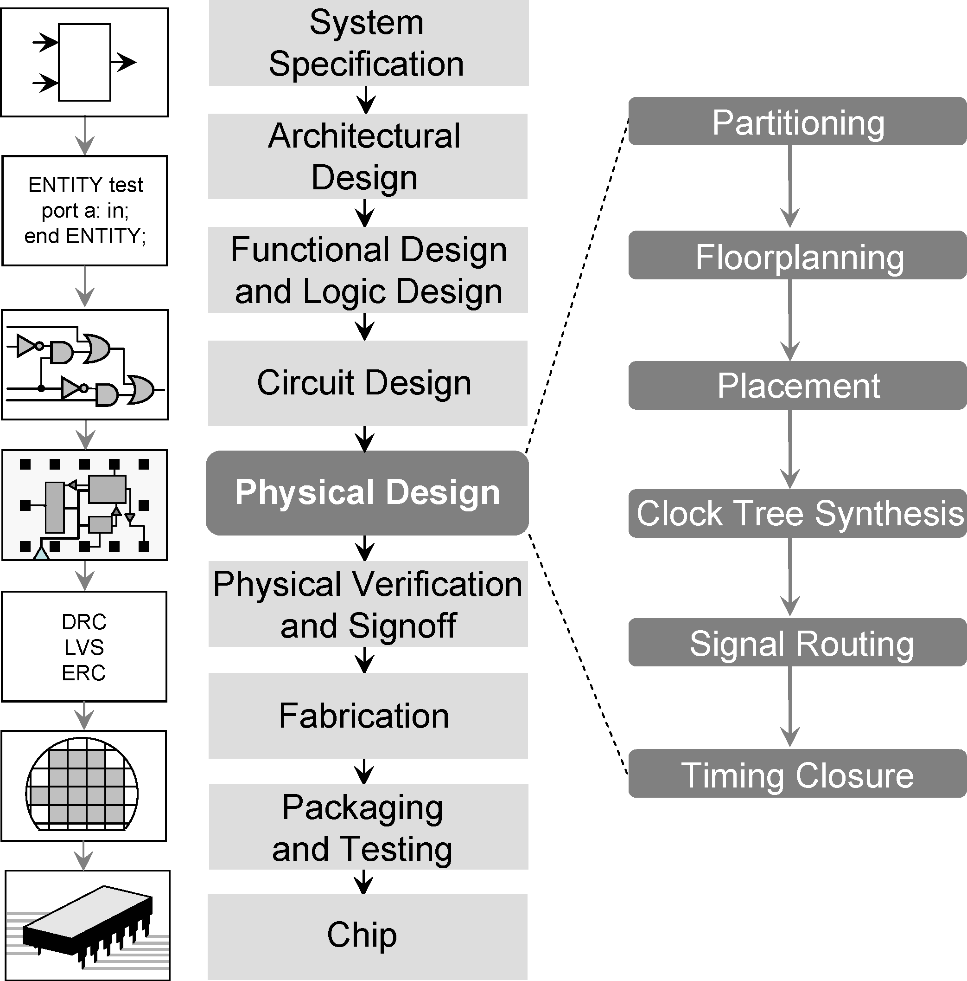
Design of approach of IC
449

Slide 123
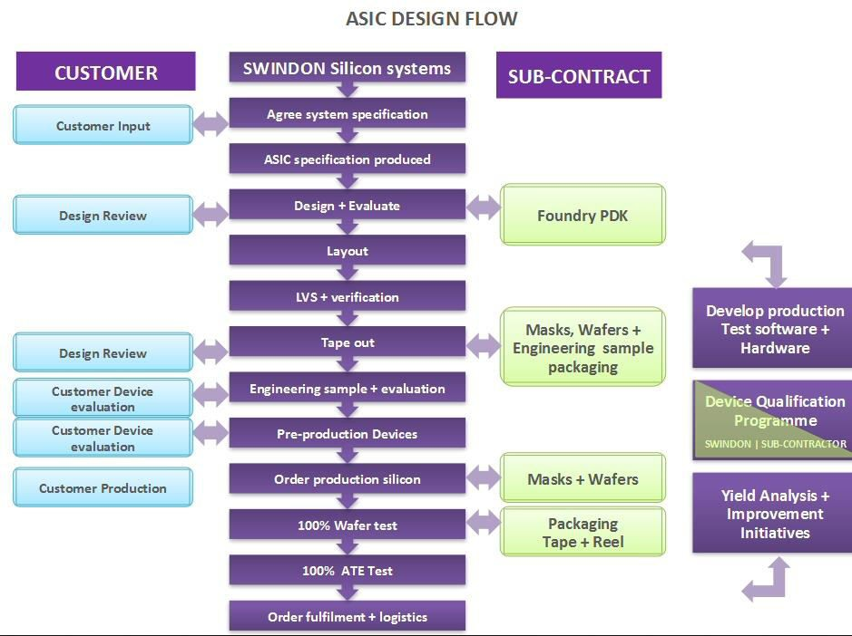
450

Slide 124
Silicon Wafers: Basic unit
Silicon Wafers Basic processing unit
150, 200, 300 mm disk, 0.5 mm thick
Newest ones 300 mm (12 inches)
Typical process 25 - 1000 wafers/run
Each wafer: 100 - 1000's of microchips (die)
Wafer cost $10 - $100's
200 mm wafer weight 0.040 Kg
Typical processing costs $1200/wafer (200
mm)
Typical processed wafer value $11,000
(all products, modest yield)
Value/Mass of processed wafer $275,000/Kg
451

Slide 125
CPLD
Complexity of CPLD is between FPGA and PLD.
CPLD featured in common PLD:-
i. Non-volatile configuration memory – does not need an external configuration PROM.
1.
2.
ii. Routing constraints. Not for large and deeply layered logic.
CPLD featured in common FPGA:-
i. Large number of gates available.
3.
ii. Can include complicated feedback path.
CPLD application:-
i. Address coding
4.
High performance control logic
Complex finite state machines
452

Slide 126
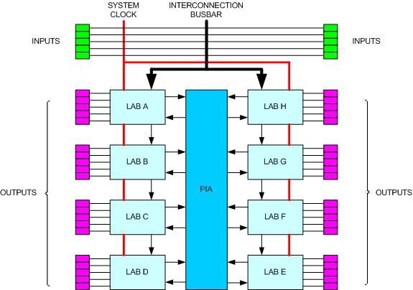
CPLD
5. CPLD architecture:-
LAB – Logic Array Block / uses PALs
PIA – Programmable Interconnect Array
453

Slide 127
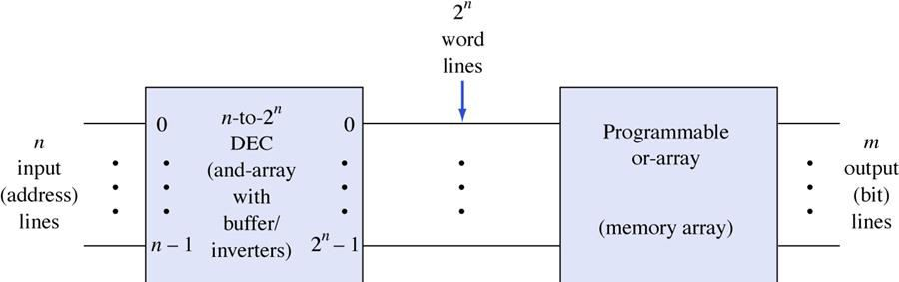
PROM Notation
454

