Slide 1
UNIT-II Sheet Resistance (Rs)
IC resistors have a specified thickness – not under the control of the circuit designer
Eliminate t by absorbing it into a new parameter: the sheet resistance (Rs)
_{R =} ρL ₌ ⎛ ρ ⎞⎛ L ⎞ _{= R} ⎛ L ⎞
⎜ ⎟⎜ ⎟
sq ⎜
⎟
Wt
⎝ t ⎠⎝W ⎠
⎝W ⎠
“Number of “quares”
6/3/2015
112

Slide 2
BASIC ELECTRICAL PROPERTIES
Topics
Basic electrical properties of MOS and BiCMOS circuits:
I_{ds}-V_{ds} relationships
MOS transistor threshold voltage, g_{m}, g_{ds}
figure of merit w_{o}
pass transistor
NMOS inverter
Various pull-ups
CMOS inverter analysis and design
BiCMOS inverters
6/3/2015

Slide 3
MOSFET I-V Characteristics
I-V Plots, Channel Length Modulation
-4
– Saturation equation yields curves independent of
6
x 10
5
VGS= 2.5 V
Resistive Saturation
4
I_{D} (A)
VGS= 2.0 V
V_{DS} = V_{GS} - V_{T}
Quadratic Relationship
VDS. Not sure! So
3
we consider the effect of channel 1 length modulation.
2
VGS= 1.5 V
VGS= 1.0 V
2 2.5
0
0
0.5
1
1.5
V_{DS}(V)
130

Slide 4
MOSFET I-V Characteristics Channel Length Modulation
Channel Length
Modulation
With pinch-off the channel at the point y such that Vc(y)=VGS - VT0, The effective channel length is equal to L’ = L – ΔL
ΔL is the length of channel segment over which QI=0.
Place L’ in the
ID(SAT) equation:
V_{S}=0
VDS>VDSAT
VGS>VT0
₌ μn Cox W ₍
₎2
I D ( SAT )
−
2
_{L′} V GS V T 0
0
y
Oxide
L’ ΔL L
(p+)
Source
n+
Drain
n+
(p+)
Channel
Pinch-off point (QI=0)
Depletion region
Substrate (p-Si)
V_{B}=0

Slide 5
MOSFET I-V Characteristics Channel Length Modulation
– ΔL increases with an increase in VDS.
We can use
1 ₌ 1
L' L − ΔL
₌ 1 1
L L − ΔL
₌ 1 1 ₌ 1 1
L 1 − λV
= ¹ (1 + λV )
–
L
1 −
ΔL
L
L
DS
λ: channel length modulation coefficient
– ID(SAT) can be rewritten as
L
DS
– The above form produces a discontinuity of current at VDS=VGS- VT0. We can include the term in ID(lin) with little error since λ is typically less than 0.1. We will usually ignore λ in manual calculations.
I D ( SAT )
₌ μn Cox W _{(V}
−V )² (1 + λV )
2 L
GS T 0
DS

Slide 6
MOSFET I-V Characteristics Substrate Bias Effect
So far, VSB=0 and thus VT0 used in the equations.
Clearly not always true – must consider body effect
– Two MOSFETs in series:
M1 G
D
S
M2 G
D
VSB
S
–
–
– V“B(M1) = VD“(M2) ≠ 0. Thus, VT0 in the M1 equation is replaced
by VT = VT(VSB) as developed in the threshold voltage section.

Slide 7
MOSFET I-V Characteristics Substrate Bias Effect (Cont.)
The general form of ID can be written as
ID = f (VGS,VDS,VSB)
which due to the body effect term is non- linear and more difficult to handle in manual calculations

Slide 8
MOSFET I-V Characteristics Summary of Analytical Equations
– The voltage directions and relationships for the three modes of pMOS are in contrast to those of nMOS.
D
nMOS
Mode | I_{D} | Voltage Range
Cut-off | 0 | V_{GS}<V_{T}
Linear | (µ_{n}C_{ox}/2)(W/L)[2(V_{GS}- V_{T})V_{DS}-V_{DS}²] | V_{GS}≥V_{T}，V_{DS}< V_{GS} -V_{T}
Saturatio n | (µ_{n}C_{ox}/2)(W/L)(V_{GS}- V_{T})²(1+hV_{DS}) | V_{GS} ≥ V_{T}，V_{DS} ≥ V_{GS} -V_{T}
pMOS
Cut-off | 0 | V_{GS}>V_{T}
Linear | (µ_{n}C_{ox}/2)(W/L)[2(V_{GS}- V_{T})V_{DS}-V_{DS}²] | V_{GS} ≤ V_{T}，V_{DS}> V_{GS} -V_{T}
Saturatio n | (µ_{n}C_{ox}/2)(W/L)(V_{GS}- V )²(1+hV ) | V_{GS} ≤ V_{T}，V_{DS}135 ≤V -V
G
B
I_{D}
VSB VDS
VGS
S
S
V
GS
VSB B
G
VDS
I_{D}
D

Slide 9
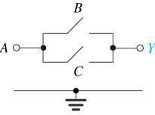
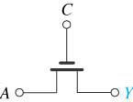
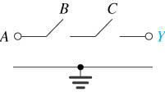
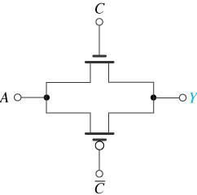


Pass-Transistor Logic Circuits (1)
A simple approach for implementing logic functions utilizes series and parallel combinations of switches that are controlled by input variables to connect the input and output nodes.
Each of the switches can be implemented either by a single NMOS transistor or by a pair of CMOS transistors connected in CMOS transmission gate
configuration.
Y=AC
136

Slide 10

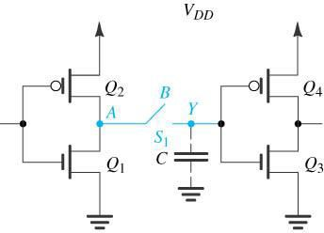

Pass-Transistor Logic Circuits (2)
An essential requirement in the design of pass-transistor logic is ensuring that every circuit node has at all times a low-resistance path to V_{DD} or to ground.
A basic design requirement of PTL circuits is that every node have, at all times, a low resistance
path to either ground or VDD. Such a path does not exist in (a) when B is low and S1 is open. It is provided in
6/3/2015
(b) through switch S2.
137

Slide 11
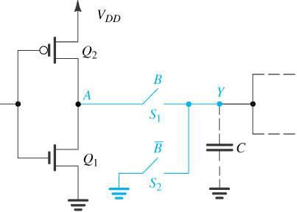

Pass-Transistor Logic Circuits (3)
The problem can be easily solved by establishing for node Y a low- resistance path that is activated when B goes low.
A basic design requirement of PTL circuits is that every node have, at all times, a low resistance
path to either ground or VDD. Such a path does not exist in (a) when B is low and S1 is open. It is provided in
(b) through switch S2.

Slide 12
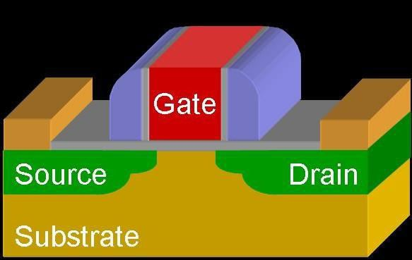
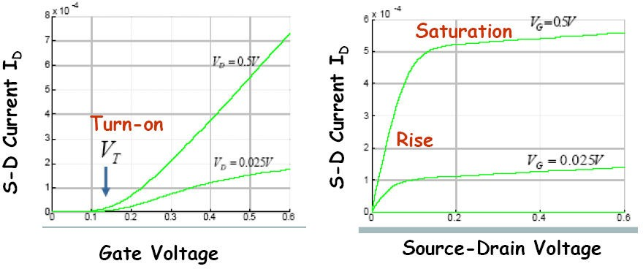
MOSFET Ids-Vds

Slide 13
I-V Characteristics
In Linear region, Ids depends on
How much charge is in the channel?
How fast is the charge moving?

Slide 14






Channel Charge
MOS structure looks like parallel plate capacitor while operating in inversion
– Gate – oxide – channel
Qchannel =
gate
+
V_{g}
+
polysilicon gate
C_{g}
source ^{V}gs
^{V}gd
drain
W
V
-
-
channel
-
+
V
^{t}ox
s
n+ n+
d
n+
L
n+
SiO₂ gate oxide
^{V}ds
p-type body
(good insulator, ε = 3.9)
p-type body
ox

Slide 15


Channel Charge
MOS structure looks like parallel plate capacitor while operating in inversion
– Gate – oxide – channel
Qchannel = CV
C =
gate
+
V_{g}
+
polysilicon gate
C_{g}
source ^{V}gs
^{V}gd
drain
W
V
-
-
channel
-
+
V
^{t}ox
s
n+ n+
d
n+
L
n+
SiO₂ gate oxide
^{V}ds
p-type body
(good insulator, ε = 3.9)
p-type body
ox

Slide 16


Channel Charge
MOS structure looks like parallel plate capacitor while operating in inversion
– Gate – oxide – channel
Qchannel = CV
C = Cg = eoxWL/tox = CoxWL
^{C}ox ^{= ε}ox ^{/ t}ox
gate
V =
V_{g}
polysilicon gate
+
+
source ^{V}gs
C_{g}
^{V}gd
drain
W
V
-
-
channel
-
+
V
^{t}ox
s
n+ n+
d
n+
L
n+
SiO₂ gate oxide
^{V}ds
p-type body
(good insulator, ε = 3.9)
p-type body
ox

Slide 17


Channel Charge
MOS structure looks like parallel plate capacitor while operating in inversion
– Gate – oxide – channel
Qchannel = CV
C = Cg = eoxWL/tox = CoxWL
V = Vgc – Vt = (Vgs – Vds/2) – Vt
^{C}ox ^{= ε}ox ^{/ t}ox
gate
+
V_{g}
+
polysilicon gate
C_{g}
source ^{V}gs
^{V}gd
drain
W
V
-
-
channel
-
+
V
^{t}ox
s
n+ n+
d
n+
L
n+
SiO₂ gate oxide
^{V}ds
p-type body
(good insulator, ε = 3.9)
p-type body
ox

Slide 18
Carrier velocity
Charge is carried by e-
Carrier velocity v proportional to lateral E-field between source and drain

Slide 19
Carrier velocity
Charge is carried by e-
Carrier velocity v proportional to lateral E-field between source and drain
v = mE m called mobility
E =energy
150

Slide 20
Carrier velocity
Charge is carried by e-
Carrier velocity v proportional to lateral E-field between source and drain
v = mE
E = Vds/L
Time for carrier to cross channel:
– t =
m called mobility

Slide 21
Carrier velocity
Charge is carried by e-
Carrier velocity v proportional to lateral E-field between source and drain
v = mE
E = Vds/L
Time for carrier to cross channel:
– t = L / v
m called mobility

Slide 22
nMOS Linear I-V
Now we know
How much charge Qchannel is in the channel
How much time t each carrier takes to cross
^{I}ds
=

Slide 23
nMOS Linear I-V
Now we know
How much charge Qchannel is in the channel
How much time t each carrier takes to cross
I
₌ ^{Q}channel
ds
t
=

Slide 24
nMOS Linear I-V
Now we know
– How much charge Qchannel is in the channel
– Ho_{Q}w much time t each carrier takes to cross
I
₌ channel
t
ds
W _{⎛⎜V}
⎞_{⎟V}
= μC
−V − ^{Vds}
ox
L ⎝
gs
t
2 ⎠
ds
W L
= β ⎛V −V −^{Vds}
⎞_{V}
β = μC
⎜
₂ ⎟
ox
⎝
gs t
⎠
ds

Slide 25
nMOS Saturation I-V
If Vgd < Vt, channel pinches off near drain
– When Vds > Vdsat = Vgs – Vt
Now drain voltage no longer increases current
^{I}ds
=

Slide 26
nMOS Saturation I-V
If Vgd < Vt, channel pinches off near drain
– When Vds > Vdsat = Vgs – Vt
Now drain voltage no longer increases current
I = β ⎛⎜V
_{−V −}^{V}dsat
⎞_{⎟V}
ds
⎝
gs
t
2 ⎠
dsat

Slide 27
nMOS Saturation I-V
If Vgd < Vt, channel pinches off near drain
– When Vds > Vdsat = Vgs – Vt
Now drain voltage no longer increases current
I = β ⎛⎜V
_{−V −}^{V}dsat
⎞_{⎟V}
ds
⎝
gs t
2 ⎠
dsat
= ^{β} (V −V
)
2
2
gs t

Slide 28
nMOS I-V Summary
Shockley 1st order transistor models
⎧
⎪
⎪
0
^{V}gs ^{< V}t
cutoff
I = ⎪β ⎛⎜V
⎞_{⎟V}
⎨
−V −^{Vds}
V < V
linear
ds
⎝
gs
t
2 ⎠
ds
ds
dsat
⎪
⎪ β
⎪⎩
(
V −V_{t} )
2
^{V}ds ^{> V}dsat
saturation
2
gs

Slide 29
Example
Example: a 0.6 mm process from AMI semiconductor
– tox = 100 Å
– m = 350 cm2/V*s
– Vt = 0.7 V
Plot Ids vs. Vds
– Vgs = 0, 1, 2, 3, 4, 5
– Use W/L = 4/2 l
2.5
V_{gs} = 5
2
I_{ds} (mA)
1.5
V = 4
gs
1
V_{gs} = 3
0.5
V_{gs} = 2
V_{gs} = 1
0
0
1
2
3
4
5
^{V}ds
W ⎛ 3.9 • 8.85⋅10
L
−14
⎞ W
W L
β = μC
( )
⎛ ⎞
μ A /V
2
= 350
⎜
⎟ ⎜ _{L} ⎟
= 120
ox
⎝
100 ⋅10⁻⁸
⎠ ⎝ ⎠
6/3/2015
160

Slide 30
Vdd
Basic Inverter: Transistor with source connected to ground and a load resistor connected from the drain to the positive Supply rail
R
Pull-Up
Vo
Output is taken from the drain and control input connected between gate and ground
Resistors are not easily formed in silicon
- they occupy too much area
Vin
Pull Down
Transistors can be used as the pull-up device
Vss

Slide 31
NMOS Depletion Mode Transistor Pull - Up
Vdd
Pull-Up is always on – Vgs = 0; depletion
D
Pull-Down turns on when Vin > Vt
With no current drawn from outputs, Ids
for both transistors is equal
Vo
S
V0
Vt
Vdd
D
Vin
S
Non-zero output
Vss
Vi

Slide 32
^{I}ds
V_{gs}=0.2V_{DD}
^{I}ds
V_{gs}=0
V_{gs}=-0.2 V_{DD} V_{gs}=-0.4 V_{DD} V_{gs}=-0.6V_{DD}
V
^{V}DD –^{V}ds
ds
^{V}in
^{V}gs^{=V}DD
^{V}DD
^{I}ds
V_{gs}=0.8V_{DD}
V_{gs}=0.6 V_{DD}
V_{gs}=0.4 V_{DD} V_{gs}=0.2V_{DD}
^{V}ds
V
^{V}DD
^{V}DD
o

Slide 33
Decreasing
Zpu/Zpd
^{V}in
^{V}DD
Increasing
Zpu/Zpd
V_{o}
V
DD
Vinv
Point where Vo = Vin is called Vinv
Transfer Characteristics and Vinv can be shifted by altering ratio
of pull-up to Pull down impedances

Slide 34
NMOS Depletion Mode Inverter Characteristics
Dissipation is high since rail to rail current flows when Vin = Logical 1
Switching of Output from 1 to 0 begins when Vin exceeds Vt of pull down device
When switching the output from 1 to 0, the pull up device is non-saturated initially and this presents a lower resistance through which to charge capacitors (Vds < Vgs – Vt)

Slide 35
NMOS Enhancement Mode Transistor Pull - Up
Dissipation is high since current flows when Vin = 1
Vdd
D
Vout can never reach Vdd (effect of channel)
Vgg can be derived from a switching source (i.e. one phase of a clock, so that dissipation can be significantly reduced
Vgg
If Vgg is higher than Vdd, and extra supply rail is required
Vo
S
V0
Vdd
D
Vt (pull up)
Vin
S
Non zero output
Vss
Vt (pull down)
Vin

Slide 36
Cascading NMOS Inverters
When cascading logic devices care must be taken to preserve integrity of logic levels
i.e. design circuit so that Vin = Vout = Vinv
Determine pull – up to pull-down ratio for driven inverter
180

Slide 37
Assume equal margins around inverter; Vinv = 0.5 Vdd
Assume both transistors in saturation, therefore: I_{ds} = K (W/L) (V_{gs} – V_{t})²/2 Depletion mode transistor has gate connected to source, i.e. V_{gs} = 0
I_{ds} = K (W_{pu}/L_{pu}) (-V_{td})²/2
Enhancement mode device Vgs = Vinv, therefore I_{ds} = K (W_{pd}/L_{pd}) (V_{inv} – V_{t})²/2
Assume currents are equal through both channels (no current drawn by load)
(W_{pd}/L_{pd}) (V_{inv} – V_{t})² = (W_{pu}/L_{pu}) (-V_{td})² Convention Z = L/W
V_{inv} = V_{t} – V_{td} / (Z_{pu}/Z_{pd})^{1/2}
Substitute in typical values V_{t} = 0.2 V_{dd} ; V_{td} = -0.6 V_{dd} ; Vinv = 0.5 V_{dd}
This gives Zpu / Zpd = 4:1 for an nmos inverter directly driven by another inverter

Slide 38
Pull-Up to Pull-Down Ratio for an nMOS inverter driven through 1 or more pass transistors
Inverter 1
Vdd
Vdd
Inverter 2
A
B
C
Vin1
Vout2
It is often the case that two inverters are connected via a series of switches (Pass Transistors) We are concerned that connection of transistors in series will degrade the logic levels into Inverter 2. The driven inverter can be designed to deal with this. (Zpu/Zpd >= 8/1)

Slide 39
Complimentary Transistor Pull – Up (CMOS)
Vdd
Vout
Vtn
Vtp
P on
N off
N on
P off
Vin
Vo
Both On
Vin
Vss
Vdd
Vss
Logic 0
Logic 1

Slide 40
Vout
Vtn
Vtp
1: Logic 0 : p on ; n off
P on N off
N on P off
5: Logic 1: p off ; n on
Both On
2: Vin > Vtn.
Vdsn large – n in saturation Vdsp small – p in resistive Small current from Vdd to Vss
Vin
4: same as 2 except reversed p and n
Vss
Vdd
3: Both transistors are in saturation
Large instantaneous current flows
1
2
3
4
5

Slide 41
CMOS INVERTER CHARACTERISTICS
Current through n-channel pull-down transistor
β_{n}
β _{p}
β
₎2
^{V}DD ^{+ V}tp ^{+ V}tn
I =
n
(V −V
V =
n
2
in tn
in
β
1 +
n
β
Current through p-channel pull-up transistor
p
and V_{tp} = –V_{tn}
₎2
If β_{n} = β_{p}
β
p
( ( )+ V_{tp}
I _{p} =
V_{in} −V_{DD}
2
At logic threshold, I_{n} = I_{p}
V_{in} =
^{V}DD
2
β
β
p
(− (
₎2
^{μ} p^{W}p ₌ μ_{n}W_{n}
L_{p} L_{n}
2
n
( − ) =
− )+
2
^{V}in ^{V}tn
2
β
^{V}in ^{V}DD ^{V}tp
β
n
(V − V ) =
p
(− (V − V )+ V )
2
β
in tn
2
in DD
tp
Mobilities are unequal : µ_{n} = 2.5 µ_{p}
n
(
^{V}in ^{− V}tn
) = −V_{in} + V_{DD} + V_{tp}
β
p
Z = L/W
⎛ _{βn} ⎞
β_{n}
β _{p}
V_{in} ⎜1 +
⎟ ₌
^{V}tn ^{+ V}DD ^{+ V}tp
⎜ β _{p} ⎟
Z /Z = 2.5:1 for a symmetrical CMOS inverter
⎝
⎠
pu pd

Slide 42
CMOS Inverter Characteristics
No current flow for either logical 1 or logical 0 inputs
Full logical 1 and 0 levels are presented at the output
For devices of similar dimensions the p –
channel is slower than the n – channel device

Slide 43



CMOS Inverter VTC
NMOS off PMOS res
NMOS sat
PMOS res
2.5
(V)
2
1.5
NMOS sat
PMOS sat
^{V}out
1
0.5
0
NMOS res
PMOS sat
1.5 2
NMOS res P2M.5OS off
0
0.5
1
V_{in} (V)

Slide 44



Cutoff
Linear
Saturation
pMOS
V_{in} -V_{DD}= V_{GS}> V_{T}
V_{in} -V_{DD}=V_{GS}< V_{T}
^{V}in ^{-V}out^{=V}GD^{< V}T
V_{in} -V_{DD}=V_{GS}> V_{T}
^{V}in ^{-V}out^{=V}GD^{>V}T
nMOS
V_{in} = V_{GS}< V_{T}
V_{in} =V_{GS}> V_{T}
^{V}in ^{-V}out ^{=V}GD^{> V}T
V_{in} =V_{GS}> V_{T}
^{V}in ^{-V}out ^{=V}GD^{< V}T
^{V}DD
G
S
Regions of operations For nMOS and pMOS In CMOS inverter
D
^{V}in
D
^{V}out
G
C_{L}
S

Slide 45
Impact of Process Variation
Good PMOS Bad NMOS
(V)
2.5
2
1.5
^{V}out
Nominal
1Bad PMOS
0.5Good NMOS
0
0 0.5
1
1.5
2
2.5
V_{in} (V)
Pprocess variations (mostly) cause a shift in the switching
threshold

Slide 46
Cmos Inverter
Look at why our NMOS and PMOS inverters might not be the best inverter designs
Introduce the CMOS inverter
Analyze how the CMOS inverter works
190

Slide 47








NMOS Inverter
5 V
When VIN change
s to logic 0, itsransistor gets
When V is logic 1, V
5 V
IN OUT
logic 0.
cutoff. ID goes to 0.
R
Constant nonzero current R
‘esistor voltag^{fl}e^{ow}g^{s} o^{thr}e^{ou}s^{gh}to^{tra}z^{ns}e^{is}r^{to}o^{r.}. VOUT “pulled
uI p=”5/tRo
V
Power is used even though no new computation is being performed.
5 V.
D
OUT
V
D
I_{D} = 0
D
OUT
^{V}IN
0 V
+
^{V}IN
5 V
+
5 V
V
0 V
DS
^{V}DS
_
_

Slide 48







PMOS Inverter
When V⁵IN^{V} changes to logic 1, transistor gets^{5 V}
cutoff. ID goes to 0.
^{V}•^{IN} ‘esisto₋r voltage goes to zero. VOUV_{I}T_{N} “pulled
- ^{V}DS
+
down”^{V}t^{D}o^{S} 0V V.
0 V
+
OUT
When V_{IN} is logic 0, V_{OUT} is logic 1.
^{V}OUT
5 V
I_{D} = -5/R
5 V
I_{D} = 0
0 V
Constant nonzero current flows through transistor.
Power is used even though no new computation is being performed.
R
R

Slide 49


Analysis of CMOS Inverter
We can fo_{V}llow_{(Lo}t_{g}h_{ic}e₁₎ same procedure to solve for
DD
currents aSnd voltages in the CMOS inverter as we did for the single NMOS and PMOS
circuits.
D
^{V}OUT
Remember, now we have two transistors so
D
^{V}IN
we write two I-V relationships and have twice
the number of variables.
We can ro^{S}ughly analyze the CMOS inverter
NMOS isg“rpaulpl-dhowicnadlelvyic.e”
PMOS is “pull-up device”
Each shuts off when not pulling

Slide 50

CMOS Analysis
^{I}D(n)
As V_{IN} goes up, V_{GS(n)} gets bigger
and V_{GS(p)} gets less negative.
NMOS I-V curve
PMOS I-V curve (written in terms of NMOS variables)
^{V}IN ^{= V}GS(n) ⁼
0.9 V
^{V}DS(n)
^{V}DD

Slide 51
CMOS Analysis
^{I}D(n)
As V_{IN} goes up, V_{GS(n)} gets bigger
and V_{GS(p)} gets less negative.
NMOS I-V curve
PMOS I-V curve (written in terms of NMOS variables)
^{V}IN ^{= V}GS(n) ⁼
4.1 V
^{V}DS(n)
^{V}DD

Slide 52





Beta Ratio
If bp / bn ≠ 1, switching point will move from VDD/2
^{V}DD
β
^{p} = 10
β
n
^{V}out
2
1
0.5
β
^{p} = 0.1
β
n
0
^{V}DD
^{V}in

Slide 53
VLSI CIRCUIT DESIGN PROCESSES
Topics
VLSI design flow
MOS layers
Stick diagrams
Design Rules and Layout
2 um CMOS design rules for wires
Contacts and Transistors
Layout diagrams for NMOS and
CMOS inverters and gates, Scaling of MOS circuits

Slide 54
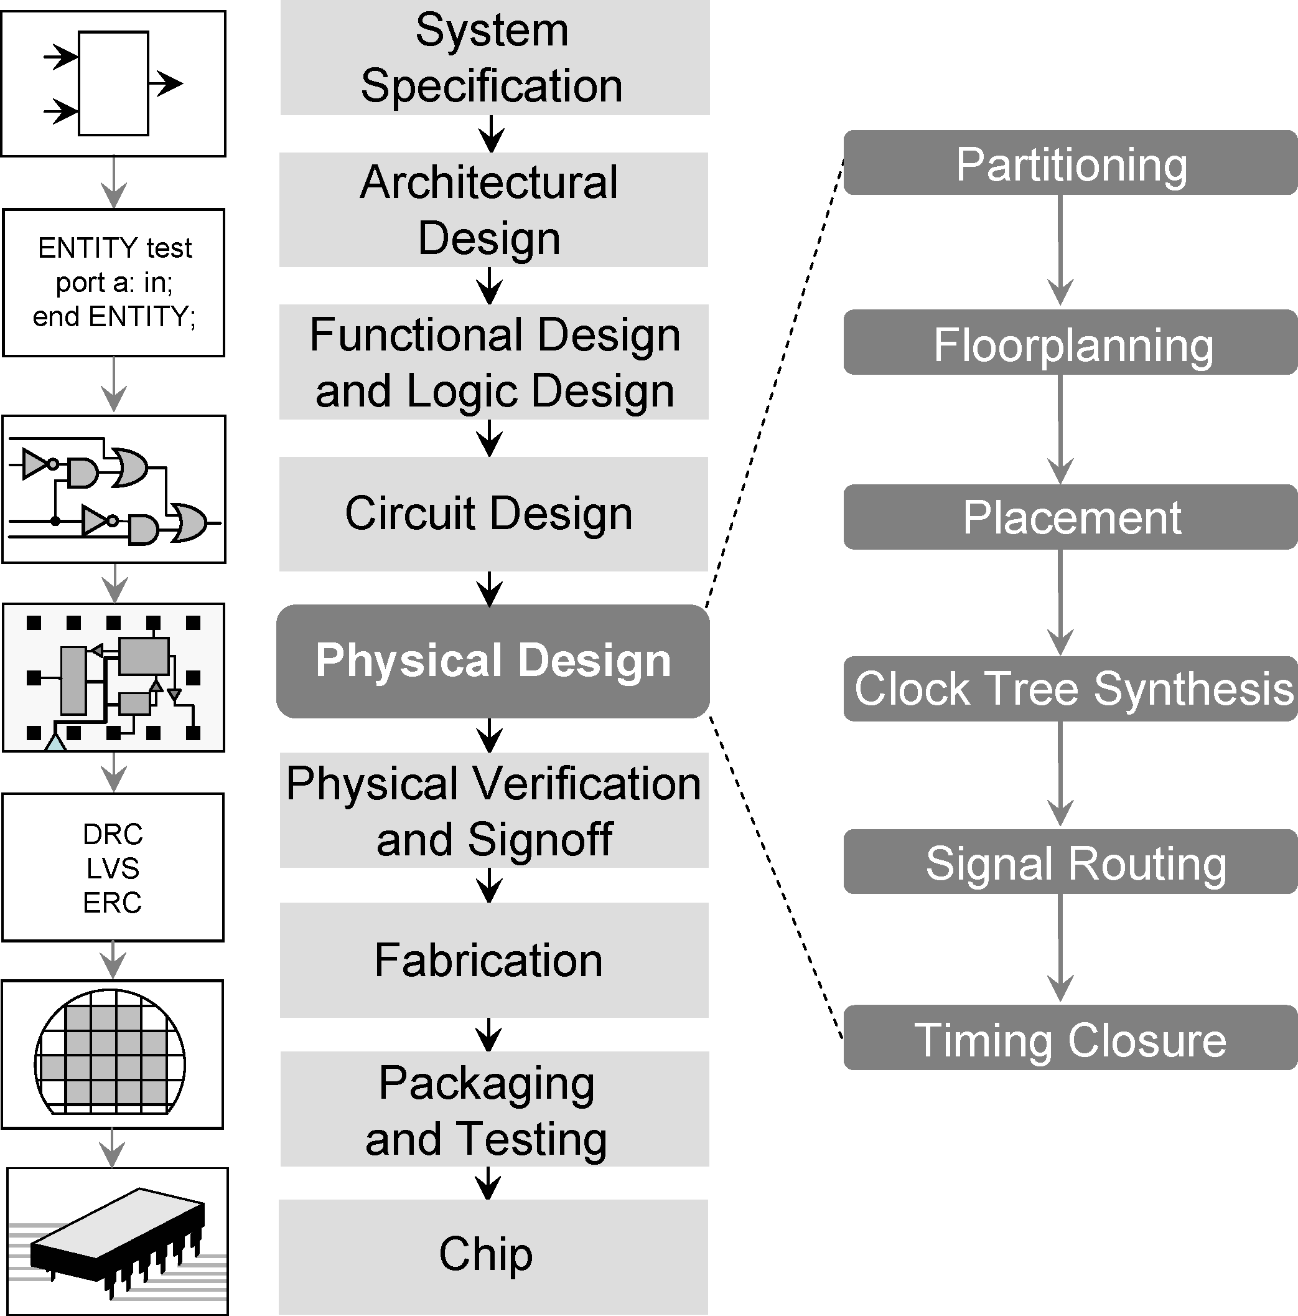
VLSI Design of approach of IC
26/038/2015

Slide 55
Layer Types
p-substrate
n-well
n+
p+
Gate oxide (thin oxide)
Gate (polycilicon)
Field Oxide
Insulated glass
Provide electrical isolation
209

Slide 56

Stick diagram
Encodings for a simple single metal nMOS process
COLOR | STICK ENCODING MONOCROME | LAYERS | MASK LAYOUT ENCODING MONOCROME | CIF | LAYER
 |  | n-
GREEN |  | diffusion n⁺active |  | N D
RED |  | Thniox Polysilicon |  | NP
BLUE |  | Metal 1 |  | N M
BLACK |  | Contact cut |  | N
 |  |  |  | C
GRAY nMOS ONLY | NOT APPLICABLE | Overglass Implant |  | N G NI
YELLO n_{W}MOS ONLY |  | Buried |  | NB
 |  | contact
BROWN
219

Slide 57
Stick Diagrams
Metal
poly ndiff
pdiff
Can also draw in shades of gray/line style.
Buried Contact
Contact Cut

Slide 58
Stick Diagrams
VLSI design aims to translate circuit concepts onto silicon.
Stick diagrams are a means of capturing topography and layer information using simple diagrams.
Stick diagrams convey layer information through colour codes (or monochrome encoding).
Acts as an interface between symbolic circuit and the actual layout.

Slide 59
Stick Diagrams
Does show all components/vias.
It shows relative placement of components.
Goes one step closer to the layout
Helps plan the layout and routing

Slide 60
Stick Diagrams
Does not show
Exact placement of components
Transistor sizes
Wire lengths, wire widths, tub boundaries.
Any other low level details such as parasitics..

Slide 61
Stick Diagrams – Some rules
Stick Diagrams
Rule 1.
When two or more ‘sticks’ of the same type cross or touch each other that represents electrical contact.

Slide 62

Stick Diagrams – Some rules
Stick Diagrams
Rule 2.
When two or more ‘sticks’ of different type cross or touch each other there is no electrical contact.
(If electrical contact is needed we have to show the connection explicitly).

Slide 63


Stick Diagrams – Some rules
Stick Diagrams
Rule 3.
When a poly crosses diffusion it represents a transistor.
Note: If a contact is shown then it is not a transistor.

Slide 64
Stick Diagrams – Some rules
Stick Diagrams
Rule 4.
In CMOS a demarcation line is drawn to avoid touching of p-diff with n-diff. All pMOS must lie on one side of the line and all nMOS will have to be on the other side.

Slide 65
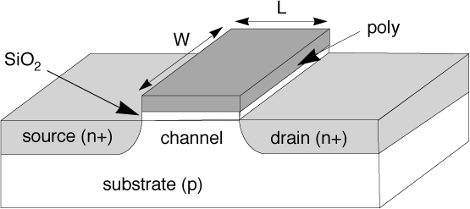
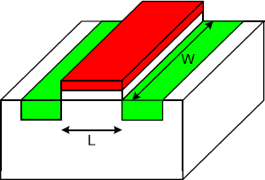
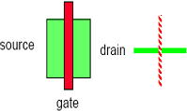
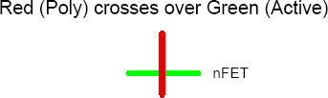

Slide 66
NMOS INVERTER
5 V
5 v
Dep
^{V}out
Enh
^{V}in
0 V
0V
220

Slide 67
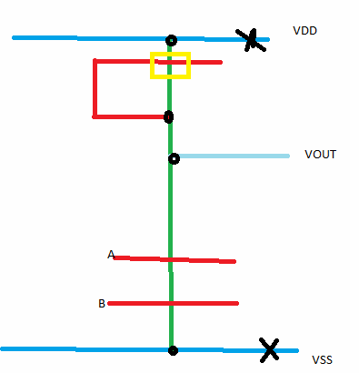
NMOS-NAND

Slide 68
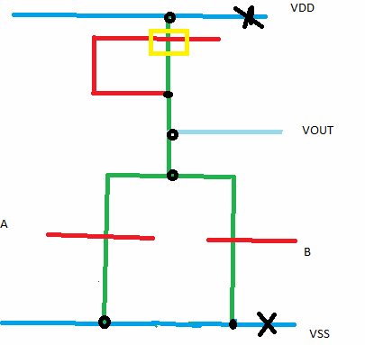
NMOS-NOR

Slide 69
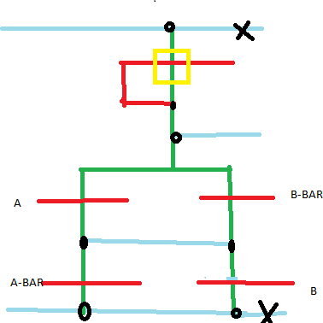
NMOS EX-OR

Slide 70
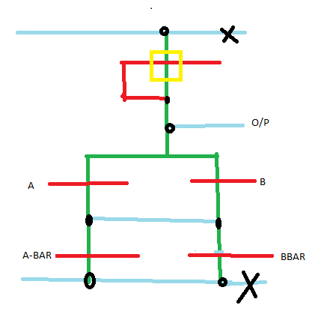
NMOS EX-NOR

Slide 71
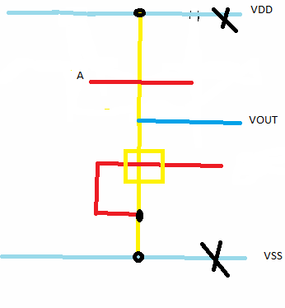
PMOS-INVERTER

Slide 72
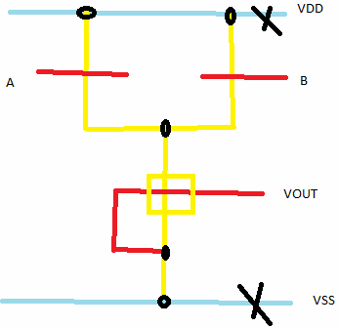
PMOS NAND

Slide 73
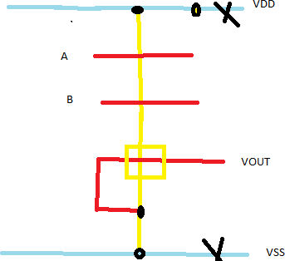
PMOS-NOR

Slide 74
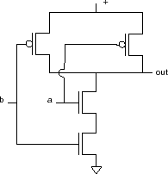
Sticks design CMOS NAND:
Start with NAND gate:

Slide 75
NAND sticks
VDD
a
out
b
VSS

Slide 76

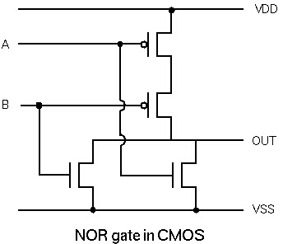
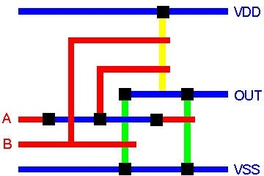
Stick Diagram - Example
A
OUT
B
NOR Gate
230

Slide 77
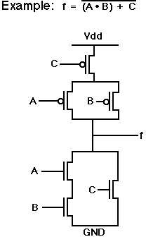
Stick Diagram - Example
Power
A
Out
C
B
Ground

Slide 78
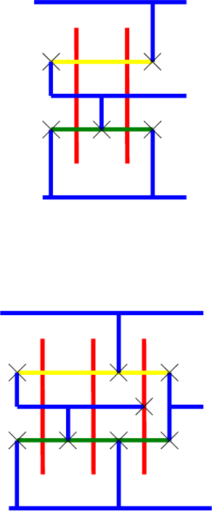
2 I/P OR GATE

Slide 79
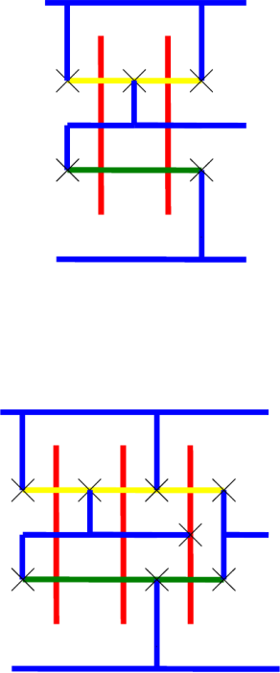
2 I/P AND

Slide 80
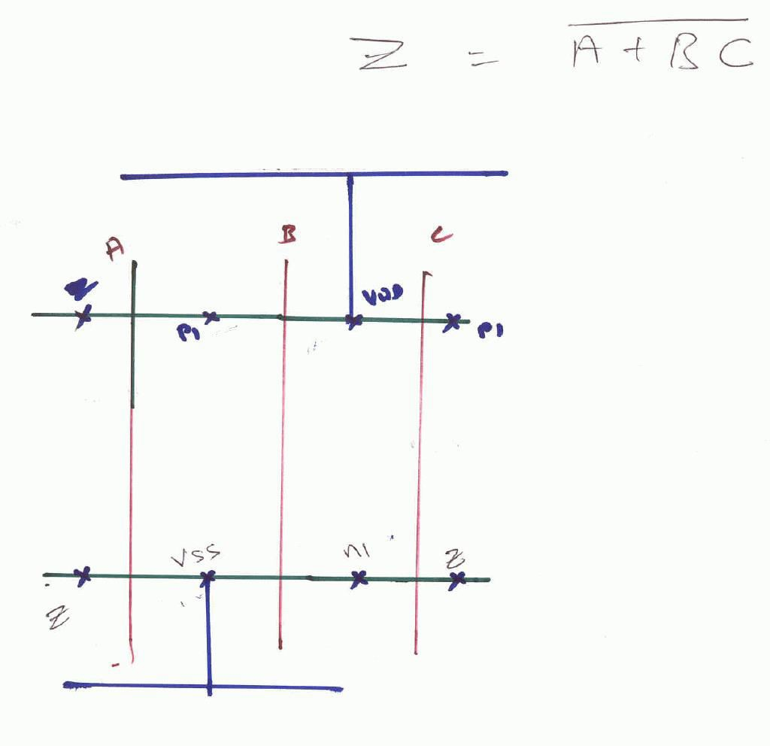

Slide 81
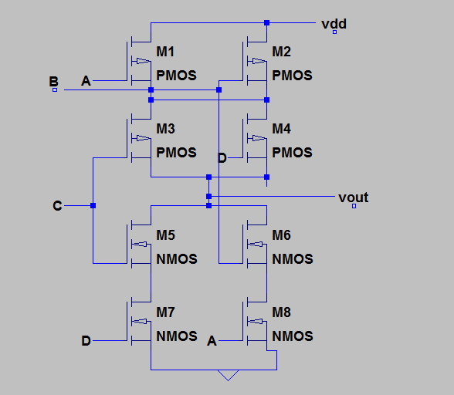
Y=(AB+CD)’

Slide 82
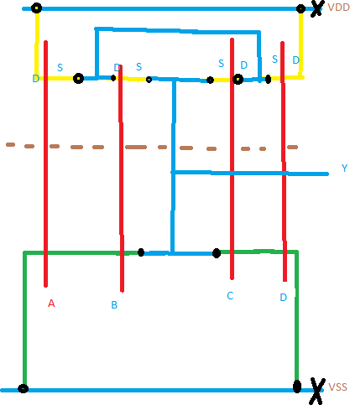
Y=(AB+CD)’ “TICK

Slide 83
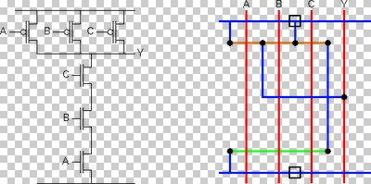

Slide 84
Design Rules
Design rules are a set of geometrical specifications that dictate the design of the layout masks
A design rule set provides numerical values
For minimum dimensions
For minimum line spacings
Design rules must be followed to insure functional structures on the fabricated chip
Design rules change with technological advances (www.mosis.org)

Slide 85
Design Rules
Minimum length or width of a feature on a layer is 2λ
Why?
To allow for shape contraction
Minimum separation of features on a layer is 2λ
Why?
To ensure adequate continuity of the intervening materials.

Slide 86
Design Rules
Minimum width of PolySi and diffusion line 2λ
Minimum width of Metal line 3λ as metal lines run over a more uneven surface than other conducting layers to ensure their continuity
Metal
Diffusion
3λ
2λ
2λ
Polysilicon

Slide 87
Design Rules
PolySi – PolySi space 2λ Metal - Metal space 2λ
Diffusion – Diffusion 3λ To avoid the possibility of their associated regions overlapping and conducting current
Metal
2λ
Diffusion
2λ
3λ
Polysilicon
250

Slide 88
Design Rules
Diffusion – PolySi λ To prevent the lines overlapping to form unwanted capacitor
Metal lines can pass over both diffusion and polySi without electrical effect. Where no separation is specified, metal lines can overlap or cross
Metal
Diffusion
λ
Polysilicon

Slide 89
Metal Vs PolySi/Diffusion
Metal lines can pass over both diffusion and polySi without electrical effect
It is recommended practice to leave λ between a metal edge and a polySi or diffusion line to which it is not electrically connected
Metal
λ
Polysilicon

Slide 90
Review:
poly-poly spacing 2λ
diff-diff spacing 3λ
(depletion regions tend to spread outward)
metal-metal spacing 2λ
diff-poly spacing λ

Slide 91
Note
Two Features on different mask layers can be misaligned by a maximum of 2l on the wafer.
If the overlap of these two different mask layers can be catastrophic to the design, they must be separated by at least 2l
If the overlap is just undesirable, they must be separated by at least l

Slide 92
When a transistor is formed?
Gate is formed where polySi crosses diffusion with
thin oxide between these layers.
Design rules
min. line width of polySi and diffusion 2λ
drain and source have min. length and width of 2λ
And

Slide 93
PolySi extends in the gate region…
The polySi of the gate extends 2λ beyond the gate area on
to the field oxide to prevent the drain and source from shorting.
diffusion short
Diffusion Problems
no overlap
overlap

Slide 94
Depletion Transistor
We need depletion implant
An implant surrounding the Transistor by 2λ
Ensures that no part of the transistor remains in the enhancement mode
A separation of 2λ from the gate of an enhancement transistor avoids affecting the device.
2λ

Slide 95
Depletion Transistor
Implants are separated by 2λ to prevent them from merging
2λ

Slide 96
Butting Contact
The gate and source of a depletion device can be connected by a method known as butting contact. Here metal makes contact to both the diffusion forming the source of the depletion transistor and to the polySi forming this device’s gate.
Advantage:
No buried contact mask required and avoids associated processing.

Slide 97

Butting Contact
Problem: Metal descending the hole has a tendency to fracture at the polySi corner, causing an open circuit.
Metal
Insulating
Oxide
n+
n+
Gate Oxide
PolySi
260

Slide 98
Buried Contact
It is a preferred method. The buried contact window defines the area where oxide is to be removed so that polySi connects directly to diffusion.
Contact Area must be a min. of 2λ*2λ to ensure adequate contact area.
2λ
Contact Area
2λ
6/3/2015
261

Slide 99
Buried Contact
The buried contact window surrounds this contact by λ in all
directions to avoid any part of this area forming a transistor.
Separated from its related transistor gate by λ to prevent gate area from being reduced.
λ

Slide 100




Buried Contact
Here gate length is depend upon the alignment of the buried contact mask relative to the polySi and therefore vary by ±λ.
PolySi
Channel length ±λ
Buried contact Diffusion
λ 2λ λ
 | 2λ

Slide 101
Contact Cut
Metal connects to polySi/diffusion by contact cut. Contact area: 2λ∗2λ
Metal and polySi or diffusion must overlap this contact area by λ so that the two desired conductors encompass the contact area despite any mis-alignment between conducting layers and the contact hole
4λ

Slide 102
Contact Cut
Contact cut – any gate: 2λ apart
Why? No contact to any part of the gate.
4λ
2λ

Slide 103
Contact Cut
Contact cut – contact cut: 2λ apart Why? To prevent holes from merging.
2λ

Slide 104
Rules for CMOS layout
Similar to those for NMOS except No
Depletion implant
Buried contact
Additional rules
Definition of n-well area
Threshold implant of two types of transistor
Definition of source and drains regions for the NMOS and PMOS.

Slide 105
Rules for CMOS layout
To ensure the separation of the PMOS and NMOS devices, n-well supporting PMOS is 6λ away from the active
area of NMOS transistor.
Why?
Avoids overlap of the associated regions
n-well
n+
6λ

Slide 106
Rules for CMOS layout
2λ
N-well must completely surround the PMOS device’s active area by 2λ
2λ

Slide 107
Rules for CMOS layout
2λ
The threshold implant mask covers all n-well and surrounds the n-well by λ
2λ
270

Slide 108
Rules for CMOS layout
The p⁺ diffusion mask defines the areas to receive a p⁺ diffusion.
It is coincident with the threshold mask surrounding the PMOS transistor but excludes the n-well region to be connected to the supply.
2λ
2λ

Slide 109
Rules for CMOS layout
A p⁺ diffusion is required to effect the ground connection to the substrate. Thus mask also defines this substrate region. It surrounds the conducting material of this contact by λ.
4λ

Slide 110


Rules for CMOS layout
Total contact area = 2λ∗4λ
Neither NMOS nor CMOS usually allow contact cuts to the gate of a transistor, because of the danger of etching away part of the gate

