Slide 1
Unit I Introduction to IC technology
Topics
MOS, PMOS, NMOS, CMOS and BiCMOS Technologies:
Oxidation
Lithography
Diffusion
Ion implantation
Metallization
Encapsulation
Probe testing
₆•_{/3/20}I₁n₅ tegrated Resistors and Capacitors
2

Slide 2
Acronym of VLSI
V -> Very
L -> Large
S -> Scale
I -> Integration
6/3/2015
2

Slide 3
Types of Field Effect Transistors (The Classification)
n-Channel JFET p-Channel JFET
FET
» JFET
MOSFET (IGFET)
Enhancement MOSFET
Depletion
MOSFET
n-Channel
EMOSFET
p-Channel
EMOSFET
n-Channel
DMOSFET
p-Channel
DMOSFET
MOSFET (Metal-Oxide Semiconductor Field-Effect Transistor)
Primary component in high-density VLSI chips such as memories and microprocessors
JFET (Junction Field-Effect Transistor)
Finds application especially in analog and RF circuit design
6/3/2015
3

Slide 4
Metal Oxide Semiconductor(MOS)
Advantages of FET over conventional Transistors
Unipolar device i. e. operation depends on only one type of charge carriers (h or e)
Voltage controlled Device (gate voltage controls drain current)
Very high input impedance (≈109-1012 Ω)
Source and drain are interchangeable in most Low-frequency applications
Low Voltage Low Current Operation is possible (Low-power consumption)
Less Noisy as Compared to BJT
No minority carrier storage (Turn off is faster)
Very small in size, occupies very small space in ICs
6/3/2015
4

Slide 5

Switch Model of NMOS Transistor
| V_{GS} |
Gate
Source (of carriers)
Drain (of carriers)
Open (off) (Gate = ‘0’)
Closed (on) (Gate = ‘1’)
^{R}on
| V_{GS} | < | V_{T} |
| V_{GS} | > | V_{T} |
6/3/2015
5

Slide 6


Switch Model of PMOS Transistor
| V |
Gate
GS
Source
(of carriers)
Drain
(of carriers)
Closed (on) (Gate = ‘0’)
^{R}on
Open (off) (Gate = ‘1’)
| V_{GS} | > | V_{DD} – | V_{T} | |
| V_{GS} | < | V_{DD} – |V_{T}| |
6/3/2015
6

Slide 7





MOS transistors Symbols
D
D
G
S
NMOS Enhancement
G
S
NMOS Depletion
Channel
D
D
G
G
B
S
S
NMOS with
Bulk Contact
PMOS
Enhancement
6/3/2015
7

Slide 8
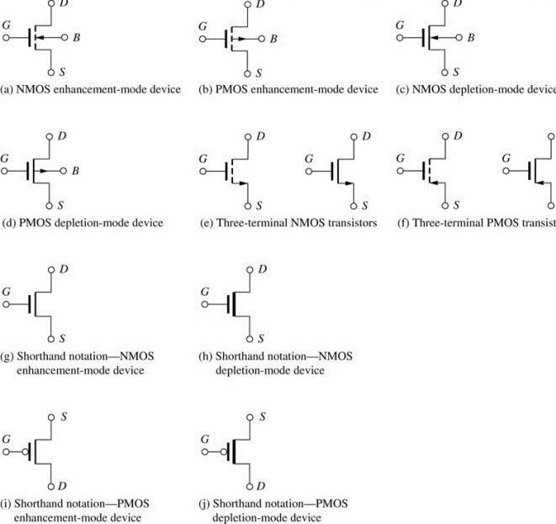
MOSFET Circuit Symbols
(g) and (i) are the most commonly used symbols in VLSI logic design.
MOS devices are symmetric.
In NMOS, n+ region at higher voltage is the drain.
In PMOS p+ region at lower voltage is the drain
6/3/2015
8

Slide 9




The NMOS Transistor Cross Section
n areas have been doped with donor ions (arsenic) of concentration N_{D} - electrons are the majority carriers
Gate oxide
Polysilicon Gate
W
Source
Drain
Field-Oxide
(SiO₂)
n+
L
p substrate
n+
p+ stopper
Bulk (Body)
p areas have been doped with acceptor ions (boron) of concentration N_{A} - holes are the
6/3/2015
majority carriers
11

Slide 10
Carriers and Current
Carriers always flow from the Source to Drain
NMOS: Free electrons move from Source to Drain.
  Current direction is from Drain to Source.
PMOS: Free holes move from Source to Drain.
  Current direction is from Source to Drain.
–
6/3/2015
12

Slide 11
The MOSFET Channel
Under certain conditions, a thin channel can be formed right underneath the Silicon- Dioxide insulating layer, electrically connecting the Drain to the Source. The depth of the channel (and hence its resistance) can be controlled by the Gate’s voltage. The length of the channel (shown in the figures above as L) and the channel’s width W, are important design parameters.
6/3/2015
14

Slide 12
REGION OF OPERATION
CASE-1 (No Gate Voltage)
Two diodes back to back exist in series.
One diode is formed by the pn junction between the n+ drain region and the p-type substrate
Second is formed by the pn junction between the n+ source region and the p-type substrate
These diodes prevent any flow of the current.
There exist a very high resistance.
6/3/2015
15

Slide 13
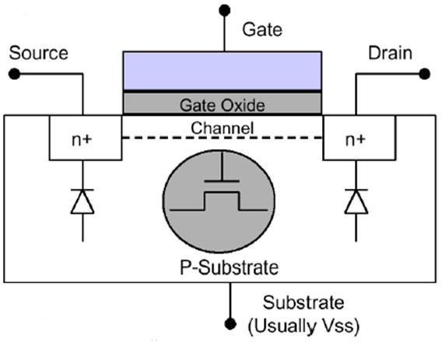
NMos Cut View
6/3/2015
16

Slide 14
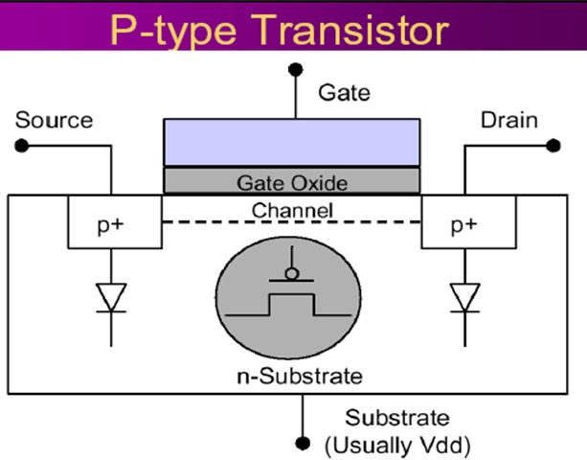
6/3/2015
17

Slide 15
REGION OF OPERATION
Creating a channel
Apply some positive voltage on the gate terminal.
This positive voltage pushes the holes downward in the substrate region.
This causes the electrons to accumulate under the gate terminal.
At the same time the positive voltage on the gate also attracts the electrons from the n+ region to accumulate under the gate terminal.
6/3/2015
18

Slide 16
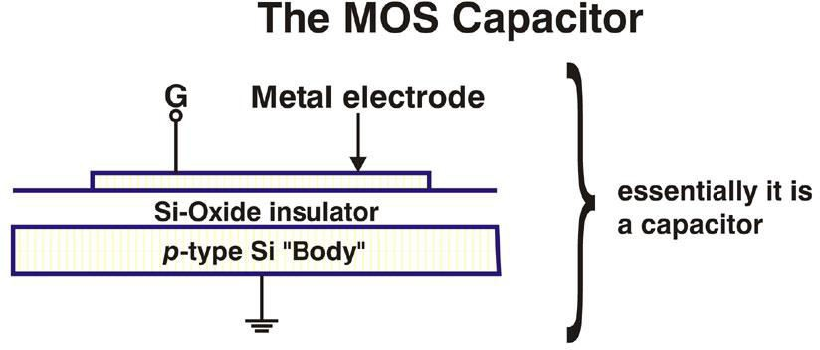
6/3/2015
19

Slide 17
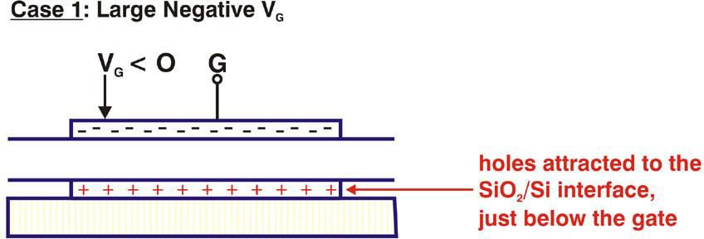
6/3/2015
20

Slide 18
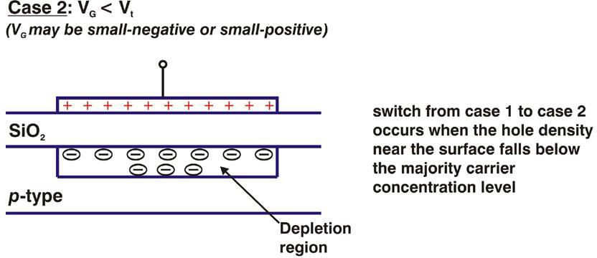
6/3/2015
21

Slide 19
REGION OF OPERATION
Creating a channel
When sufficient electrons are accumulated under the gate an n-region is created, connecting the drain and the source
This causes the current to flow from the drain to source
The channel is formed by inverting the substrate surface from p to n, thus induced channel is also called as the inversion layer.
The voltage between gate and source called vgs at which there are sufficient electron under the gate to form a conducting channel is called threshold voltage Vth.
6/3/2015
22

Slide 20
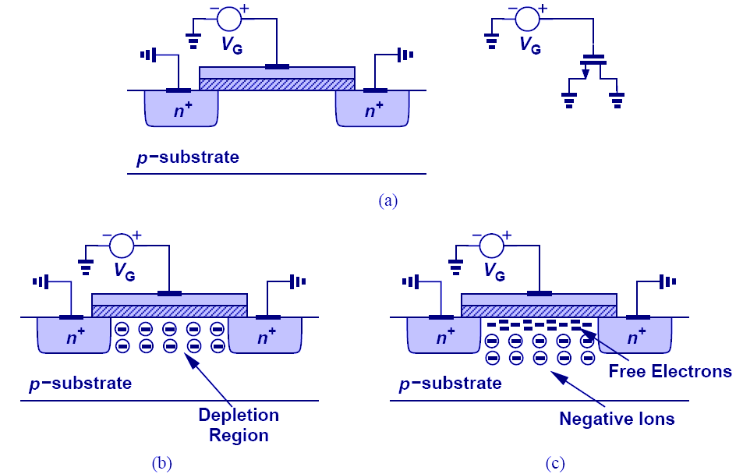
Formation of Channel
Fi re p le n fo re ele to
creating a channel
(“inversion layer”).
rst, the holes are
pelled by the ositive gate voltage, aving behind egative ions and rming a depletion gion. Next,
ctrons are attracted
the interface,
6/3/2015
23

Slide 21
MOS Transistor Current direction
The source terminal of an n-channel(p-channel) transistor is defined as whichever of the two terminals has a lower(higher) voltage.
When a transistor is turned ON, current flows from the drain to source in an n-channel device and from source to drain in a p-channel transistor.
In both cases, the actual carriers travel from the source to drain.
The current directions are different because n-channel carriers are negative, whereas p-channel carriers are positive.
6/3/2015
24

Slide 22
MOS I/V
For a NMOS, a necessary
condition for the channel to exist is:
≥ V_{TH}
^{V}GS
6/3/2015
25

Slide 23
REGION OF OPERATION
Applying small Vds
Now we applying some small voltage between source and drain
The voltage Vds causes a current to flow from drain to gate.
Now as we increase the gate voltage, more current will flow.
Increasing the gate voltage above the threshold voltage enhances the channel, hence this mode is called as enhancement mode operation.
6/3/2015
26

Slide 24
Operation – nMOS Transistor
Accumulation Mode - If Vgs < 0, then an electric field is established across the substrate.
Depletion Mode -If 0<Vgs< Vtn, the region under gate will be depleted of charges.
Inversion Mode – If Vgs > Vtn, the region below the gate will be inverted.
6/3/2015
27

Slide 25
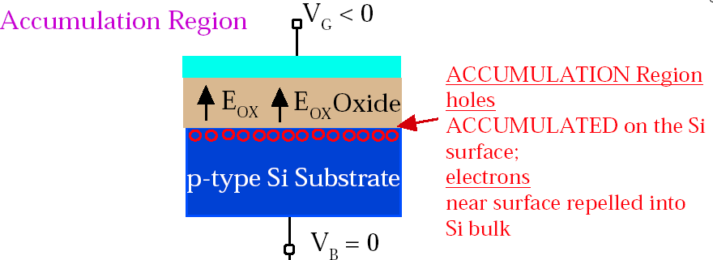
Operation – nMOS Transistor
6/3/2015
28

Slide 26
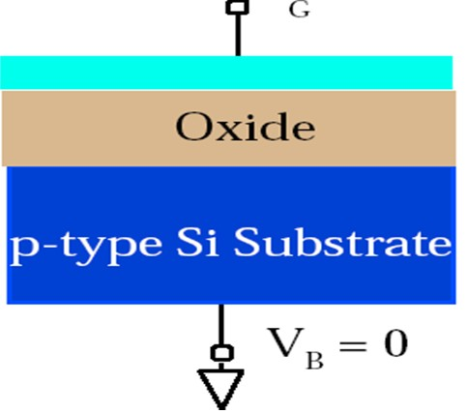
Operation – nMOS Transistor
V =0
6/3/2015
29

Slide 27
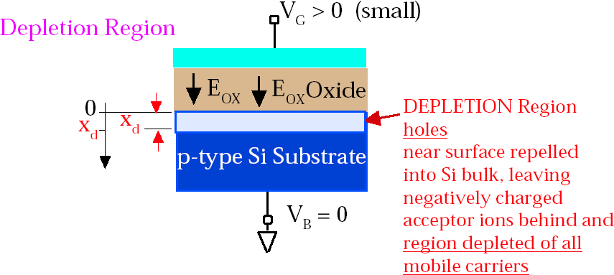
Operation – nMOS Transistor
6/3/2015
30

Slide 28
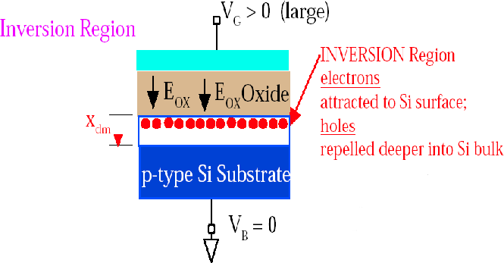
Operation – nMOS Transistor
6/3/2015
31

Slide 29
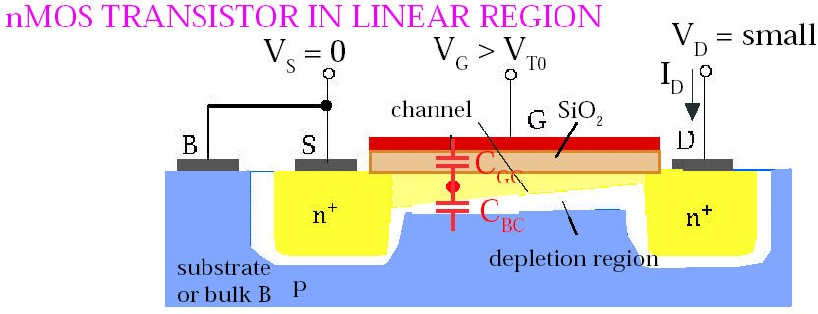
Operation – nMOS Transistor
6/3/2015
32

Slide 30
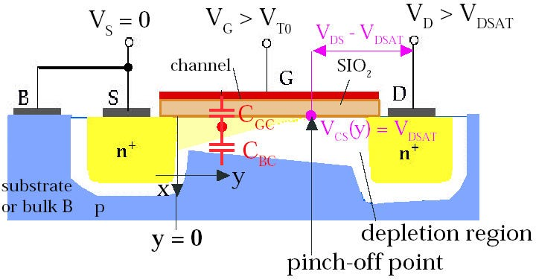
Operation – nMOS Transistor
6/3/2015
33

Slide 31
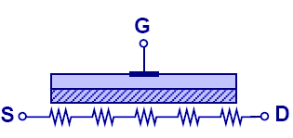
Voltage-Dependent Resistor
The invers of a MOS seen as a
Since the density in
channel depends on the gate voltage, this resistance is also voltage-dependent.
ion channel
FET can be resistor.
charge side the
6/3/2015
34

Slide 32
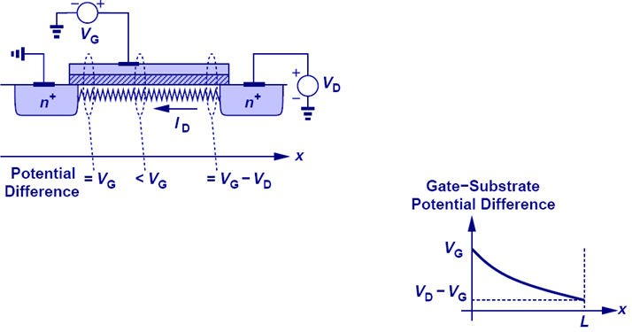
Channel Potential Variation
“ince cha bet sourc biase the s pote
gate and channel will decrease from source to drain.
there’s a
nnel resistance ween drain and
e, and if drain is
d higher than ource, then the ntial between
6/3/2015
35

Slide 33
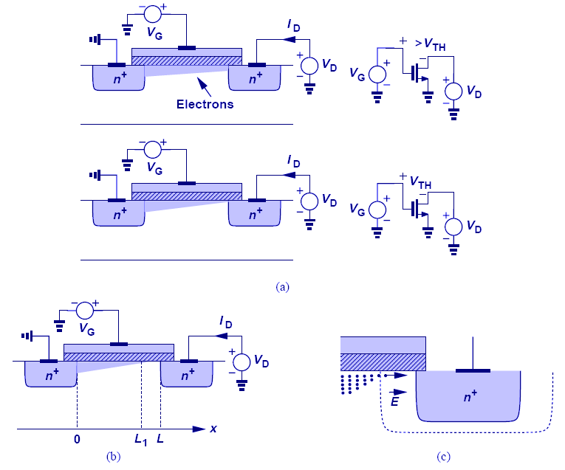
Channel Pinch-Off
As the poten difference b and gate bec positive, the layer beneat interface sta off around d
When VD s> the channel totally pinch
when VD s< VGs - Vth, the channel length starts to decrease.
tial
etween drain omes more inversion
h the
rts to pinch rain.
VGs - Vth, at drain es off, and
6/3/2015
36

Slide 34
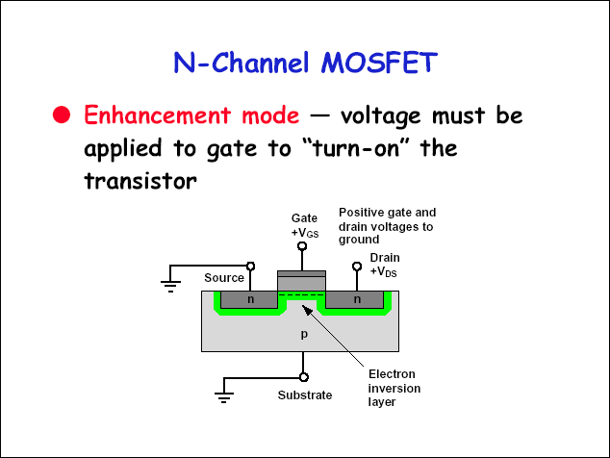
6/3/2015
37

Slide 35
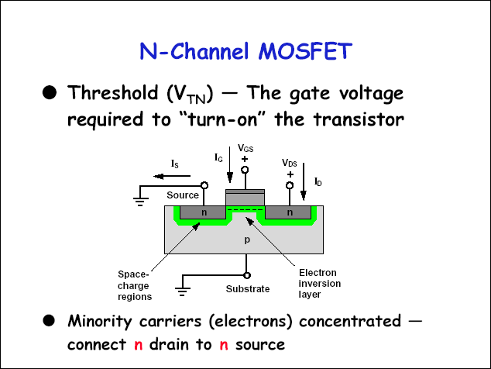
6/3/2015
38

Slide 36
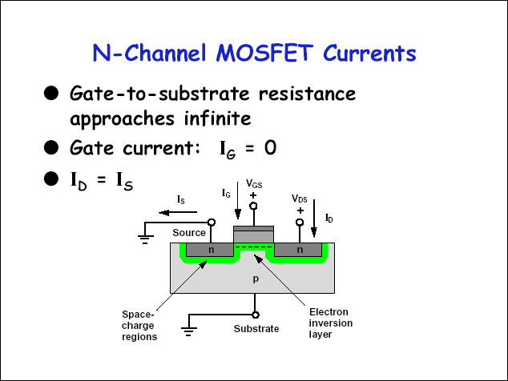
6/3/2015
39

Slide 37








Transistor in Saturation Mode
Assuming V_{GS} > V_{T}
V_{DS} > V_{GS} - V_{T}
^{V}GS
S
G
^{V}DS
D
I_{D}
n+
-
+
n+
V_{GS} - V_{T}
Pinch-off
B
The current remains constant (saturates).
6/3/2015
40

Slide 38
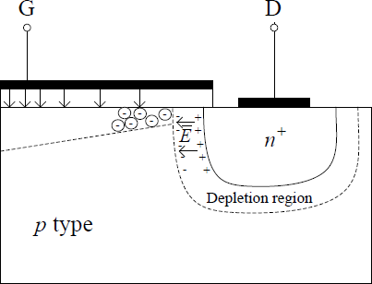
During “pinchoff”
Does this mean that the current i =0 ? Actually, it does not. A MOSFET
that is “pinched off” at the drain end of the channel still conducts current:
The large E in the depletion region surrounding the drain will sweep electrons across the end of the pinched off channel to the drain.
This is very similar to the operation of the BJT. For an npn BJT, the electric field of the reversed biased CBJ swept electrons from the base to the collector regions.
6/3/2015
41

Slide 39
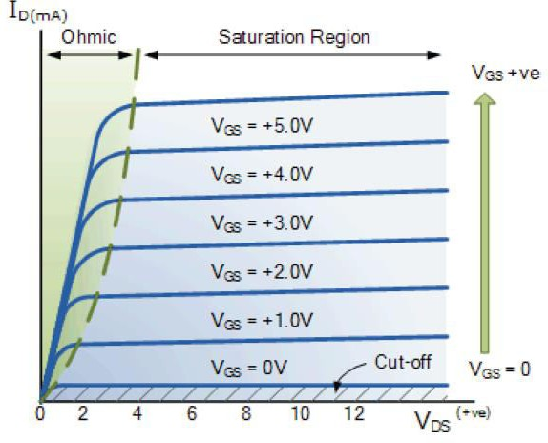
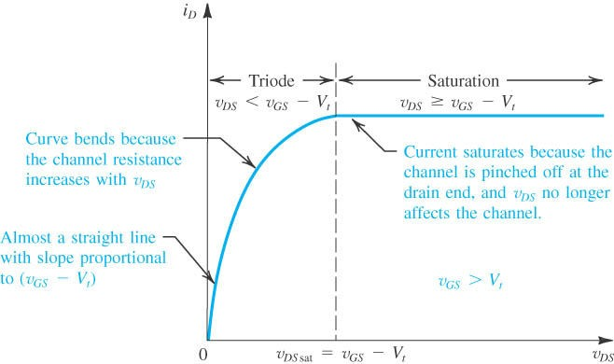
N-Channel MOSFET characteristics
6/3/2015
42

Slide 40
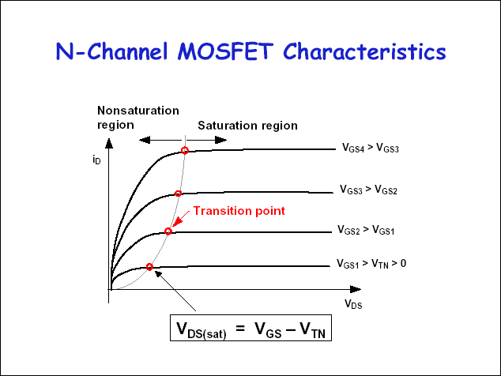
6/3/2015
43

Slide 41
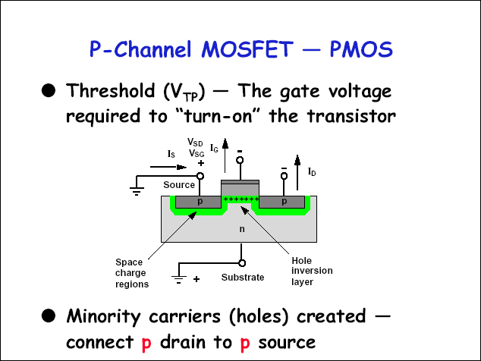
6/3/2015
44

Slide 42
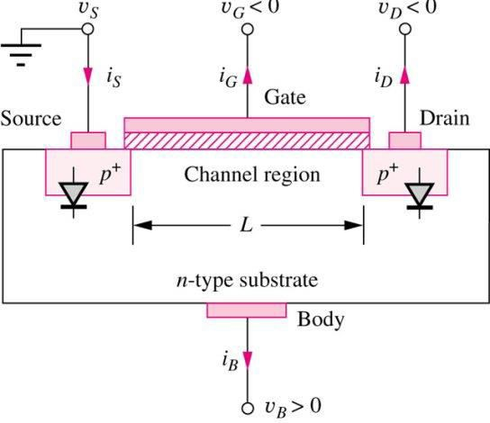
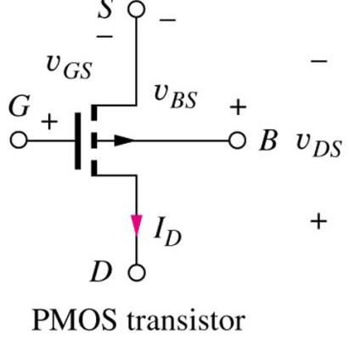
Enhancement-Mode PMOS Transistors: Structure
p-type source and drain
regions in n-type substrate.
vGS < 0 required to create p- type inversion layer in channel region
For current flow, vGS < vTP
To maintain reverse bias on source-substrate and drain- substrate junctions, vSB < 0 and vDB < 0
Positive bulk-source potential causes VTP to become more negative
6/3/2015
45

Slide 43
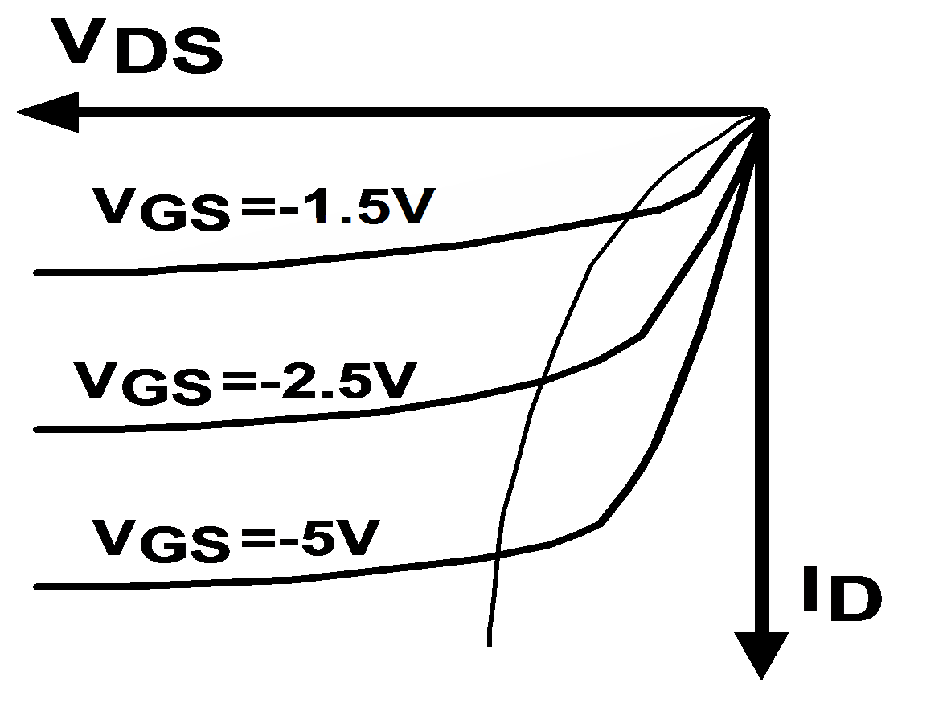
P-channel MOSFET characteristics
saturation
linear
p transistor
6/3/2015
46

Slide 44
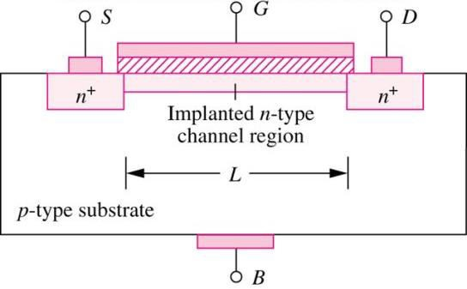
Depletion-Mode MOSFETS
NMOS transistors with
Ion implantation process is used to form a built-in n-type channel in the device to connect source and drain by a resistive channel
Non-zero drain current for vGS = 0; negative vGS required to turn device off.
V_{TN} ≤ 0
6/3/2015
47

Slide 45
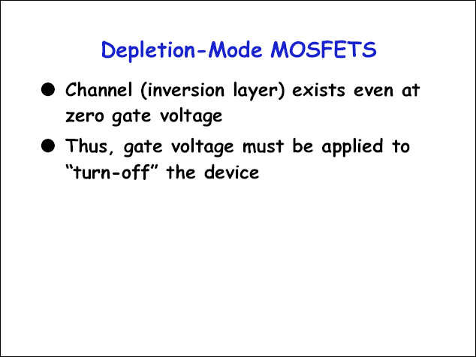
6/3/2015
48

Slide 46
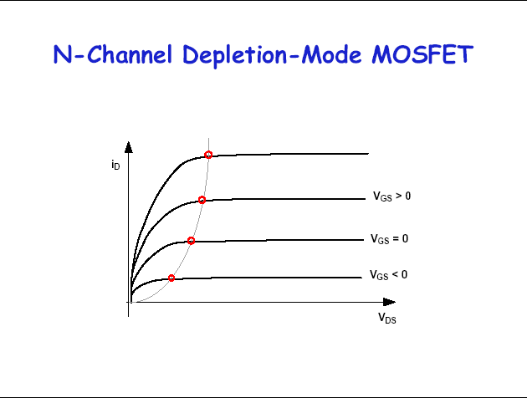
6/3/2015
49

Slide 47
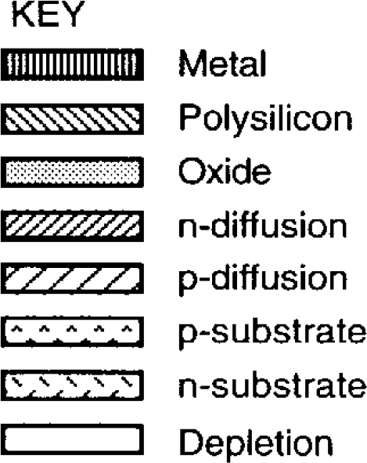
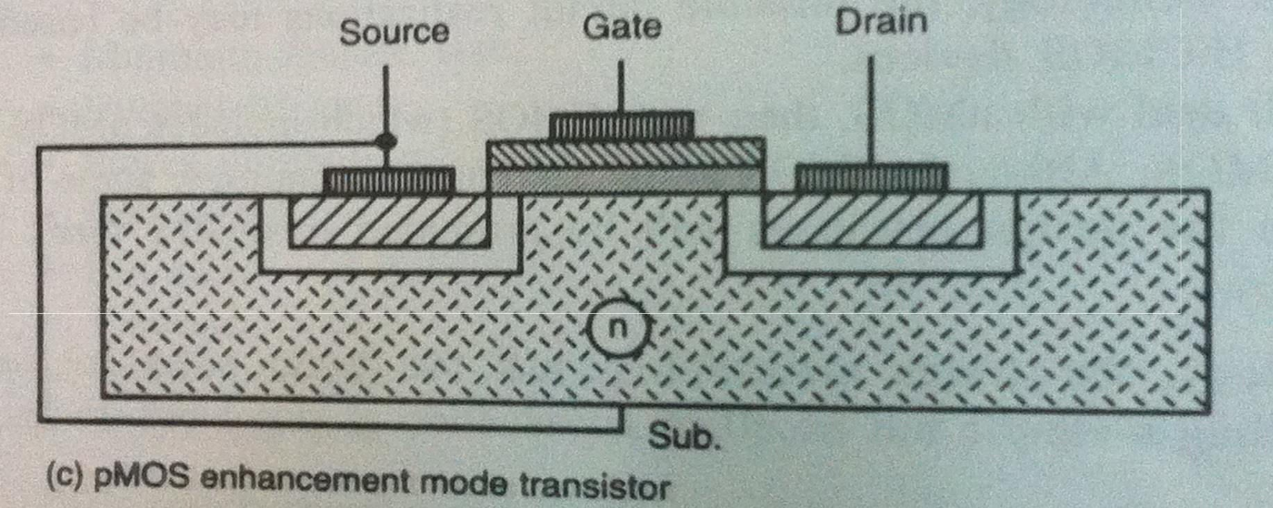
pMOS are 2.5 time slower than nMOS due to electron and hole mobilities
6/3/2015
50

Slide 48
nMOS fabrication steps
Processing is carried out on a thin wafer cut from a single crystal of silicon of high purity into which the required p-impurities are introduced as the crystal is grown.
A layer of silicon dioxide (Si02) is grown all over the surface of the wafer to protect the surface, act as a barrier to dopants during processing, and provide a generally insulating substrate on to which other layers may be deposited and patterned.
The surface is now covered with a photoresist which is deposited onto the wafer and spun to achieve an even distribution of the required thickness.
The photoresist layer is then exposed to ultraviolet light through a mask which defines those regions into which diffusion is to take place together with transistor channels.
These areas are subsequently readily etched away together with the underlying silicon dioxide so that the wafer surface is exposed in the window defined by the mask.
The remaining photoresist is removed and a thin layer of Si02 is grown over the entire chip surface and then polysilicon is deposited on top of this to form the gate structure.
Further photoresist coating and masking allows the polysilicon to be patterned (as shown in Step 6) and then the thin oxide is removed to expose areas into which
Thick oxide (Si02) is grown over all again and is then masked with photoresist and etched to expose selected areas of the polysilicon gate and the drain and source areas where connections (i.e. contact cuts) are to be made.
The whole chip then has metal (aluminium) deposited over its surface. This metal layer is then masked and etched to form the required interconnection pattern.
61

Slide 49
p
1.
Substrate
………………………………………
2.
Thick oxide (1μm)
p
3.
………………………………………
Photoresist
………………………………………
p
62

Slide 50
…………………………………………
UV light
Mask
……………………………………
4.
p
5.
…………………………………………………………
……………………
Window in oxide
p
63

Slide 51
……………………………………………………………………………
……… …………
…………………………………………
6.
Patterned Poly. (1-2 μm)
On thin oxide
( 800-1000A⁰ )
p
7.
n⁺ diffusion (1 μm deep)
………
……………………
…………
…………
……
……
…………
p
64

Slide 52
8.
……………………
…
…
……………………
…………
…….…………
…
…
…………
Contact holes (cuts)
………………
……
……………………
…………………………………………
…………
…………
…………
p
9.
……………………
…
…
……………………
Patterned Metallization (aluminum
1 μm)
…………
…….…………
…
…
…………
………………
……
…………
…………………………………………
…………
…………
…………
…………
p
65

Slide 53
CMOS FABRICATION
There are a number of approaches to CMOS fabrication, including the p-well, the n-well, the twin-tub, and the silicon-on-insulator processes.
66

Slide 54
The p-well Process
In primitive terms, the structure consists of an n- type substrate in which p-devices may
be formed by suitable masking and diffusion and, in order to accommodate n-type devices,
a deep p-well is diffused into the n-type substrate as shown.
67

Slide 55
The p-well CMOS fabrication
In all other respects-masking, patterning, and diffusion-the process is similar to
nMOS fabrication. In summary, typical processing steps are:
Mask 1 - defines the areas in which the deep p-well diffusions are to take place.
Mask 2 - defines the thinox regions, namely those areas where the thick oxide is to be stripped and thin oxide grown to accommodate p- and n-transistors and wires.
Mask 3 - used to pattern the polysilicon layer which is deposited after the thin
oxide.
Mask 4 - A p-plus mask is now used (to be in effect "Anded" with Mask 2) to define all areas where p-diffusion is to take place.
Mask 5 - This is usually performed using the negative form of the p-plus mask and defines those areas where n-type diffusion is to take place.
Mask 6 - Contact cuts are now defined.
Mask 7 - The metal layer pattern is defined by this mask.
Mask 8 - An overall passivation (overglass) layer is now applied and Mask 8 ts needed to define the openings for access to bonding pads.
68

Slide 56
………………………………………
SiO₂
…
1.
p-well (4-5 μm)
p
n
Polysilicon
…
……
…
2.
Thin oxide and polysilicon
p
n
69

Slide 57
p-diffusion
P⁺ mask (positive)
…
……
…
3.
p
n
P⁺ mask (negative)
n-diffusion
…
……
…
4.
p
n
70

Slide 58



Polysilicon Oxide
n-diffusion P-diffusion
^{V}in
^{V}out
^{V}DD
^{V}SS
p
n
CMOS p-well inverter showing V_{DD} and V_{SS} substrate connections
71

Slide 59
Polysilicon Oxide
n-diffusion P-diffusion
^{V}in
^{V}out
^{V}DD
^{V}SS
n
p
CMOS n-well inverter showing V_{DD} and V_{SS} substrate connections
72

Slide 60
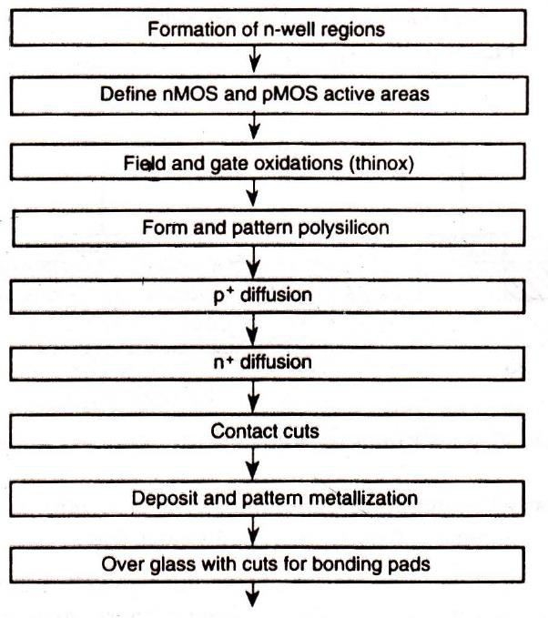
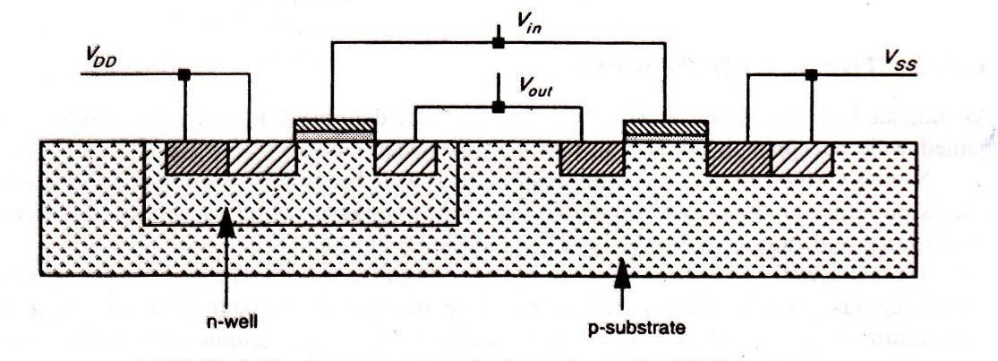
The n-well Process
As indicated earlier, although the p-well process is widely used, n-well fabrication has also gained wide acceptance, initially as a retrofit to nMOS lines.
6/3/2015
73

Slide 61
The twin-tub-Tub Process
A logical extension of the p-well and n-well approaches is the twin-tub fabrication process.
Here we start with a substrate of high resistivity n-type material and then create both .. n-well and p-well regions. Through this process it is possible to preserve the performance of n-transistors without compromising the p-transistors. Doping control is more readily achieved
and some relaxation in manufacturing tolerances results.
This is particularly important as far
as latch-up is concerned.
6/3/2015
74

Slide 62

Polysilicon Oxide
n-diffusion P-diffusion
^{V}in
^{V}out
^{V}DD
^{V}SS
Epitaxial layer
n well p well
n substrate
Twin-tub structure
( A logical extension of the p-well and n-well)
6/3/2015
75

Slide 63
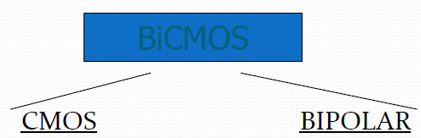
Bi-CMOS
Bipolar compatible CMOS(Bi-CMOS) technology: Introduced in early 1980s
Combines Bipolar and CMOS logic
Low power dissipation High packing density
High speed
High output
drive
High Noise Margin
High transconductance
(g_{m})
High input impedance
6/3/2015
76

Slide 64
Features
The objective of the Bi-CMOS is to combine bipolar and CMOS so as to
exploit the advantages of both the technologies.
Today Bi-CMOS has become one of the dominant technologies used for high speed, low power and highly functional VLSI circuits.
The process step required for both CMOS and bipolar are almost similar The primary approach to realize high performance Bi-CMOS devices is the
addition of bipolar process steps to a baseline CMOS process.
The Bi-CMOS gates could be used as an effective way of speeding up the VLSI circuits.
The applications of Bi-CMOS are vast.
Advantages of bipolar and CMOS circuits can be retained in Bi-CMOS chips.
B₆i-_{/3}C_{/20}M₁₅OS technology enables high performance integrated circuits IC’s b₇₇ut
increases process complexity.

Slide 65
Characteristics of Bipolar Technology
Higher switching speed
Higher current drive per unit area, higher gain
Generally better noise performance and better high frequency characteristics
Improved I/O speed (particularly significant with the growing importance
of package limitations in high speed systems).
high power dissipation
lower input impedance (high drive current)
low packing density
low delay sensitivity to load
It^{6/3}is^{/20}e¹⁵ssentially unidirectional.
78

Slide 66
Characteristics of CMOS
Lower static power dissipation
Higher noise margins Higher packing density
High yield with large integrated complex functions High input impedance (low drive current)
Scalable threshold voltage High delay load sensitivity
Low output drive current (issue when driving large capacitive loads) Bi-directional capability (drain & source are interchangeable)
A near ideal switching device, Low gain
6/3/2015
79

Slide 67
Bi-CMOS FABRICATION PROCESS
CMOS process process
1 . N-well
step)
PMOS source and drain
NMOS source and drain
BI-POLAR
n+ sub-collector
P base doping(extra
p+ base contact
n+ emitter
6/3/2015
80

