Slide 1
UNIT-5
Multirate signal processing &
Finite Word length Effects

Slide 2
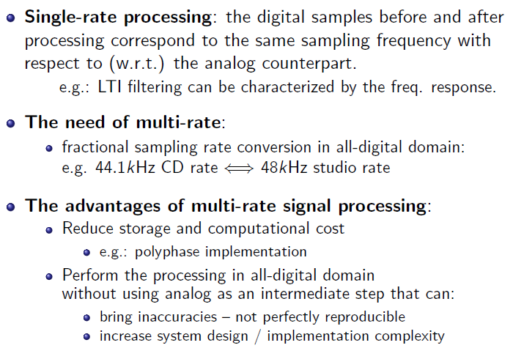
Single vs Multirate Processing

Slide 3
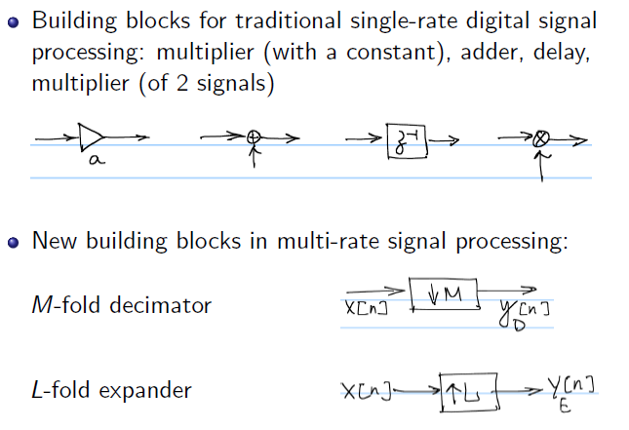
Basic Multirate operations: Decimation and Interpolation

Slide 4
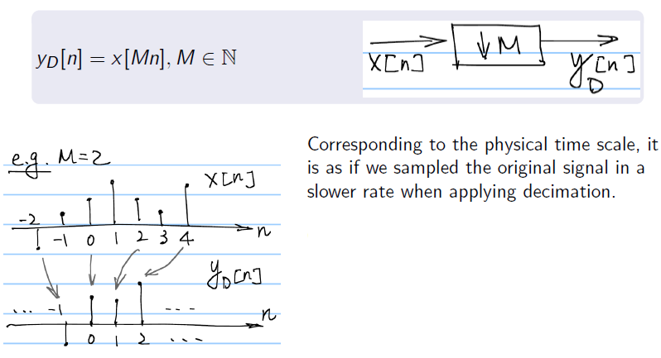
M-fold Decimator

Slide 5
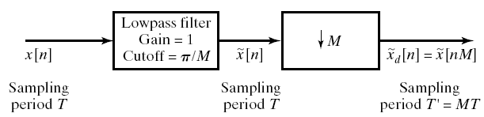
Sampling Rate Reduction by an Integer Factor: Downsampling
We reduce the sampling rate of a sequence by “sampling” it
This is accomplished with a sampling rate compressor
We obtain x_{d}[n] that is identical to what we would get by reconstructing the signal and resampling it with T’=MT
There will be no aliasing if

Slide 6
Frequency Domain Representation of Downsampling
Recall the DTFT of x[n]=x_{c}(nT)
The DTFT of the downsampled signal can similarly written as
Let’s represent the summation index as
And finally

Slide 7
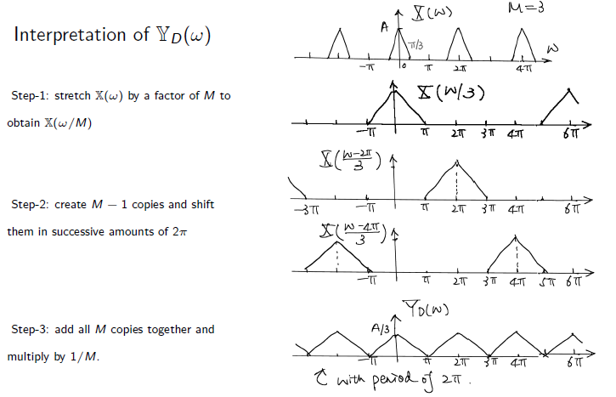
Frequency Domain Representation of Downsampling

Slide 8
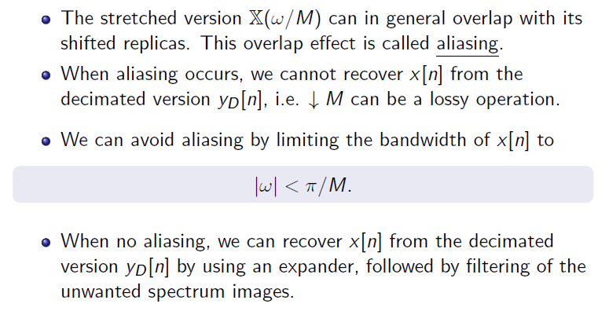
Aliasing

Slide 9
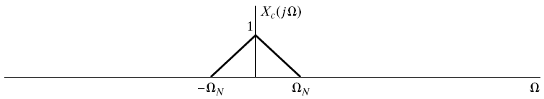
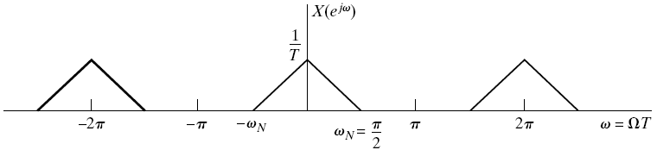
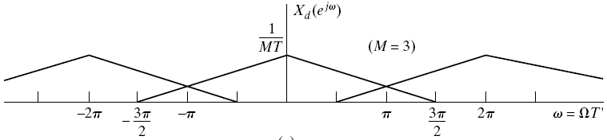
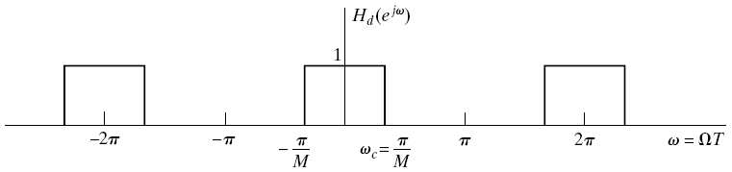
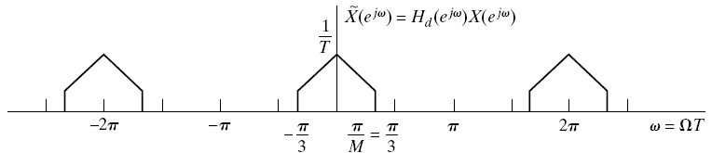
Frequency Domain Representation of Downsampling w/ Prefilter

Slide 10
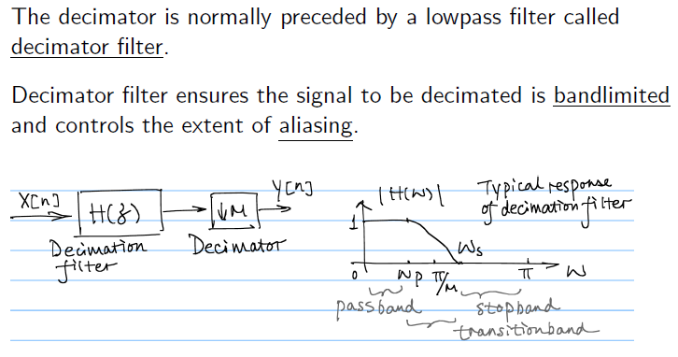
Decimation filter

Slide 11
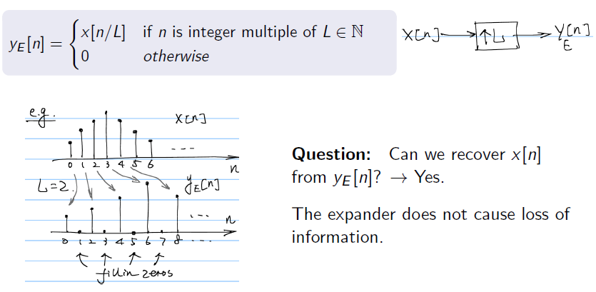
L-fold Interpolator

Slide 12
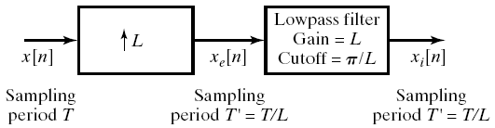
Increasing the Sampling Rate by an Integer Factor: Upsampling
We increase the sampling rate of a sequence interpolating it
This is accomplished with a sampling rate expander
We obtain x_{i}[n] that is identical to what we would get by reconstructing the signal and resampling it with T’=T/L
Upsampling consists of two steps
  Expanding
  Interpolating

Slide 13
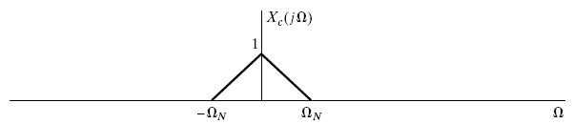
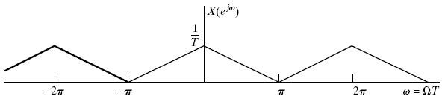
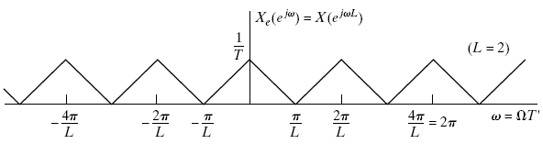
Frequency Domain Representation of Expander
The DTFT of x_{e}[n] can be written as
The output of the expander is frequency-scaled

Slide 14
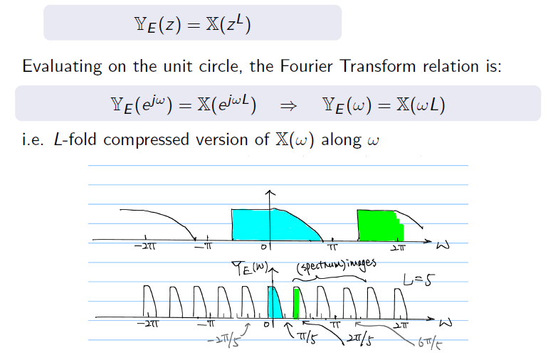
Input-output relation on the Spectrum

Slide 15
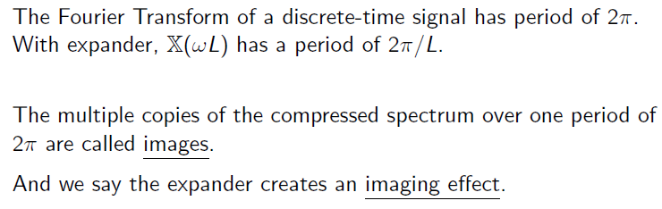
Periodicity and spectrum images

Slide 16
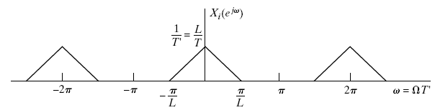
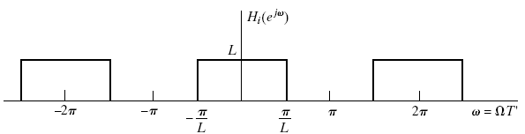
Frequency Domain Representation of Interpolator
The DTFT of the desired interpolated signals is
The extrapolator output is given as
To get interpolated signal we apply the following LPF

Slide 17
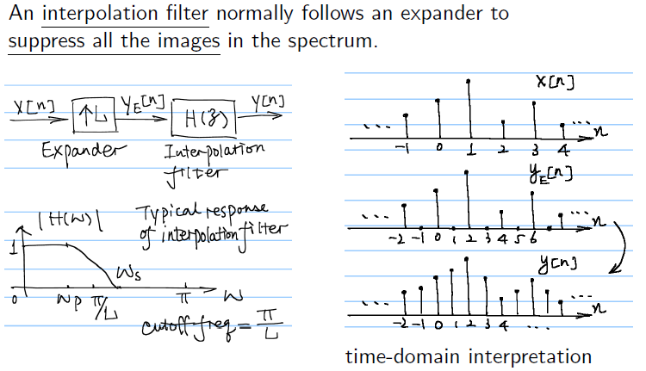
Interpolation filters

Slide 18
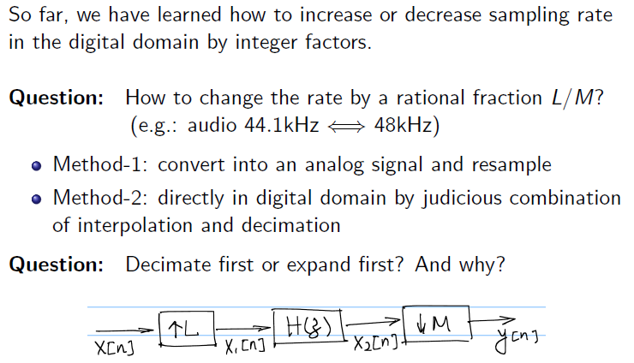
Fractional sampling rate convertor

Slide 19
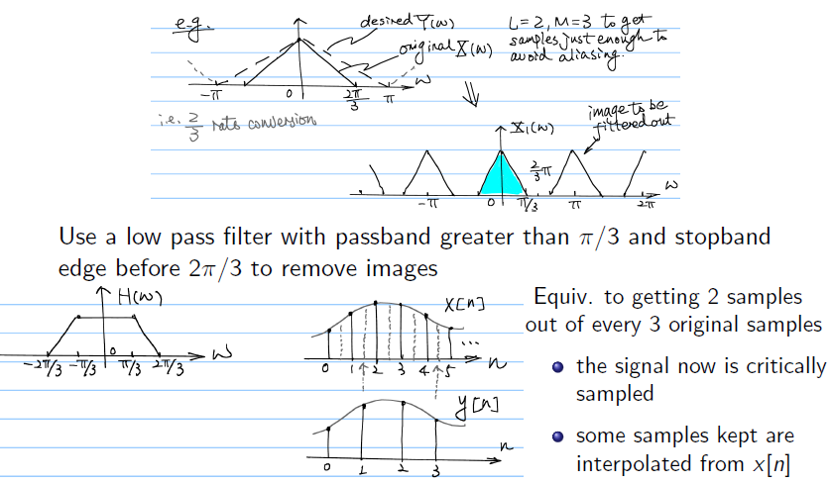
Fractional sampling rate convertor

Slide 20
Changing the Sampling Rate by Non-Integer Factor
Combine decimation and interpolation for non-integer factors
The two low-pass filters can be combined into a single one
Interpolator Decimator
Lowpass filter
Gain = L
Cutoff = p/L
Lowpass filter
Gain = 1
Cutoff = p/M
x[n]
L
x_{e}[n]
x_{i}[n]
x_{o}[n]
M
x_{d}[n]
T T/L T/L T/L TM/L
Lowpass filter
Gain = L
Cutoff =
min(p/L, p/M)
x[n]
L
x_{e}[n]
x_{o}[n]
M
x_{d}[n]
T T/L T/L TM/L

Slide 21
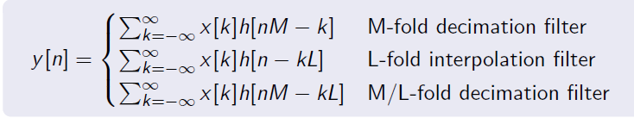
Time Domain
x_{i}[n] in a low-pass filtered version of x[n]
The low-pass filter impulse response is
Hence the interpolated signal is written as
Note that
Therefore the filter output can be written as

Slide 22
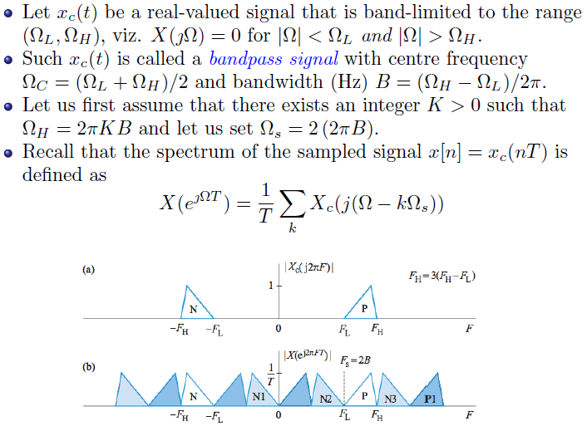
Sampling of bandpass signals

Slide 23
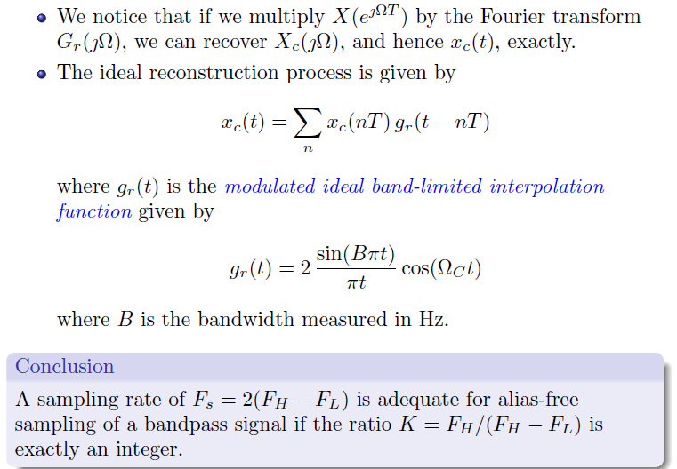
Sampling of bandpass signals

Slide 24
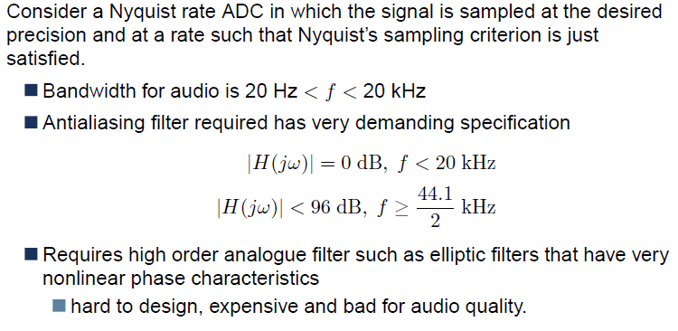
Over sampling -ADC

Slide 25
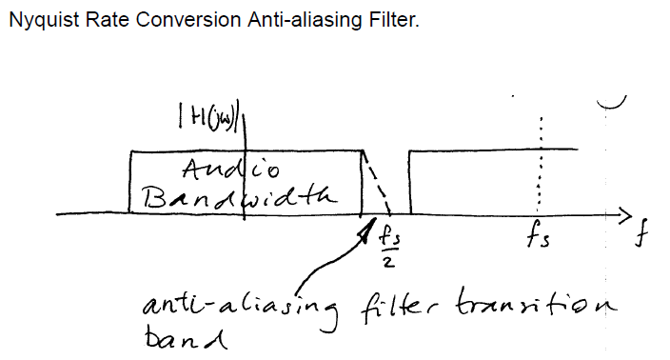
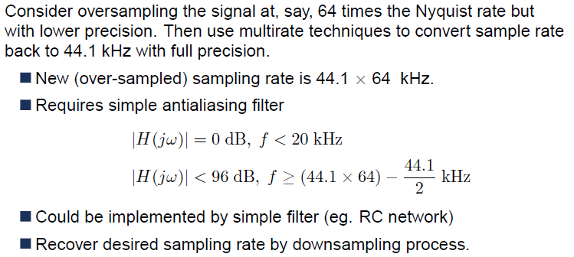

Slide 26
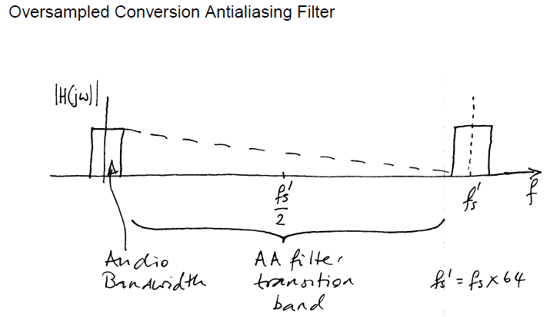

Slide 27
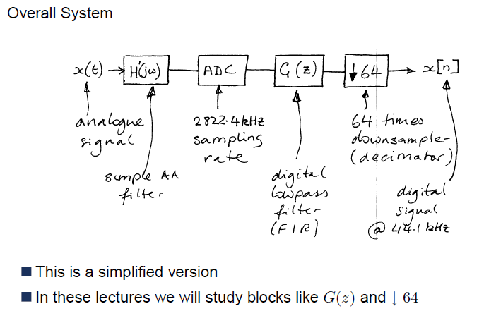

Slide 28
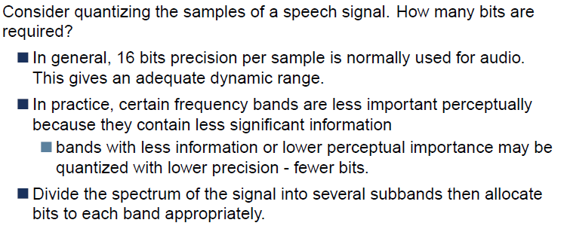
Sub band coding

Slide 29
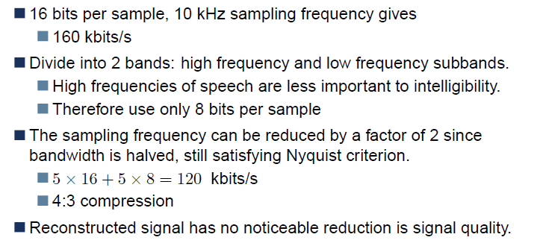
Sub band coding

Slide 30
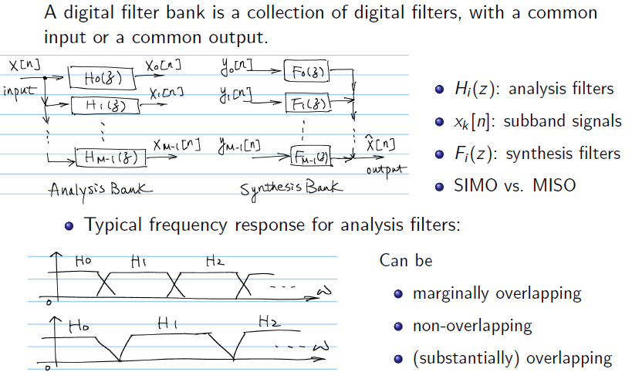
Digital filter banks

Slide 31
Finite Word length Effects

Slide 32
Finite Wordlength Effects
Finite register lengths and A/D converters cause errors in:-
(i) Input quantisation.
(ii) Coefficient (or multiplier) quantisation
(iii) Products of multiplication truncated or rounded due to machine length

Slide 33
Finite Wordlength Effects
Quantisation
Output
Q
Input

Slide 34
Finite Wordlength Effects
The pdf for e using rounding
Noise power
  or

Slide 35
Finite Wordlength Effects
Let input signal be sinusoidal of unity amplitude. Then total signal power
If b bits used for binary then
so that
Hence
or dB

Slide 36
Finite Wordlength Effects
Consider a simple example of finite precision on the coefficients a,b of second order system with poles
where

Slide 37
Finite Wordlength Effects
bit pattern
000 | 0 | 0
001 | 0.125 | 0.354
010 | 0.25 | 0.5
011 | 0.375 | 0.611
100 | 0.5 | 0.707
101 | 0.625 | 0.791
110 | 0.75 | 0.866
111 | 0.875 | 0.935
1.0 | 1.0 | 1.0

Slide 38
Finite Wordlength Effects
Finite wordlength computations
+
INPUT
OUTPUT
+
+

Slide 39
Limit-cycles; "Effective Pole"
Model; Deadband
Observe that for
instability occurs when
i.e. poles are
    (i) either on unit circle when complex
    (ii) or one real pole is outside unit circle.
Instability under the "effective pole" model is considered as follows

Slide 40
Finite Wordlength Effects
In the time domain with
With for instability we have
indistinguishable from
Where is quantisation

Slide 41
Finite Wordlength Effects
With rounding, therefore we have
are indistinguishable (for integers)
or
Hence
With both positive and negative numbers

Slide 42
Finite Wordlength Effects
The range of integers
constitutes a set of integers that cannot be individually distinguished as separate or from the asymptotic system behaviour.
The band of integers
is known as the "deadband".
In the second order system, under rounding, the output assumes a cyclic set of values of the deadband. This is a limit-cycle.

Slide 43
Finite Wordlength Effects
Consider the transfer function
if poles are complex then impulse response is given by

Slide 44
Finite Wordlength Effects
Where
If then the response is sinusiodal with frequency
Thus product quantisation causes instability implying an "effective “ .

Slide 45
Finite Wordlength Effects
Notice that with infinite precision the response converges to the origin
With finite precision the reponse does not converge to the origin but assumes cyclically a set of values –the Limit Cycle

Slide 46
Finite Wordlength Effects
Assume , ….. are not correlated, random processes etc.
Hence total output noise power
Where and

Slide 47
Finite Wordlength Effects
ie

Slide 48
Finite Wordlength Effects
For FFT
A(n)
B(n+1)
B(n)
B(n+1)
-
W(n)
A(n)
A(n+1)
B(n+1)
B(n)
B(n)W(n)

Slide 49
Finite Wordlength Effects
FFT
AVERAGE GROWTH: 1/2 BIT/PASS

Slide 50
Finite Wordlength Effects
IMAG
1.0
FFT
PEAK GROWTH: 1.21.. BITS/PASS
-1.0
1.0
REAL
-1.0

Slide 51
Finite Wordlength Effects
Linear modelling of product quantisation
Modelled as
x(n)
x(n)
+
q(n)

Slide 52
Finite Wordlength Effects
For rounding operations q(n) is uniform distributed between , and where Q is the quantisation step (i.e. in a wordlength of bits with sign magnitude representation or mod 2, ).
A discrete-time system with quantisation at the output of each multiplier may be considered as a multi-input linear system

Slide 53
Finite Wordlength Effects
Then
where is the impulse response of the system from the output of the multiplier to y(n).
h(n)

Slide 54
Finite Wordlength Effects
For zero input i.e. we can write
where is the maximum of which is not more than
ie

Slide 55
Finite Wordlength Effects
However
And hence
ie we can estimate the maximum swing at the output from the system parameters and quantisation level

Slide 56
Finite Precision Numerical Effects

Slide 57
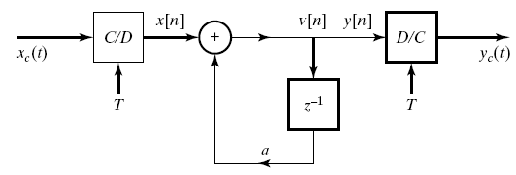
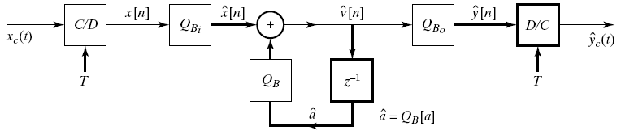
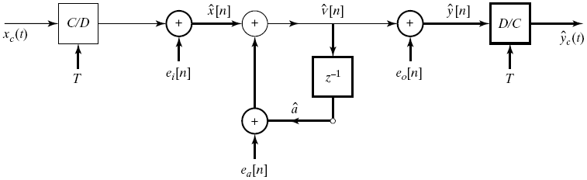
Quantization in Implementing Systems
Consider the following system
A more realistic model would be
In order to analyze it we would prefer

Slide 58
Effects of Coefficient Quantization in IIR Systems
When the parameters of a rational system are quantized
  The poles and zeros of the system function move
If the system structure of the system is sensitive to perturbation of coefficients
  The resulting system may no longer be stable
  The resulting system may no longer meet the original specs
We need to do a detailed sensitivity analysis
  Quantize the coefficients and analyze frequency response
  Compare frequency response to original response
We would like to have a general sense of the effect of quantization

Slide 59
Effects on Roots
Quantization
Each root is affected by quantization errors in ALL coefficient
Tightly clustered roots can be significantly effected
  Narrow-bandwidth lowpass or bandpass filters can be very sensitive to quantization noise
The larger the number of roots in a cluster the more sensitive it becomes
This is the reason why second order cascade structures are less sensitive to quantization error than higher order system
  Each second order system is independent from each other

Slide 60
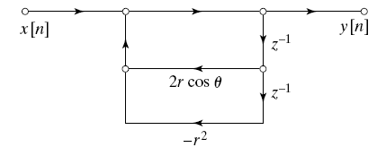
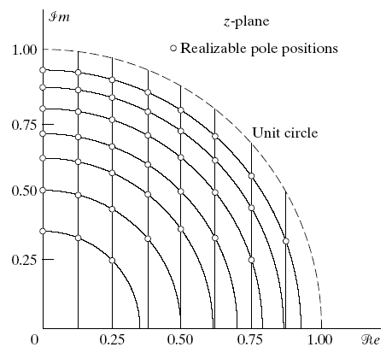
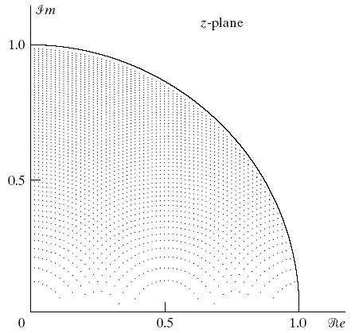
Poles of Quantized Second-Order Sections
Consider a 2nd order system with complex-conjugate pole pair
The pole locations after quantization will be on the grid point
← 3-bits
7-bits →

Slide 61
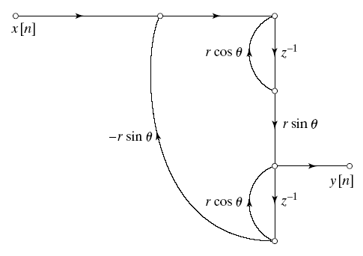
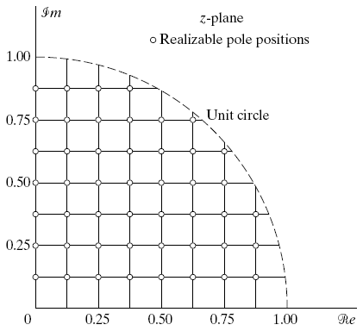
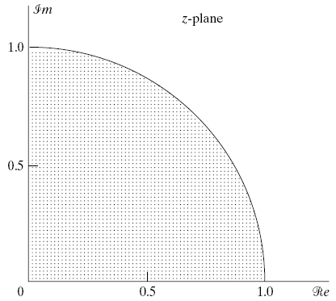
Coupled-Form Implementation of Complex-Conjugate Pair
Equivalent implementation of the second order system
But the quantization grid this time is

Slide 62
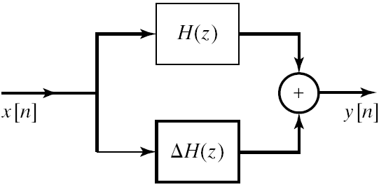
Effects of Coefficient Quantization in FIR Systems
No poles to worry about only zeros
Direct form is commonly used for FIR systems
Suppose the coefficients are quantized
Quantized system is linearly related to the quantization error
Again quantization noise is higher for clustered zeros
However, most FIR filters have spread zeros

Slide 63
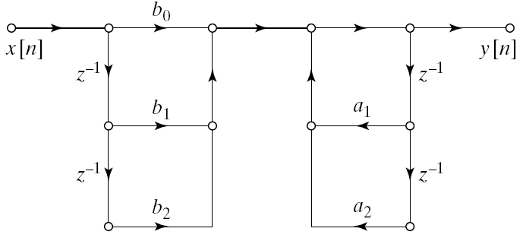
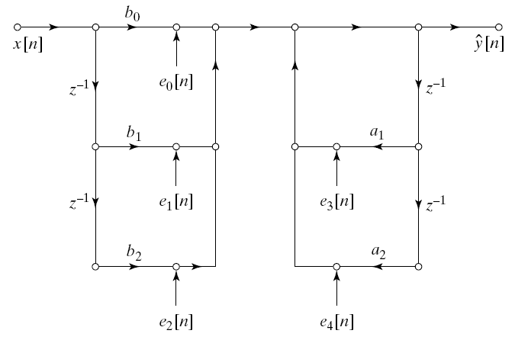
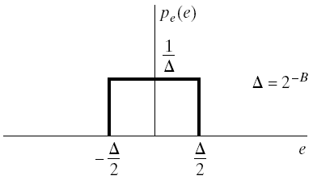
Round-Off Noise in Digital Filters
Difference equations implemented with finite-precision arithmetic are non-linear systems
Second order direct form I system
Model with quantization effect
Density function error terms for rounding

Slide 64
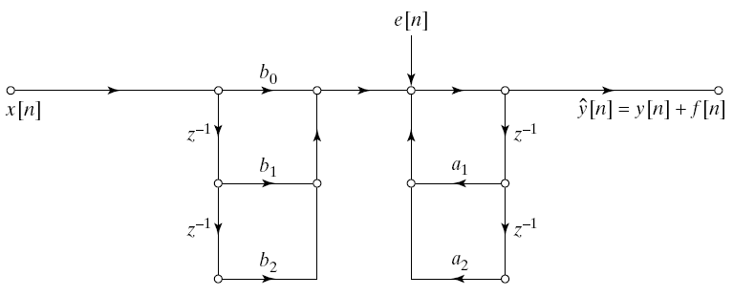
Analysis of Quantization Error
Combine all error terms to single location to get
The variance of e[n] in the general case is
The contribution of e[n] to the output is
The variance of the output error term f[n] is

Slide 65
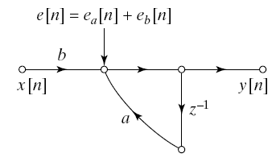
Round-Off Noise in a First-Order System
Suppose we want to implement the following stable system
The quantization error noise variance is
Noise variance increases as |a| gets closer to the unit circle
As |a| gets closer to 1 we have to use more bits to compensate for the increasing error

Slide 66


Zero-Input Limit Cycles in Fixed-Point Realization of IIR Filters
For stable IIR systems the output will decay to zero when the input becomes zero
A finite-precision implementation, however, may continue to oscillate indefinitely
Nonlinear behaviour very difficult to analyze so we sill study by example
Example: Limit Cycle Behavior in First-Order Systems
Assume x[n] and y[n-1] are implemented by 4 bit registers

Slide 67

Example Cont’d
Assume that a=1/2=0.100b and the input is
If we calculate the output for values of n
A finite input caused an oscillation with period 1
n | y[n] | Q(y[n])
0 | 7/8=0.111b | 7/8=0.111b
1 | 7/16=0.011100b | 1/2=0.100b
2 | 1/4=0.010000b | 1/4=0.010b
3 | 1/8=0.001000b | 1/8=0.001b
4 | 1/16=0.00010b | 1/8=0.001b

Slide 68
Example: Limit Cycles due to Overflow
Consider a second-order system realized by
  Where Q() represents two’s complement rounding
  Word length is chosen to be 4 bits
Assume a₁=3/4=0.110b and a₂=-3/4=1.010b
Also assume
The output at sample n=0 is
After rounding up we get
Binary carry overflows into the sign bit changing the sign
When repeated for n=1

Slide 69
Avoiding Limit Cycles
Desirable to get zero output for zero input: Avoid limit-cycles
Generally adding more bits would avoid overflow
Using double-length accumulators at addition points would decrease likelihood of limit cycles
Trade-off between limit-cycle avoidance and complexity
FIR systems cannot support zero-input limit cycles

