Slide 1
UNIT-IV
FIR & IIR FILTERS

Slide 2
IIR filters

Slide 3
Filter Design Techniques
Any discrete-time system that modifies certain frequencies
Frequency-selective filters pass only certain frequencies
Filter Design Steps
  Specification
    Problem or application specific
  Approximation of specification with a discrete-time system
    Our focus is to go from spec to discrete-time system
  Implementation
    Realization of discrete-time systems depends on target technology
We already studied the use of discrete-time systems to implement a continuous-time system
  If our specifications are given in continuous time we can use
C/D
H(e^{jω})
D/C
xc(t)
yr(t)

Slide 4
Digital Filter Specifications
Only the magnitude approximation problem
Four basic types of ideal filters with magnitude responses as shown below (Piecewise flat)

Slide 5
Digital Filter Specifications
These filters are unealisable because (one of the following is sufficient)
  their impulse responses infinitely long non-causal
  Their amplitude responses cannot be equal to a constant over a band of frequencies
  Another perspective that provides some understanding can be obtained by looking at the ideal amplitude squared.

Slide 6
Digital Filter Specifications
The realisable squared amplitude response transfer function (and its differential) is continuous in
Such functions
  if IIR can be infinite at point but around that point cannot be zero.
  if FIR cannot be infinite anywhere.
Hence previous differential of ideal response is unrealisable

Slide 7
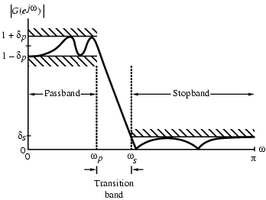
Digital Filter Specifications
For example the magnitude response of a digital lowpass filter may be given as indicated below

Slide 8
Digital Filter Specifications
In the passband we require that with a deviation
In the stopband we require that with a deviation

Slide 9
Digital Filter Specifications
Filter specification parameters
- passband edge frequency
- stopband edge frequency
- peak ripple value in the passband
- peak ripple value in the stopband

Slide 10
Digital Filter Specifications
Practical specifications are often given in terms of loss function (in dB)
Peak passband ripple
dB
Minimum stopband attenuation
dB

Slide 11
Digital Filter Specifications
In practice, passband edge frequency and stopband edge frequency are specified in Hz
For digital filter design, normalized bandedge frequencies need to be computed from specifications in Hz using

Slide 12
Digital Filter Specifications
Example - Let kHz, kHz, and kHz
Then

Slide 13
IIR Digital Filter Design
Standard approach
(1) Convert the digital filter specifications into an analogue prototype lowpass filter specifications
(2) Determine the analogue lowpass filter transfer function
(3) Transform by replacing the complex variable to the digital transfer function

Slide 14
IIR Digital Filter Design
This approach has been widely used for the following reasons:
(1) Analogue approximation techniques are highly advanced
(2) They usually yield closed-form solutions
(3) Extensive tables are available for analogue filter design
(4) Very often applications require digital simulation of analogue systems

Slide 15
IIR Digital Filter Design
Let an analogue transfer function be
where the subscript “a” indicates the analogue domain
A digital transfer function derived from this is denoted as

Slide 16
IIR Digital Filter Design
Basic idea behind the conversion of into is to apply a mapping from the s-domain to the z-domain so that essential properties of the analogue frequency response are preserved
Thus mapping function should be such that
  Imaginary ( ) axis in the s-plane be mapped onto the unit circle of the z-plane
  A stable analogue transfer function be mapped into a stable digital transfer function

Slide 17
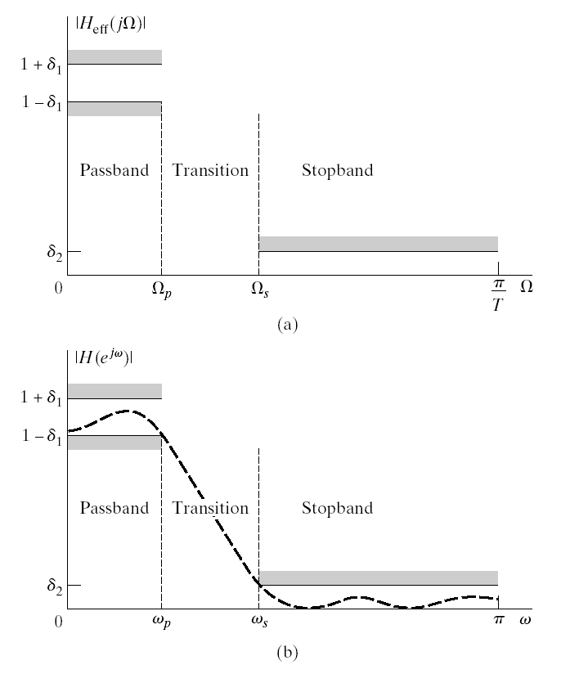
Specification for effective frequency response of a continuous-time lowpass filter and its corresponding specifications for discrete-time system.
d_{p} or d₁ passband ripple
d_{s} or d₂ stopband ripple
W_{p}, w_{p} passband edge frequency
W_{s}, w_{s} stopband edge frequency
e² passband ripple parameter
1 – d_{p} = 1/√1 + e²
BW bandwidth = w_{u} – w_{l}
w_{c} 3-dB cutoff frequency
w_{u}, w_{l} upper and lower 3-dB cutoff
frequensies
Dw transition band = |w_{p} – w_{s}|
A_{p} passband ripple in dB
= ± 20log10(1 ± d_{p})
A_{s} stopband attenuation in dB
= -20log10(d_{s})

Slide 18
Design of Discrete-Time IIR Filters
From Analog (Continuous-Time) Filters
  Approximation of Derivatives
  Impulse Invariance
  the Bilinear Transformation

Slide 19
Reasons of Design of Discrete-Time IIR Filters from Continuous-Time Filters
The art of continuous-time IIR filter design is highly advanced and, since useful results can be achieved, it is advantageous to use the design procedures already developed for continuous-time filters.
Many useful continuous-time IIR design methods have relatively simple closed-form design formulas. Therefore, discrete-time IIR filter design methods based on such standard continuous-time design formulas are rather simple to carry out.
The standard approximation methods that work well for continuous-time IIR filters do not lead to simple closed-form design formulas when these methods are applied directly to the discrete-time IIR case.

Slide 20
Characteristics of Commonly Used Analog Filters
Butterworth Filter
Chebyshev Filter
  Chebyshev Type I
  Chebyshev Type II of Inverse Chebyshev Filter

Slide 21
Butterworth Filter
Lowpass Butterworth filters are all-pole filters characterized by the magnitude-squared frequency response
|H(W)|² = 1/[1 + (W/W_{c})^{2N}] = 1/[1 + e²(W/W_{p})^{2N}]
where N is the order of the filter, W_{c} is its – 3-dB frequency (cutoff frequency), W_{p} is the bandpass edge frequency, and 1/(1 + e²) is the band-edge value of |H(W)|².
At W = W_{s} (where W_{s} is the stopband edge frequency) we have
1/[1 + e²(W_{s}/W_{p})^{2N}] = d₂²
and
N = (1/2)log₁₀[(1/d₂²) – 1]/log₁₀(W_{s}/W_{c}) = log₁₀(d/e)/log₁₀(W_{s}/W_{p})
where d₂= 1/√1 + d₂².
Thus the Butterworth filter is completely characterized by the parameters N, d₂, e, and the ratio W_{s}/W_{p}.

Slide 22
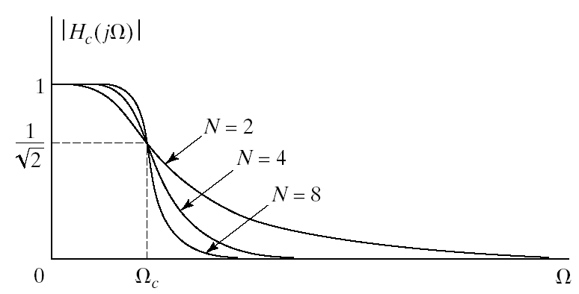
Butterworth Lowpass Filters
Passband is designed to be maximally flat
The magnitude-squared function is of the form

Slide 23
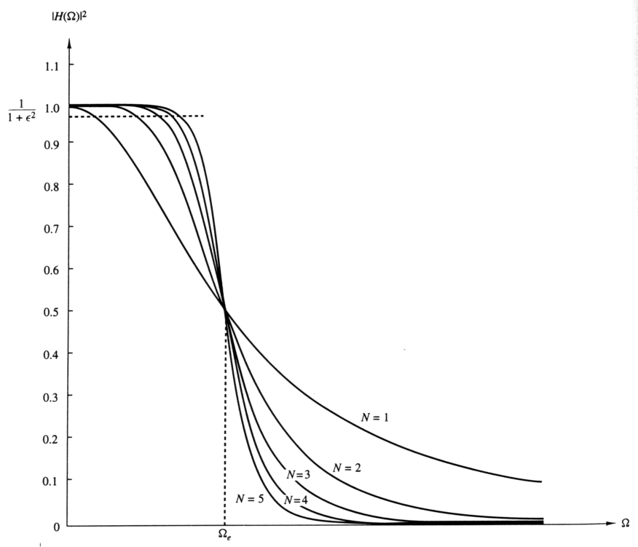
Frequency response of lowpass Butterworth filters

Slide 24
Chebyshev Filters
The magnitude squared response of the analog lowpass Type I Chebyshev filter of Nth order is given by:
|H(W)|² = 1/[1 + e²T_{N}²(W/W_{p})].
where T_{N}(W) is the Chebyshev polynomial of order N:
T_{N}(W) = cos(Ncos⁻¹ W), |W| ≤ 1,
= cosh(Ncosh⁻¹ W), |W| > 1.
The polynomial can be derived via a recurrence relation given by
T_{r}(W) = 2WT_{r-1}(W) – T_{r-2}(W), r ≥ 2,
with T₀(W) = 1 and T₁(W) = W.
The magnitude squared response of the analog lowpass Type II or inverse Chebyshev filter of Nth order is given by:
|H(W)|² = 1/[1 + e²{T_{N}(W_{s}/W_{p})/ T_{N}(W_{s}/W)}²].

Slide 25
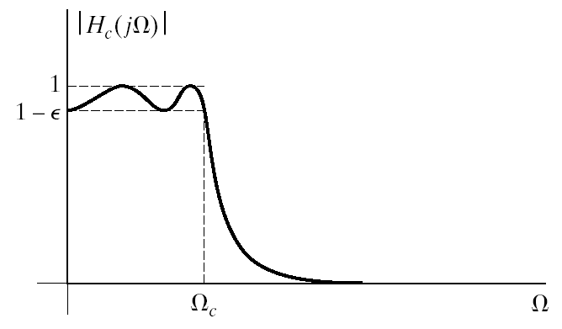
Chebyshev Filters
Equiripple in the passband and monotonic in the stopband
Or equiripple in the stopband and monotonic in the passband

Slide 26
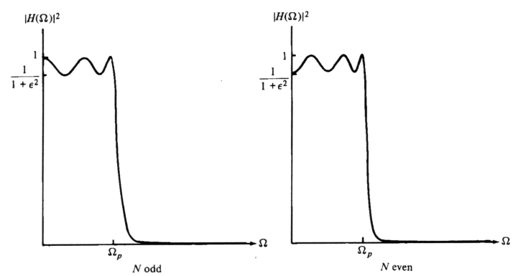
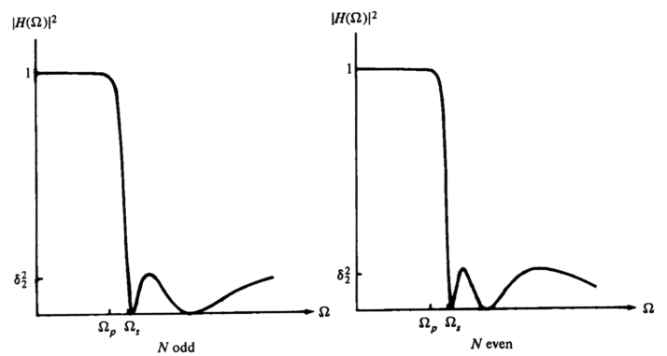
Frequency response of
lowpass Type I Chebyshev filter
|H(W)|² = 1/[1 + e²T_{N}²(W/W_{p})]
Frequency response of
lowpass Type II Chebyshev filter
|H(W)|² = 1/[1 + e²{T_{N}²(W_{s}/W_{p})/T_{N}²(W_{s}/W)}]

Slide 27
N = log₁₀[(√ 1 - d₂² + √ 1 – d₂²(1 + e²))/ed₂]/log₁₀[(W_{s}/W_{p}) + √ (W_{s}/W_{p})² – 1 ]
= [cosh⁻¹(d/e)]/[cosh⁻¹(W_{s}/W_{p})]
for both Type I and II Chebyshev filters, and where
d₂ = 1/ √ 1 + d².
The poles of a Type I Chebyshev filter lie on an ellipse in the s-plane with major axis r₁ = W_{p}{(b² + 1)/2b] and minor axis r₁ = W_{p}{(b² - 1)/2b] where b is related to e according to
b = {[√ 1 + e² + 1]/e}^{1/N}
The zeros of a Type II Chebyshev filter are located on the imaginary axis.

Slide 28
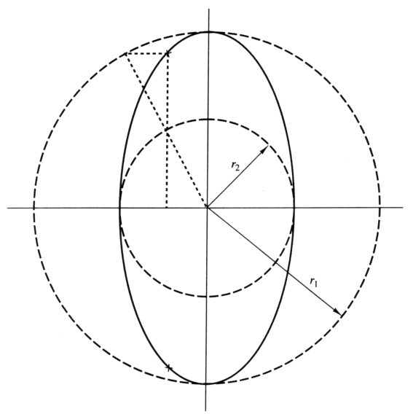
Type I: pole positions are
x_{k} = r₂cosf_{k}
y_{k} = r₁sinf_{k}
f_{k} = [p/2] + [(2k + 1)p/2N]
r₁ = W_{p}[b₂ + 1]/2b
r₂ = W_{p}[b² – 1]/2b
b = {[√ 1 + e² + 1]/e}^{1/N}
Type II: zero positions are
s_{k} = jW_{s}/sinf_{k}
and pole positions are
v_{k} = W_{s}x_{k}/√ x_{k}² + y_{k}²
w_{k} = W_{s}y_{k}/√ x_{k}² + y_{k}²
b = {[1 + √ 1 – d₂² ]/d₂}^{1/N}
k = 0, 1, …, N-1.
Determination of the pole locations
for a Chebyshev filter.

Slide 29
Approximation of Derivative Method
Approximation of derivative method is the simplest one for converting an analog filter into a digital filter by approximating the differential equation by an equivalent difference equation.
  For the derivative dy(t)/dt at time t = nT, we substitute the backward difference [y(nT) – y(nT – T)]/T. Thus
  where T represents the sampling period. Then, s = (1 – z⁻¹)/T
  The second derivative d²y(t)/dt² is derived into second difference as follow:
which s² = [(1 – z⁻¹)/T]². So, for the kth derivative of y(t), s^{k} = [(1 – z⁻¹)/T]^{k}.

Slide 30
Approximation of Derivative Method
Hence, the system function for the digital IIR filter obtained as a result of the approximation of the derivatives by finite difference is
H(z) = H_{a}(s)|_{s=(z-1)/Tz}
It is clear that points in the LHP of the s-plane are mapped into the corresponding points inside the unit circle in the z-plane and points in the RHP of the s-plane are mapped into points outside this circle.
  Consequently, a stable analog filter is transformed into a stable digital filter due to this mapping property.
jW
Unit circle
s
s-plane
z-plane

Slide 31
Example: Approximation of derivative method
Convert the analog bandpass filter with system function
H_{a}(s) = 1/[(s + 0.1)² + 9]
Into a digital IIR filter by use of the backward difference for the derivative.
Substitute for s = (1 – z⁻¹)/T into H_{a}(s) yields
H(z) = 1/[((1 – z⁻¹)/T) + 0.1)² + 9]
T can be selected to satisfied specification of designed filter. For example, if T = 0.1, the poles are located at
p_{1,2} = 0.91 ± j0.27 = 0.949exp[± j16.5^{o]}

Slide 32
Filter Design by Impulse Invariance
Remember impulse invariance
  Mapping a continuous-time impulse response to discrete-time
  Mapping a continuous-time frequency response to discrete-time
If the continuous-time filter is bandlimited to
If we start from discrete-time specifications T_{d} cancels out
  Start with discrete-time spec in terms of ω
  Go to continuous-time Ω= ω /T and design continuous-time filter
  Use impulse invariance to map it back to discrete-time ω= ΩT
Works best for bandlimited filters due to possible aliasing

Slide 33
Impulse Invariance of System Functions
Develop impulse invariance relation between system functions
Partial fraction expansion of transfer function
Corresponding impulse response
Impulse response of discrete-time filter
System function
Pole s=s_{k} in s-domain transform into pole at

Slide 34
Impulse Invariant Algorithm
Step 1: define specifications of filter
  Ripple in frequency bands
  Critical frequencies: passband edge, stopband edge, and/or cutoff frequencies.
  Filter band type: lowpass, highpass, bandpass, bandstop.
Step 2: linear transform critical frequencies as follow
W = w/T_{d}
Step 3: select filter structure type and its order: Bessel, Butterworth, Chebyshev type I, Chebyshev type II or inverse Chebyshev, elliptic.
Step 4: convert H_{a}(s) to H(z) using linear transform in step 2.
Step 5: verify the result. If it does not meet requirement, return to step 3.

Slide 35
Example: Impulse invariant method
Convert the analog filter with system function
H_{a}(s) = [s + 0.1]/[(s + 0.1)² + 9]
into a digital IIR filter by means of the impulse invariance method.
The analog filter has a zero at s = - 0.1 and a pair of complex conjugate poles at p_{k} = - 0.1 ± j3. Thus,
Then

Slide 36
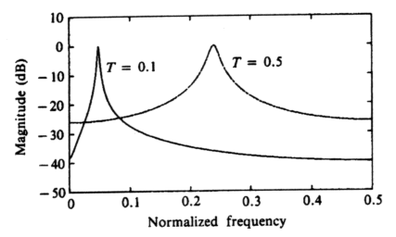
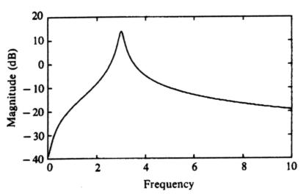
Frequency response
of digital filter.
Frequency response
of analog filter.

Slide 37
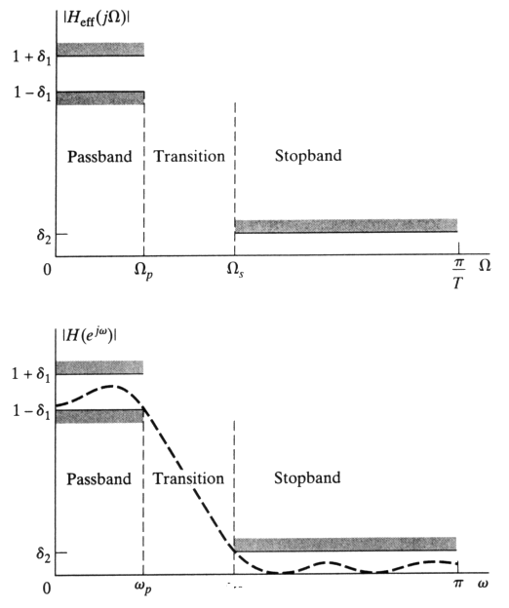
Disadvantage of previous
techniques: frequency
warping → aliasing effect
and error in specifications
of designed filter (frequencies)
So, prewarping of frequency
is considered.
∞
∞

Slide 38
Example
Impulse invariance applied to Butterworth
Since sampling rate T_{d} cancels out we can assume T_{d}=1
Map spec to continuous time
Butterworth filter is monotonic so spec will be satisfied if
Determine N and Ω_{c} to satisfy these conditions

Slide 39
Example Cont’d
Satisfy both constrains
Solve these equations to get
N must be an integer so we round it up to meet the spec
Poles of transfer function
The transfer function
Mapping to z-domain

Slide 40
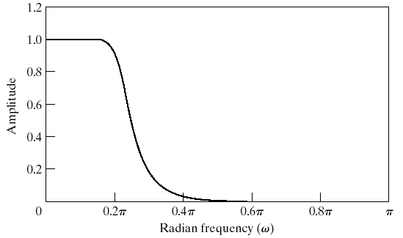
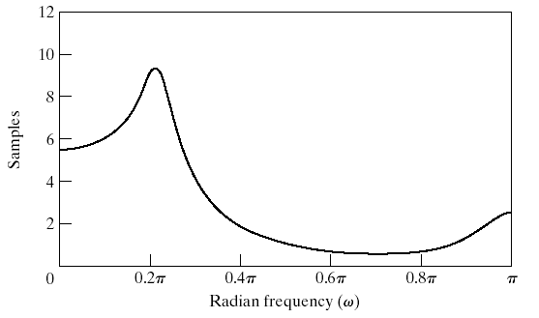
Example Cont’d

Slide 41
Filter Design by Bilinear Transformation
Get around the aliasing problem of impulse invariance
Map the entire s-plane onto the unit-circle in the z-plane
  Nonlinear transformation
  Frequency response subject to warping
Bilinear transformation
Transformed system function
Again T_{d} cancels out so we can ignore it
We can solve the transformation for z as
Maps the left-half s-plane into the inside of the unit-circle in z
  Stable in one domain would stay in the other

Slide 42
Bilinear Transformation
On the unit circle the transform becomes
To derive the relation between ω and Ω
Which yields

Slide 43
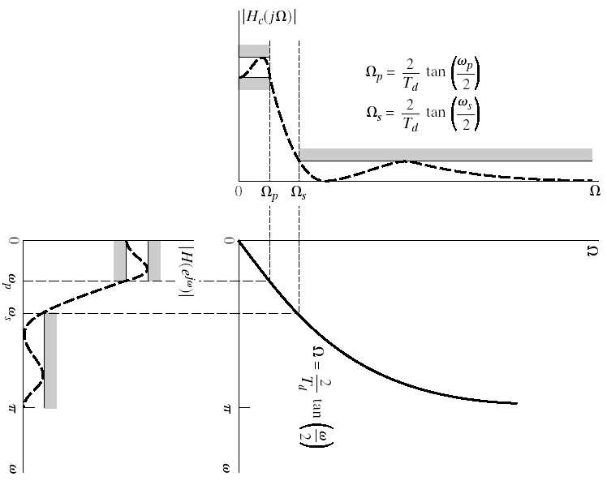
Bilinear Transformation

Slide 44
Example
Bilinear transform applied to Butterworth
Apply bilinear transformation to specifications
We can assume T_{d}=1 and apply the specifications to
To get

Slide 45
Example Cont’d
Solve N and Ω_{c}
The resulting transfer function has the following poles
Resulting in
Applying the bilinear transform yields

Slide 46
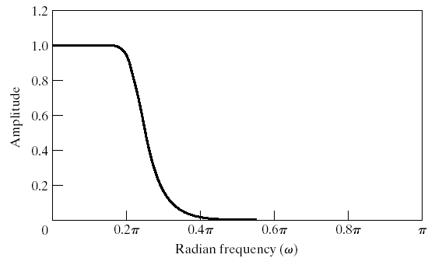
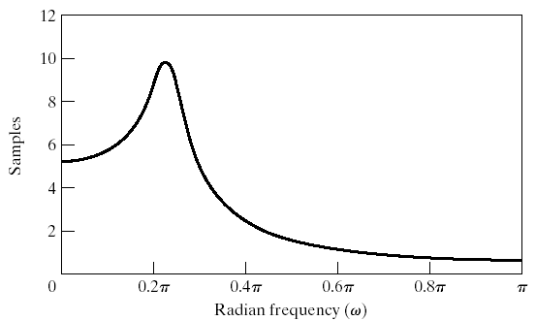
Example Cont’d

Slide 47
IIR Digital Filter: The bilinear transformation
To obtain G(z) replace s by f(z) in H(s)
Start with requirements on G(z)
G(z) | Available H(s)
Stable | Stable
Real and Rational in z | Real and Rational in s
Order n | Order n
L.P. (lowpass) cutoff | L.P. cutoff

Slide 48
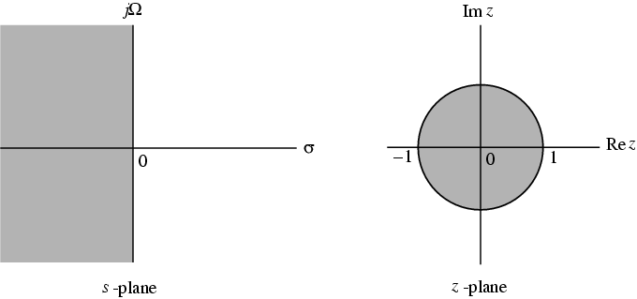
Bilinear Transformation
Mapping of s-plane into the z-plane

Slide 49
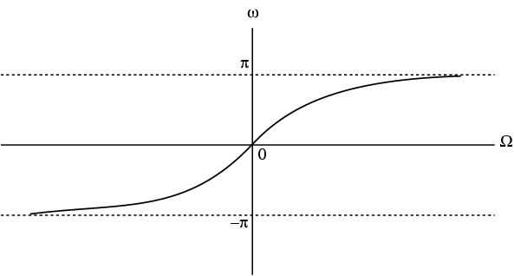
Bilinear Transformation
For with unity scalar we have
or

Slide 50
Bilinear Transformation
Mapping is highly nonlinear
Complete negative imaginary axis in the s-plane from to is mapped into the lower half of the unit circle in the z-plane from to
Complete positive imaginary axis in the s-plane from to is mapped into the upper half of the unit circle in the z-plane from to

Slide 51
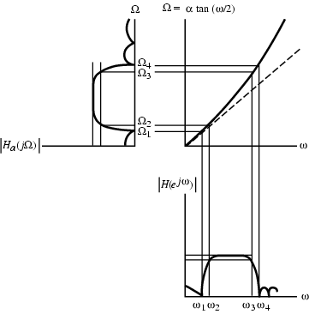
Bilinear Transformation
Nonlinear mapping introduces a distortion in the frequency axis called frequency warping
Effect of warping shown below

Slide 52
Spectral Transformations
To transform a given lowpass transfer function to another transfer function that may be a lowpass, highpass, bandpass or bandstop filter (solutions given by Constantinides)
has been used to denote the unit delay in the prototype lowpass filter and to denote the unit delay in the transformed filter to avoid confusion

Slide 53
Spectral Transformations
Unit circles in z- and -planes defined by
,
Transformation from z-domain to
-domain given by
Then

Slide 54
Spectral Transformations
From , thus , hence
Therefore must be a stable allpass function

Slide 55
Lowpass-to-Lowpass
Spectral Transformation
To transform a lowpass filter with a cutoff frequency to another lowpass filter with a cutoff frequency , the transformation is
On the unit circle we have
which yields

Slide 56
Lowpass-to-Lowpass
Spectral Transformation
Solving we get
Example - Consider the lowpass digital filter
which has a passband from dc to with a 0.5 dB ripple
Redesign the above filter to move the passband edge to

Slide 57
Lowpass-to-Lowpass
Spectral Transformation
Here
Hence, the desired lowpass transfer function is

Slide 58
Lowpass-to-Lowpass
Spectral Transformation
The lowpass-to-lowpass transformation
can also be used as highpass-to-highpass, bandpass-to-bandpass and bandstop-to-bandstop transformations

Slide 59
Lowpass-to-Highpass
Spectral Transformation
Desired transformation
The transformation parameter is given by
where is the cutoff frequency of the lowpass filter and is the cutoff frequency of the desired highpass filter

Slide 60
Lowpass-to-Highpass
Spectral Transformation
Example - Transform the lowpass filter
with a passband edge at to a highpass filter with a passband edge at
Here
The desired transformation is

Slide 61
Lowpass-to-Highpass
Spectral Transformation
The desired highpass filter is

Slide 62
Lowpass-to-Highpass
Spectral Transformation
The lowpass-to-highpass transformation can also be used to transform a highpass filter with a cutoff at to a lowpass filter with a cutoff at
and transform a bandpass filter with a center frequency at to a bandstop filter with a center frequency at

Slide 63
Lowpass-to-Bandpass
Spectral Transformation
Desired transformation

Slide 64
Lowpass-to-Bandpass
Spectral Transformation
The parameters and are given by
where is the cutoff frequency of the lowpass filter, and and are the desired upper and lower cutoff frequencies of the bandpass filter

Slide 65
Lowpass-to-Bandpass
Spectral Transformation
Special Case - The transformation can be simplified if
Then the transformation reduces to
where with denoting the desired center frequency of the bandpass filter

Slide 66
Lowpass-to-Bandstop
Spectral Transformation
Desired transformation

Slide 67
Lowpass-to-Bandstop
Spectral Transformation
The parameters and are given by
where is the cutoff frequency of the lowpass filter, and and are the desired upper and lower cutoff frequencies of the bandstop filter

Slide 68
UNIT-4
FIR Filters

Slide 69
Selection of Filter Type
The transfer function H(z) meeting the specifications must be a causal transfer function
For IIR real digital filter the transfer function is a real rational function of
H(z) must be stable and of lowest order N or M for reduced computational complexity

Slide 70
Selection of Filter Type
FIR real digital filter transfer function is a polynomial in (order N) with real coefficients
For reduced computational complexity, degree N of H(z) must be as small as possible
If a linear phase is desired then we must have:

Slide 71
Selection of Filter Type
Advantages in using an FIR filter -
(1) Can be designed with exact linear phase
(2) Filter structure always stable with quantised coefficients
Disadvantages in using an FIR filter - Order of an FIR filter is considerably higher than that of an equivalent IIR filter meeting the same specifications; this leads to higher computational complexity for FIR

Slide 72
FIR Filter Design
Digital filters with finite-duration impulse response (all-zero, or FIR filters) have both advantages and disadvantages compared to infinite-duration impulse response (IIR) filters.
FIR filters have the following primary advantages:
They can have exactly linear phase.
They are always stable.
The design methods are generally linear.
They can be realized efficiently in hardware.
The filter startup transients have finite duration.
The primary disadvantage of FIR filters is that they often require a much higher filter order than IIR filters to achieve a given level of performance. Correspondingly, the delay of these filters is often much greater than for an equal performance IIR filter.

Slide 73
FIR Design
FIR Digital Filter Design
Three commonly used approaches to FIR filter design -
(1) Windowed Fourier series approach
(2) Frequency sampling approach
(3) Computer-based optimization methods

Slide 74
Finite Impulse Response Filters
The transfer function is given by
The length of Impulse Response is N
All poles are at .
Zeros can be placed anywhere on the z-plane

Slide 75
FIR: Linear phase
For phase linearity the FIR transfer function must have zeros outside the unit circle

Slide 76
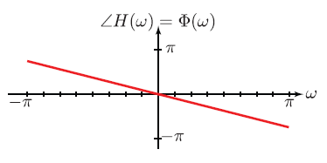
Linear Phase
What is linear phase?
Ans: The phase is a straight line in the passband of the system.
Example: linear phase (all pass system)
I Group delay is given by the negative of the slope of the line

Slide 77
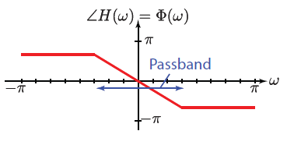
Linear phase
linear phase (low pass system)
Linear characteristics only need to pertain to the passband frequencies only.

Slide 78
FIR: Linear phase
For Linear Phase t.f. (order N-1)
so that for N even:

Slide 79
FIR: Linear phase
for N odd:
I) On we have for N even, and +ve sign

Slide 80
FIR: Linear phase
II) While for –ve sign
[Note: antisymmetric case adds rads to phase, with discontinuity at ]
III) For N odd with +ve sign

Slide 81
FIR: Linear phase
IV) While with a –ve sign
[Notice that for the antisymmetric case to have linear phase we require
The phase discontinuity is as for N even]

Slide 82
FIR: Linear phase
The cases most commonly used in filter design are (I) and (III), for which the amplitude characteristic can be written as a polynomial in

Slide 83
Summary of Properties
Type | I | II | III | IV
Order N | even | odd | even | odd
Symmetry | symmetric | symmetric | anti-symmetric | anti-symmetric
Period | 2π | 4π | 2π | 4π
ω₀ | 0 | 0 | π/2 | π/2
F(ω) | 1 | cos(ω/2) | sin(ω) | sin(ω/2)
K | N/2 | (N-1)/2 | (N-2)/2 | (N-1)/2
H(0) | arbitrary | arbitrary | 0 | 0
H(π) | arbitrary | 0 | 0 | arbitrary

Slide 84
Design of FIR filters: Windows
(i) Start with ideal infinite duration
(ii) Truncate to finite length. (This produces unwanted ripples increasing in height near discontinuity.)
(iii) Modify to
Weight w(n) is the window

Slide 85
Design of FIR filters: Windows
Simplest way of designing FIR filters
Method is all discrete-time no continuous-time involved
Start with ideal frequency response
Choose ideal frequency response as desired response
Most ideal impulse responses are of infinite length
The easiest way to obtain a causal FIR filter from ideal is
More generally

Slide 86
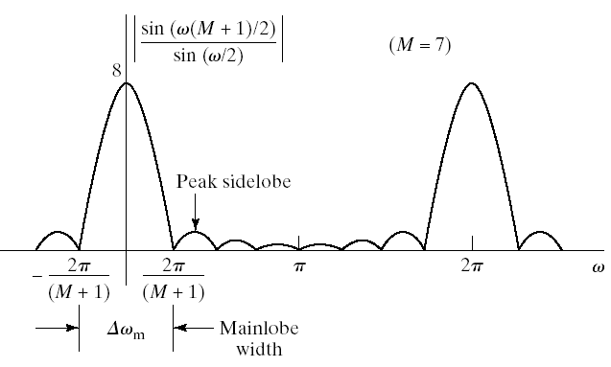
Properties of Windows
Prefer windows that concentrate around DC in frequency
  Less smearing, closer approximation
Prefer window that has minimal span in time
  Less coefficient in designed filter, computationally efficient
So we want concentration in time and in frequency
  Contradictory requirements
Example: Rectangular window

Slide 87
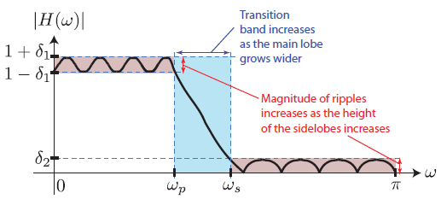
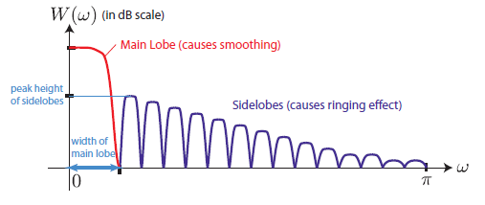
Windowing distortion
increasing window length generally reduces the width of the main lobe
peak of sidelobes is generally independent of M

Slide 88
Windows
Commonly used windows
Rectangular 1
Bartlett
Hanning
Hamming
Blackman
Kaiser

Slide 89
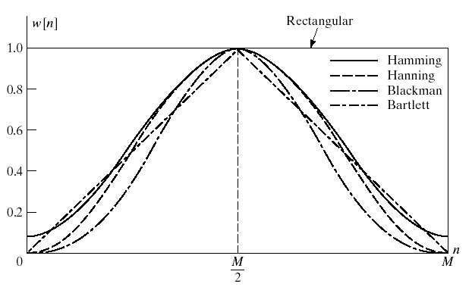
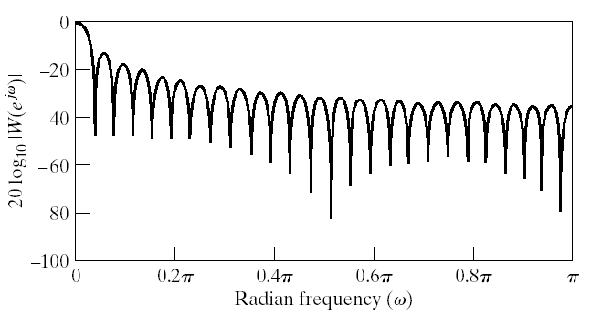
Rectangular Window
Narrowest main lob
  4π/(M+1)
  Sharpest transitions at discontinuities in frequency
Large side lobs
  -13 dB
  Large oscillation around discontinuities
Simplest window possible

Slide 90
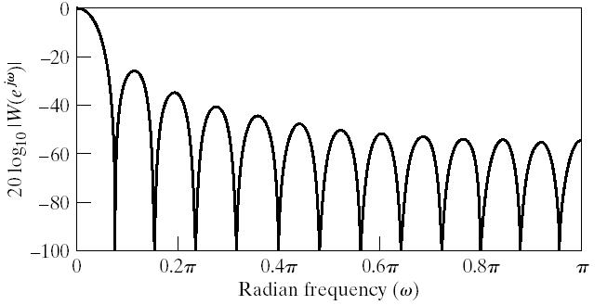
Bartlett (Triangular) Window
Medium main lob
  8π/M
Side lobs
  -25 dB
Hamming window performs better
Simple equation

Slide 91
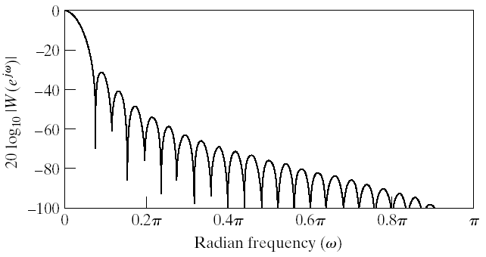
Hanning Window
Medium main lob
  8π/M
Side lobs
  -31 dB
Hamming window performs better
Same complexity as Hamming

Slide 92
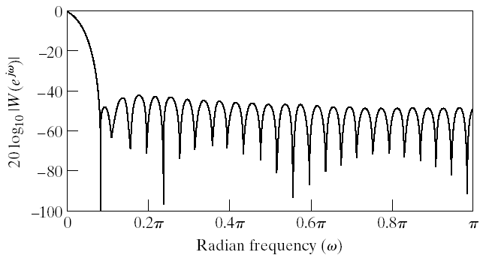
Hamming Window
Medium main lob
  8π/M
Good side lobs
  -41 dB
Simpler than Blackman

Slide 93
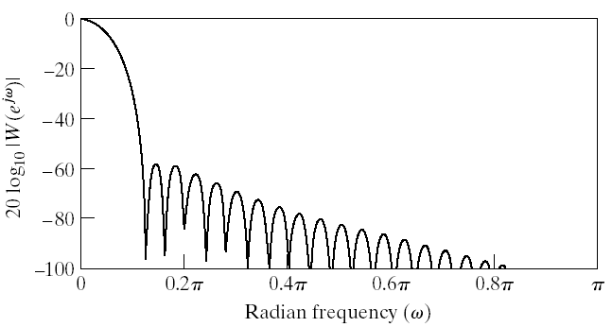
Blackman Window
Large main lob
  12π/M
Very good side lobs
  -57 dB
Complex equation

Slide 94
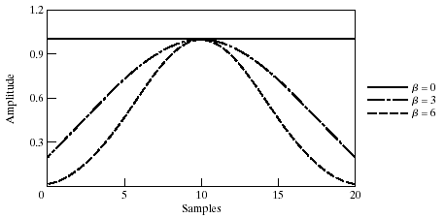
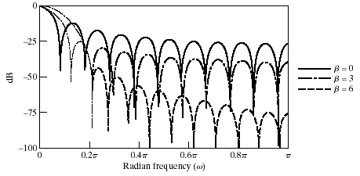
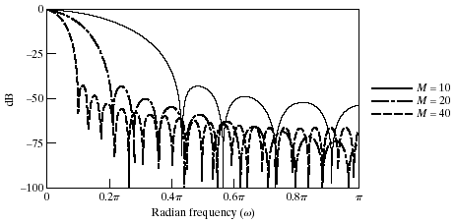
Kaiser Window Filter Design Method
Parameterized equation forming a set of windows
  Parameter to change main-lob width and side-lob area trade-off
  I₀(.) represents zeroth-order modified Bessel function of 1st kind

Slide 95
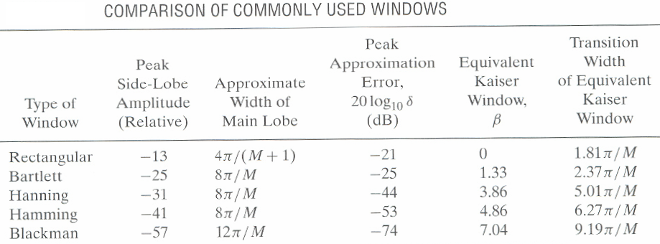
Comparison of windows

Slide 96
Kaiser window
Kaiser window
β | Transition width (Hz) | Min. stop attn dB
2.12 | 1.5/N | 30
4.54 | 2.9/N | 50
6.76 | 4.3/N | 70
8.96 | 5.7/N | 90

Slide 97
Example
Lowpass filter of length 51 and

Slide 98
Frequency Sampling Method
In this approach we are given and need to find
This is an interpolation problem and the solution is given in the DFT part of the course
It has similar problems to the windowing approach

Slide 99
FIR Digital Filter Order Estimation
Kaiser’s Formula:
ie N is inversely proportional to transition band width and not on transition band location

