Slide 1
UNIT-III
STRUCTURES FOR THE REALIZATION OF DISCRETE TIME SYSTEMS

Slide 2
Structures for Discrete-Time Systems
Block Diagram Representation of Linear Constant-Coefficient Difference Equations
Signal Flow Graph Representation of Linear Constant-Coefficient Difference Equations
Basic Structures for IIR Systems
Transposed Forms
Basic Network Structures for FIR Systems
Lattice Structures

Slide 3
Introduction
Example: The system function of a discrete-time system is
|z| > |a|
Its impulse response will be
h[n] = b₀a^{n}u[n] + b₁a^{n-1}u[n-1]
Its difference equation will be
y[n] –ay[n-1] = b₀x[n] + b₁x[n-1]
Since this system has an infinite-duration impulse response, it is not possible to implement the system by discrete convolution. However, it can be rewritten in a form that provides the basis for an algorithm for recursive computation.
y[n] = ay[n-1] + b₀x[n] + b₁x[n-1]

Slide 4
Block Diagram Representation of Linear Constant-coefficient Difference Equations
x[n] a ax[n]
Multiplication of a
sequence by a constant
Unit delay
Addition of two sequences
z⁻¹
x[n] x[n-1]
+
x₁[n]
x₁[n] + x₂[n]
x₂[n]

Slide 5
Block Diagram Representation of Linear Constant-coefficient Difference Equations
1
2

Slide 6
Block diagram representation for a general Nth-order difference equation:
Direct Form I
x[n]
b₀
v[n]
y[n]
+
+
z⁻¹
z⁻¹
b₁
a₁
x[n-1]
+
+
y[n-1]
z⁻¹
z⁻¹
x[n-2]
y[n-2]
b_{M-1}
a_{N-1}
+
+
z⁻¹
z⁻¹
b_{M}
a_{N}
x[n-M]
y[n-N]

Slide 7
Block diagram representation for a general Nth-order difference equation:
Direct Form II
x[n]
w[n]
b₀
y[n]
+
+
z⁻¹
z⁻¹
a₁
b₁
+
w[n-1]
w[n-1]
+
z⁻¹
z⁻¹
w[n-2]
w[n-2]
a_{N-1}
b_{M-1}
+
+
z⁻¹
z⁻¹
a_{N}
b_{M}
w[n-N]
w[n-M]

Slide 8
Combination of delay units (in case N = M)
x[n]
w[n]
b₀
y[n]
+
+
z⁻¹
a₁
b₁
+
+
z⁻¹
a_{N-1}
b_{N-1}
+
+
z⁻¹
a_{N}
b_{N}

Slide 9
Block Diagram Representation of Linear Constant-coefficient Difference Equations 2
An implementation with the minimum number of delay elements is commonly referred to as a canonic form implementation.
The direct form I is a direct realization of the difference equation satisfied by the input x[n] and the output y[n], which in turn can be written directly from the system function by inspection.
The direct form II or canonic direct form is an rearrangement of the direct form I in order to combine the delay units together.

Slide 10
Signal Flow Graph Representation of Linear Constant-coefficient Difference Equations
a
Attenuator
x[n] d e y[n]
a
z⁻¹
z⁻¹
c
Delay Unit
b
z⁻¹
Node: Adder, Separator, Source, or Sink

Slide 11
Basic Structures for IIR Systems
Direct Forms
Cascade Form
Parallel Form
Feedback in IIR Systems

Slide 12
Basic Structures for IIR Systems
Direct Forms

Slide 13
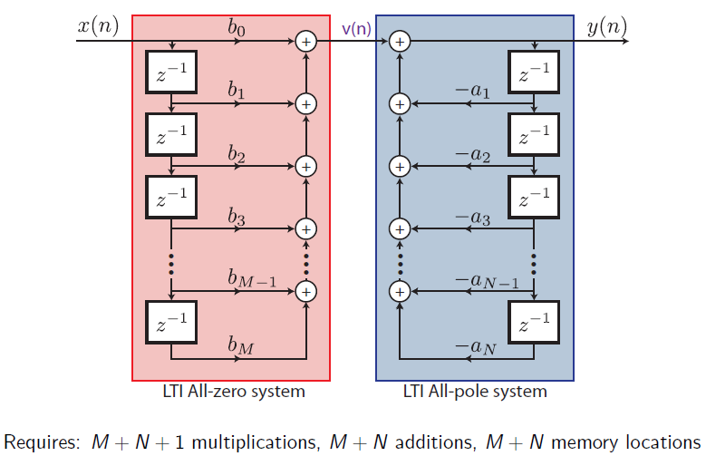
Direct Form I (M = N)

Slide 14
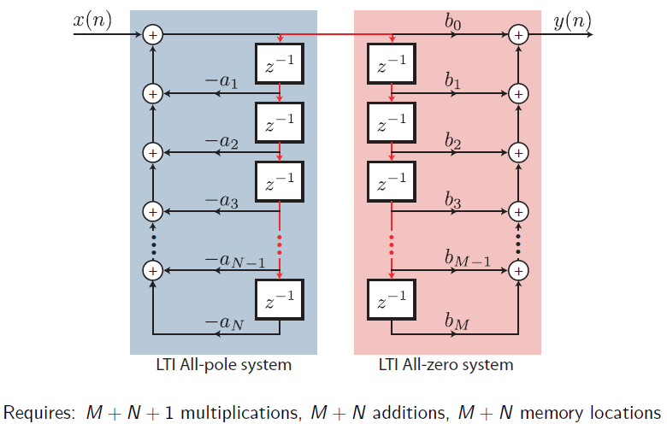
Direct Form II (M = N)

Slide 15
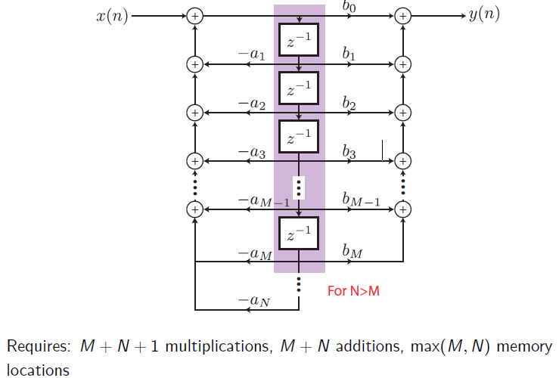
Direct Form II

Slide 16
x[n]
y[n]
+
+
z⁻¹
z⁻¹
2
0.75
+
+
z⁻¹
z⁻¹
-0.125
x[n]
y[n]
+
+
z⁻¹
0.75
2
+
+
z⁻¹
-0.125

Slide 17
x[n]
y[n]
z⁻¹
z⁻¹
2
0.75
z⁻¹
z⁻¹
-0.125
x[n]
y[n]
z⁻¹
0.75
2
z⁻¹
-0.125

Slide 18
Basic Structures for IIR Systems 2
Cascade Form
where M = M₁+2M₂ and N = N₁+2N₂ .
A modular structure that is advantageous for many types of implementations is obtained by combining pairs of real factors and complex conjugate pairs into second-order factors.
where N_{s} is the largest integer contained in (N+1)/2.

Slide 19
w₁[n]
y₁[n]
w₂[n]
y₂[n]
w₃[n]
y₃[n]
x[n]
b₀₁
b₀₂
b₀₃
y[n]
z⁻¹
z⁻¹
z⁻¹
a₁₁
b₁₁
a₁₂
b₁₂
a₁₃
b₁₃
z⁻¹
z⁻¹
z⁻¹
a₂₁
b₂₁
a₂₂
b₂₂
a₂₃
b₂₃
x[n]
y[n]
z⁻¹
z⁻¹
z⁻¹
z⁻¹
0.5
0.25
x[n]
y[n]
z⁻¹
z⁻¹
0.5
0.25

Slide 20
Basic Structures for IIR Systems 3
Parallel Form
where N = N₁+2N₂ . If M ณ N, then N_{P} = M - N; otherwise, the first summation in right hand side of equation above is not included.
Alternatively, the real poles of H(z) can be grouped in pairs :
where N_{S} is the largest integer contained in (N+1)/2, and if N_{P} = M - N is negative, the first sum is not present.

Slide 21
C₀
w₁[n]
b₀₁
y₁[n]
a₁₁
z⁻¹
b₁₁
a₂₁
z⁻¹
x[n]
w₂[n]
b₀₂
y₂[n]
y[n]
a₁₂
z⁻¹
b₁₂
a₂₂
z⁻¹
w₃[n]
b₀₃
y₃[n]
a₁₃
z⁻¹
b₁₃
a₂₃
z⁻¹
Parallel form structure for
sixth order system (M=N=6).

Slide 22
8
x[n]
y[n]
-7
8
z⁻¹
0.75
8
x[n]
18
y[n]
z⁻¹
z⁻¹
-0.125
0.5
-25
z⁻¹
0.25

Slide 23
Transposed Forms
Transposition (or flow graph reversal) of a flow graph is accomplished by reversing the directions of all branches in the network while keeping the branch transmittances as they were and reversing the roles of the input and output so that source nodes become sink nodes and vice versa.
x[n]
y[n]
y[n]
x[n]
z⁻¹
z⁻¹
a
a
x[n]
y[n]
z⁻¹
a

Slide 24
x[n]
b₀
y[n]
z⁻¹
z⁻¹
b₁
a₁
z⁻¹
z⁻¹
b₂
a₂
b_{N-1}
a_{N-1}
z⁻¹
z⁻¹
b_{N}
a_{N}
x[n]
b₀
y[n]
z⁻¹
z⁻¹
a₁
b₁
z⁻¹
z⁻¹
a₂
b₂
a_{N-1}
b_{N-1}
z⁻¹
z⁻¹
a_{N}
b_{N}

Slide 25
x[n]
b₀
y[n]
z⁻¹
a₁
b₁
z⁻¹
a₂
b₂
a_{N-1}
b_{N-1}
z⁻¹
x[n]
b₀
y[n]
a_{N}
b_{N}
z⁻¹
b₁
a₁
z⁻¹
b₂
a₂
b_{N-1}
a_{N-1}
z⁻¹
b_{N}
a_{N}

Slide 26
Basic Network Structures for FIR Systems
Direct Form
  It is also referred to as a tapped delay line structure or a transversal filter structure.
Transposed Form
Cascade Form
where M_{S} is the largest integer contained in (M + 1)/2. If M is odd, one of coefficients b_{2k} will be zero.

Slide 27
Direct Form
For causal FIR system, the system function has only zeros (except for poles at z = 0) with the difference equation:
y[n] = S^{M}_{k=0} b_{k}x[n-k]
It can be interpreted as the discrete convolution of x[n] with the impulse response
h[n] = b_{n} , n = 0, 1, …, M,
0 , otherwise.

Slide 28
Direct Form (Tapped Delay Line or Transversal Filter)
x[n]
b₀
y[n]
z⁻¹
b₁
z⁻¹
b₂
b_{N-1}
z⁻¹
b_{N}
x[n]
z⁻¹
z⁻¹
z⁻¹
h[0]
h[1]
h[2]
h[M-1]
h[M]
y[n]

Slide 29
Transposed Form of FIR Network
z⁻¹
z⁻¹
z⁻¹
z⁻¹
y[n]
h[M]
h[M-1]
h[M-2]
h[2]
h[1]
h[0]
x[n]

Slide 30
Cascade Form Structure of a FIR System
x[n]
b₀₁
b₀₂
b_{0Ms}
y[n]
z⁻¹
z⁻¹
z⁻¹
b₁₁
b₁₂
b_{1Ms}
z⁻¹
b₂₁
z⁻¹
b₂₂
z⁻¹
b_{2Ms}

Slide 31
Structures for Linear-Phase FIR Systems
Structures for Linear Phase FIR Systems :
  h[M-n] = h[n] for n = 0, 1, ..., M
    For M is an even integer : Type I
    y[n] = S_{k=0}^{(M/2)-1} h[k](x[n-k] + x[n-M+k]) + h[M/2]x[n-M/2]
    For M is an odd integer : Type II
    y[n] = S_{k=0}^{(M-1)/2} h[k](x[n-k] + x[n-M+k])
  h[M-n] = -h[n] for n = 0, 1, ..., M
    For M is an even integer : Type III
    y[n] = S_{k=0}^{(M/2)-1} h[k](x[n-k] - x[n-M+k])
    For M is an odd integer : Type IV
    y[n] = S_{k=0}^{(M-1)/2} h[k](x[n-k] - x[n-M+k])

Slide 32
Direct form structure for an FIR linear-phase when M is even.
x[n]
z⁻¹ z⁻¹ z⁻¹
z⁻¹ z⁻¹ z⁻¹
y[n]
h[0] h[1] h[2] h[(M/2)-1] h[M/2]
Direct form structure for an FIR linear-phase when M is odd.
x[n]
z⁻¹ z⁻¹ z⁻¹
z⁻¹
z⁻¹ z⁻¹ z⁻¹
y[n]
h[0] h[1] h[2] h[(M-3)/2] h[(M-1)/2]

Slide 33
Lattice Structures
Theory of autoregressive signal modeling :
  Lattice Structure
Development of digital filter structures that are analogous to analog filter structures :
  Wave Digital Filters
Another structure development approach is based on state-variable representations and linear transformations.

Slide 34
Lattice Structures 2
FIR Lattice
The coefficients {k_{i}} in the lattice structures are referred to as the k-parameters, which are called reflection coefficients or PARCOR coefficients.
  When used in signal modeling, the k-parameters are estimated from a data signal .
  Given a set of k-parameters, the system function can be found and therefore the impulse response : by recurrence formula for computing A(z) in terms of the intermediate system functions

Slide 35
Reflection coefficients or PARCOR coefficients structure
x[n] e₀[n] e₁[n] e₂[n] e_{N-1}[n] e_{N}[n] y[n]
-k₁
-k₂
-k_{N}
-k₁
-k₂
-k_{N}
z⁻¹
z⁻¹
z⁻¹
e~₀[n] e~₁[n] e~₂[n] e~_{N-1}[n] e~_{N}[n]
Signal flow graph of an FIR lattice system
e₀[n] = e~₀[n] = x[n]
e_{i}[n] = e_{i-1}[n] – k_{i}e~_{i-1}[n-1], i = 1, 2, …, N,
e~_{i}[n] = -k_{i}e_{i-1}[n] + e~_{i-1}[n-1]
y[n] = e_{N}[n]

Slide 36
A recurrence formula for computing A(z) = H(z) = Y(z)/X(z) can be obtained in terms of intermediate system functions:
By recursive technique:
a_{i}^{(i)} = k_{i} ,
a_{m}^{(i)} = a_{m}^{(i-1)} - k_{i} a_{i-m}^{(i-1)} ,
m = 1, 2, ..., (i-1)
Or by reverse recursive technique:
k_{i} = a_{i}^{(i)}
a_{m}^{(i-1)} = [a_{m}^{(i)} + k_{i}a_{i-m}^{(i)}]/[1 – k_{i}²], m = 1, 2, …, (i – 1)

Slide 37
Example:
A(z) = (1-0.8jz⁻¹)(1+0.8jz⁻¹)(1-0.9z⁻¹) = 1 – 0.9z⁻¹ + 0.64z⁻² – 0.576z⁻³.
Then, a₁⁽³⁾ = 0.9, a₂⁽³⁾ = -0.64, and a₃⁽³⁾ = 0.576
The k-parameter can be computed as follow:
k₃ = a₃⁽³⁾ = 0.576
a₁⁽²⁾ = [a₁⁽³⁾ + k₃a₂⁽³⁾]/[1 – k₃²] = 0.79518245
a₂⁽²⁾ = [a₂⁽³⁾ + k₃a₁⁽³⁾]/[1 – k₃²] = - 0.18197491
k₂ = a₂⁽²⁾ = - 0.18197491
a₁⁽¹⁾ = [a₁⁽²⁾ + k₂a₁⁽²⁾]/[1 – k₂²] = 0.67275747
k₁ = a₁⁽¹⁾ = 0.67275747

Slide 38
x[n]
y[n]
-0.6728
+0.182
-0.576
-0.6728
+0.182
-0.576
z⁻¹
z⁻¹
z⁻¹
z^{–1} z^{–1} z⁻¹
x[n]
-0.9 0.64 -0.576
y[n]

Slide 39
All-Pole Lattice
A lattice system with an all-pole system function H(z) = 1/A(z) can be developed from the FIR lattice .
  all roots of A(z) must be inside the unit circle: |k_{i}| < 1, i = 1, ..., N
e_{i}[n] e_{i-1}[n]
e_{N}[n] = x[n]
E_{i-1}[n] = e_{i}[n] + k_{i}e~_{i-1}[n-1], i = N, (N-1), …1,
e~_{i}[n] = -k_{i}e_{i-1}[n] + e~_{i-1}[n-1]
y[n] = e₀[n] = e~₀[n]
k_{i}
-k_{i}
z⁻¹
z⁻¹
e~_{i}[n] e~_{i-1}[n]
x[n] e₀[n] e₁[n] e₂[n] e_{N-1}[n] e_{N}[n] y[n]
k_{N}
k_{N-2}
k₁
-k_{N}
-k_{N-2}
-k₁
z⁻¹
z⁻¹
z⁻¹
e~_{N}[n] e~_{N-1}[n] e~₁[n] e~₀[n]

Slide 40
Basic all-pole lattice structures
Three-multiplier form
Four-multiplier, normalized form
Four-multiplier, Kelly-Lochbaum form : was first derived as an acoustic tube model for speech synthesis.

Slide 41
e_{i}[n] e_{i-1}[n]
-k_{i} k_{i}
Three-multiplier form
Four-multiplier, normalized
form
Four-multiplier, Kelly-
Lochbaum form
e’_{i}[n] (1 - k_{i}²) e’_{i-1}[n]
e_{i}[n] cos q_{i} e_{i-1}[n]
-sin q_{i} sin q_{i}
e’_{i}[n] cos q_{i} e’_{i-1}[n]
e_{i}[n] (1 + k_{i}) e_{i-1}[n]
-k_{i} k_{i}
e’_{i}[n] (1 - k_{i}) e’_{i-1}[n]

Slide 42
Lattice Systems with Poles and Zeros
x[n] = e_{N}[n] e_{N-1}[n] e_{N-2}[n] e₁[n] e₀[n]
Section
N
Section
N - 1
Section
1
e’_{N}[n] e’_{N-1}[n] e’_{N-2}[n] e’₁[n] e’₀[n]
c_{N} c_{N-1} c_{N-2} c₁ c₀
y[n]

Slide 43
Example of lattice IIR filter with poles and zeros
x[n]
y[n]
z⁻¹
0.9
3
z⁻¹
-0.64
3
z⁻¹
0.576
x[n]
0.576 -0.182 0.6728
-0.576 0.182 -0.6728
z⁻¹
z⁻¹
z⁻¹
3.9 5.4612 4.5404
y[n]

