Slide 1
Fast Fourier Transform

Slide 2
Discrete Fourier Transform
The DFT pair was given as
Baseline for computational complexity:
  Each DFT coefficient requires
    N complex multiplications
    N-1 complex additions
  All N DFT coefficients require
    N² complex multiplications
    N(N-1) complex additions
Complexity in terms of real operations
    4N² real multiplications
    2N(N-1) real additions
Most fast methods are based on symmetry properties
  Conjugate symmetry
  Periodicity in n and k

Slide 3
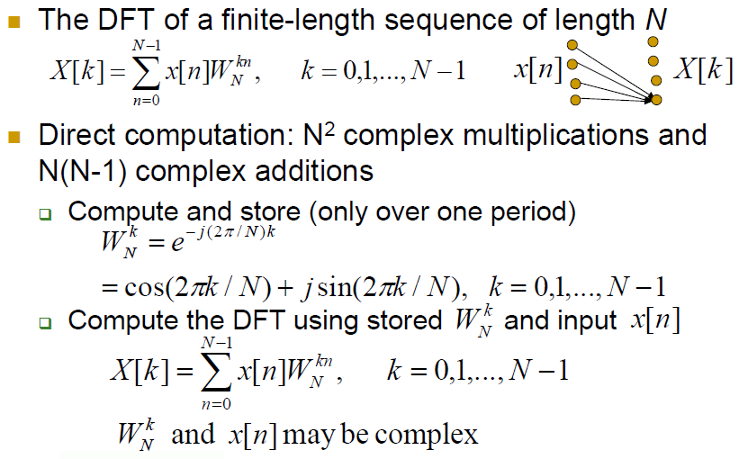
Direct computation of DFT

Slide 4
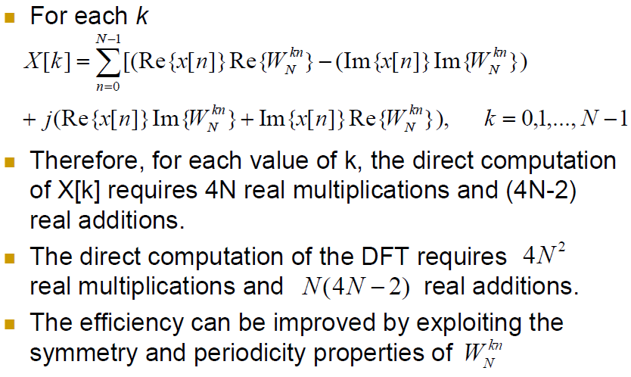
Direct computation of DFT

Slide 5
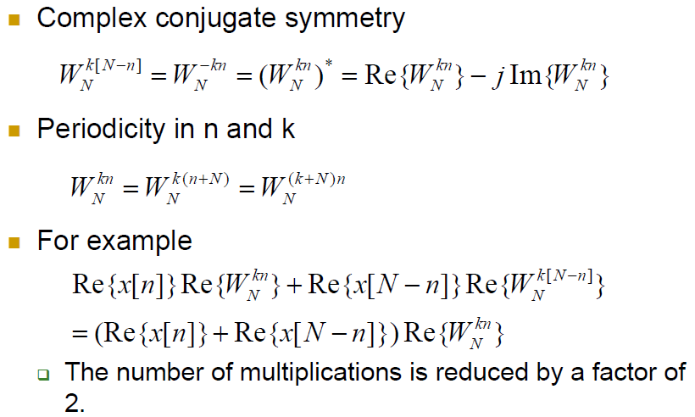

Slide 6
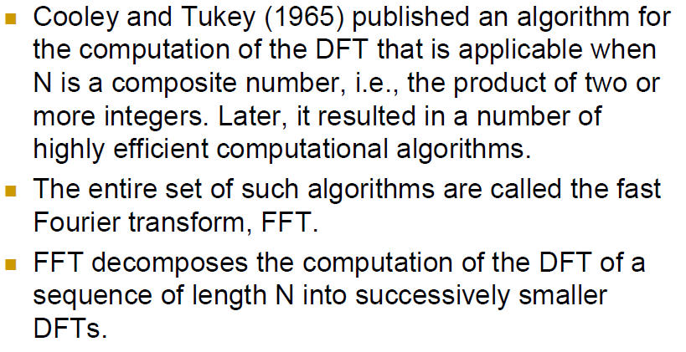
FFT

Slide 7
Decimation-In-Time FFT Algorithms
Makes use of both symmetry and periodicity
Consider special case of N an integer power of 2
Separate x[n] into two sequence of length N/2
  Even indexed samples in the first sequence
  Odd indexed samples in the other sequence
Substitute variables n=2r for n even and n=2r+1 for odd
G[k] and H[k] are the N/2-point DFT’s of each subsequence

Slide 8
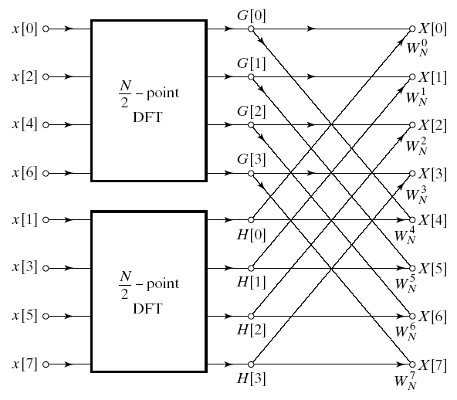
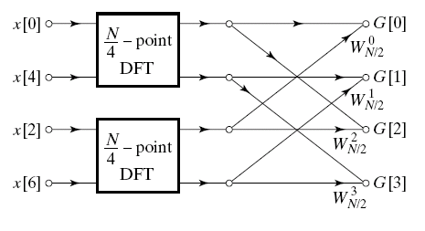
Decimation In Time
8-point DFT example using decimation-in-time
Two N/2-point DFTs
  2(N/2)² complex multiplications
  2(N/2)² complex additions
Combining the DFT outputs
  N complex multiplications
  N complex additions
Total complexity
  N²/2+N complex multiplications
  N²/2+N complex additions
  More efficient than direct DFT
Repeat same process
  Divide N/2-point DFTs into
  Two N/4-point DFTs
  Combine outputs

Slide 9
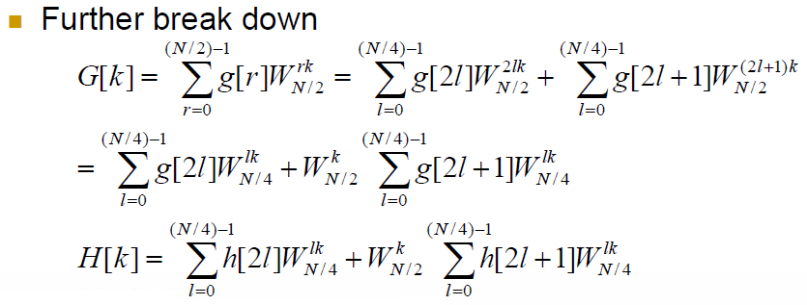
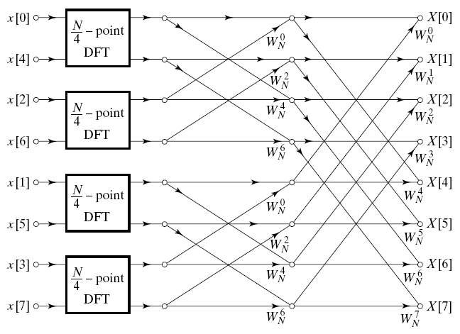
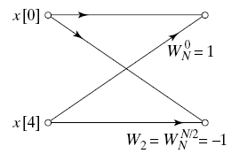
Decimation In Time Cont’d
After two steps of decimation in time
Repeat until we’re left with two-point DFT’s

Slide 10
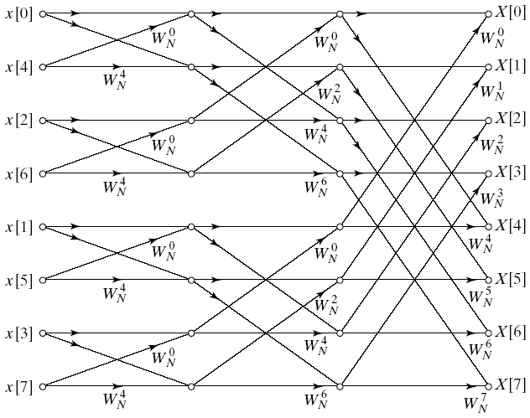
Decimation-In-Time FFT Algorithm
Final flow graph for 8-point decimation in time
Complexity:
  Nlog₂N complex multiplications and additions

Slide 11
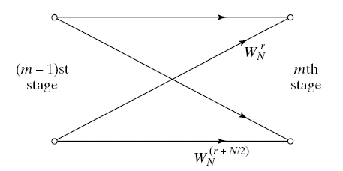
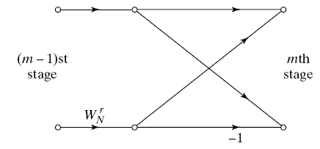
Butterfly Computation
Flow graph constitutes of butterflies
We can implement each butterfly with one multiplication
Final complexity for decimation-in-time FFT
  (N/2)log₂N complex multiplications and additions

Slide 12
In-Place Computation
Decimation-in-time flow graphs require two sets of registers
  Input and output for each stage
Note the arrangement of the input indices
  Bit reversed indexing

Slide 13
Decimation-In-Frequency FFT Algorithm
The DFT equation
Split the DFT equation into even and odd frequency indexes
Substitute variables to get
Similarly for odd-numbered frequencies

Slide 14
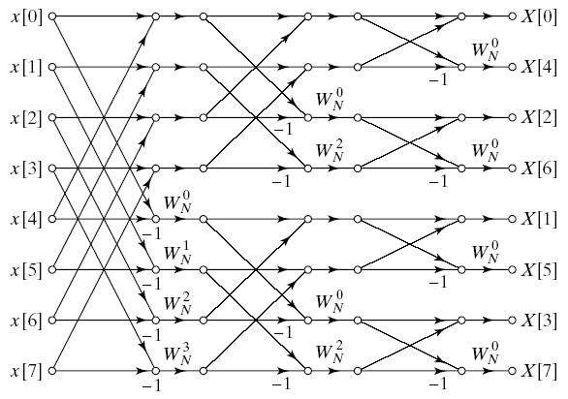
Decimation-In-Frequency FFT Algorithm
Final flow graph for 8-point decimation in frequency

